Slide 1
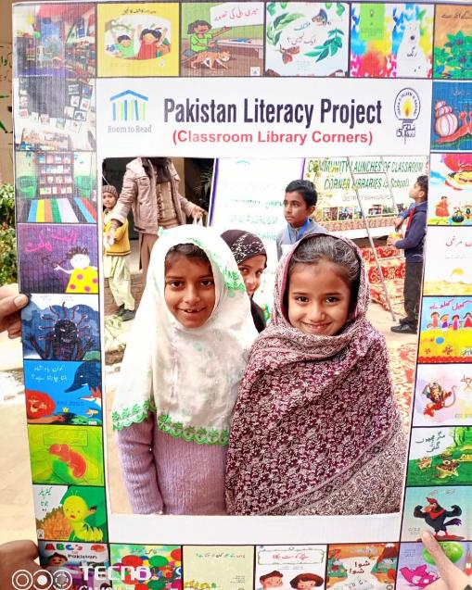
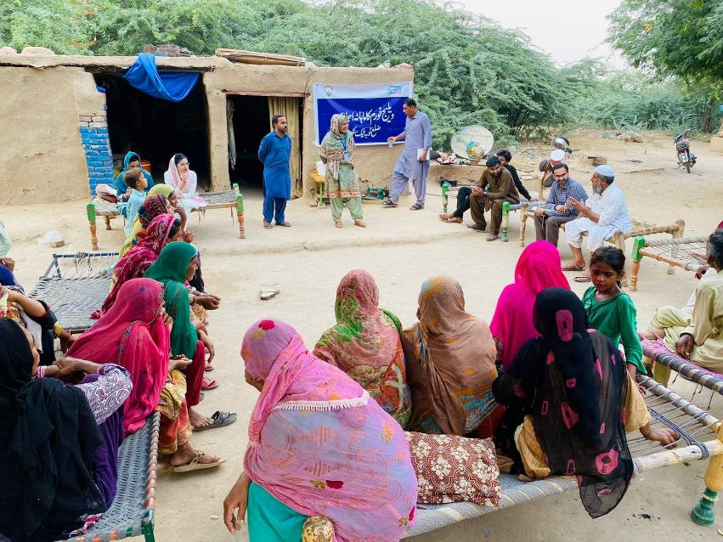
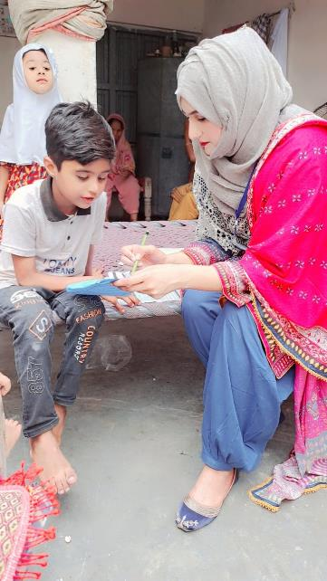
Idara-e-Taleem-o-Aagahi
Meeting of Board of Trustees

Slide 2
agenda
Adoption of the Agenda of 58th Meeting of the Board of Trustees
Approval of minutes of 57th meeting of Board of Trustees
Approval of new Projects with following donors:
FCDO/British Council Project 2024-2027- South Punjab and Merged Districts of KP "Girls and Out of School Children: Action for Learning (GOAL)”: Khilo aur Barho, Action for Learning (2.7 million USD ITA share and USD 5 million
Room to Read (PLP) approved for Sept. 2024 to December 2025 USD 0.3 million
Oxford Policy Management (OPM) agreed for Sindh – Teaching at the Right Level (TARL) Foundational Learning 0.36
Malala Fund for Sindh province 0.24
UNICEF SERVICES study for Sindh province
ConnectEd Phone Based Tutoring Pilot Kasur-Bahawalpur with Youth Impact
SELECT PKR 34 Million
British Council PKR 108 million
Other Initiatives
Update on status of Economic Affairs Division as result of decision of Lahore High Court
Updates of key projects and its implementation
Any Other business as board may think appropriate

Slide 3
Minutes of meetings
Trustees confirmed minutes of the 56th meeting of the Board of Trustees and the agenda of the 57th Meeting of Board of Trustees.
Board of Trustees recommended to have legal opinion for impact of taxation for registration of Idara-e-Taleem-o-Aaghai Public Trust under section 42 of Companies Act 2017 and agreed to proceed.
Board of Trustees approved Prevention of Sexual Exploitation and Abuse” (PSEA) policy templates and guidelines
Board of Trustees approved financial statements for year ended June 30, 2023
Board of Trustees approved Appointment of Grant Thornton Anjum Rehman Chartered Accountants as auditors for the year ending June 30, 2024
Board of Trustees approved formation of Audit and Fund Raising Committees for better governance
Board of Trustees approved process to start EAD Renewal under EAD policy 2022.
Chief Executive Officer updated board of trustees on progress of various projects implemented during this period. Board of Trustees appreciated progress and shared feedback for quality assurance purpose .

Slide 4
New projects
FCDO/British Council Project 2024-2027- South Punjab and Merged Districts of KP
"Girls and Out of School Children: Action for Learning (GOAL)”: Khilo aur Barho, Action for Learning
Room to Read (PLP) approved for Sept. 2024 to December 2025
Oxford Policy Management (OPM) agreed for Sindh – Teaching at the Right Level (TARL) Foundational Learning
Malala Fund for Sindh province
UNICEF SERVICES study for Sindh province
SELECT – SELD-World Bank
ConnectEd Phone Based Tutoring Pilot Kasur-Bahawalpur with Youth Impact
Other Initiatives: ITA @25

Slide 5
FCDO/British Council Project 2024-2027- South Punjab and Merged Districts of KP "Girls and Out of School Children: Action for Learning (GOAL)”: Khilo aur Barho, Action for Learning

Slide 6
GOAL - KHILO AUR BARHO
The GOAL project is funded by FCDO and implementation is led by consortium partners including British Council, ITA, SDPI, PAMS, Pratham International (PI) and Open University UK
Major Objectives
Target Beneficiaries
mproving Foundational Learning for children in and out of school through accelerated/alternative learning programs (ALP)
Remediation Improving reading and maths skills of children.
Remediation and learning support to girls, religious minority communities, and children with disabilities.
Target OOSC = 100,000 children
Target for In-School Children = 150,000
10% Children with Disabilities
20% Children from Religious Minority Groups
ITA’s Responsibility
Direct Implementation on Learning Solutions 10% of the total beneficiaries
ITA’s Technical Support & Capacity building for Partners doing 90% Implementation
Offices in 8 District Hubs located in the target Schools

Slide 7
GOAL - KHILO AUR BARHO
Implementation
Resources
10% of the students mentioned will be directly served by ITA
ITA will implement its learning solutions such as contextualized TaRL and short, medium and long term AL through downstream implementation partners
ITA will be closely monitoring and evaluating downstream partners and core teams throughout the program.

Slide 8
Organogram GOAL - Kab - the Human Resource Implications
ORGANOGRAM
Girls and Out of School Children: Action for Learning (GOAL)
Project Director 1
Lahore
Director Operations (1) Lahore
Project Manager (1)
Lhr/Isb
Manager M&E (1)
Lhr/Isb
Quality Assurance Manager (1) Lhr/Isb
Manager Finance (1) Lahore
Manager HR (1) Lahore
Asst. Project Manager (1) Lhr/Isb
Asst. Manager M&E (2) Lhr/Isb
Research & Documentation Associate (1) Lhr/Isb
District Manager 8 (NMD KP & South Punjab)
Finance Officer (1) Lahore
Support
Staff
Academic Coordinator (2) Lhr/Isb/KP
District Training & Support Officer 8 (NMD KP & South Punjab)

Slide 9
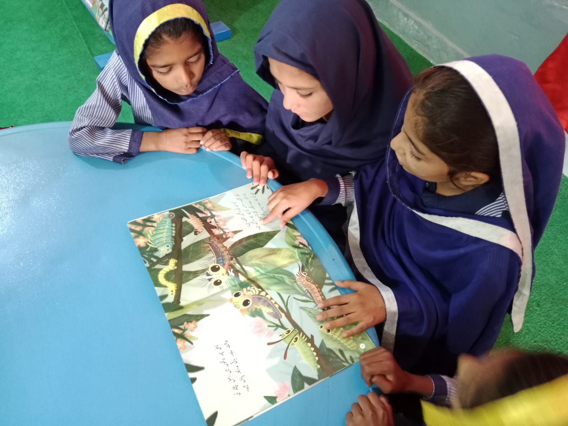
Reigniting the Spark! Pakistan Literacy Project.. Un paused…
After a brief pause, we are thrilled to announce that Room to Read are resuming work in Pakistan with Idara-e-Taleem-o-Aagahi as its country partner.
Our collaborative efforts will continue to enhance literacy across Pakistan. This renewed partnership reflects our commitment to supporting the Active Learning & Literacy needs of young readers and making a positive impact in classrooms and communities throughout the country.

Slide 10
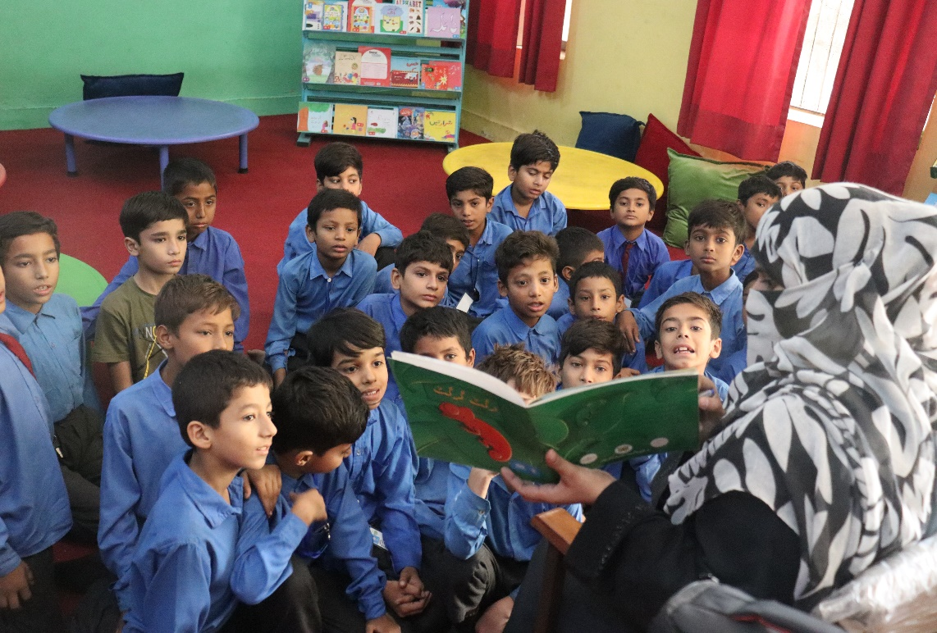
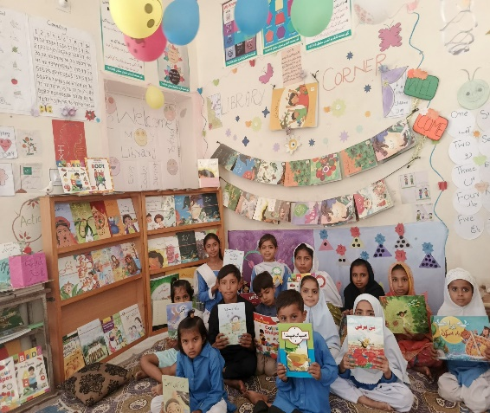
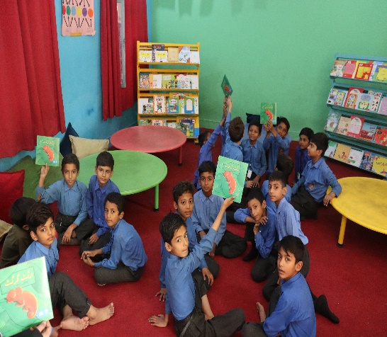
Accelerating Impact: Sep – Dec 2024
We are set to make significant strides in the coming months with the following key initiatives:
Translating and distributing adapted titles in Punjabi and Saraiki to enhance accessibility in collaboration with PILAC (Punjab Institute of Language, Arts and Culture) and Room to Read
Creating and publishing 12 new children’s storybooks to foster a love for reading an outcome of ITA’s workshops in Karachi (Authors/Illustrators)
Conducting capacity-building workshops for educators to strengthen their skills.
Dubbing the "She Creates Change" videos into multiple languages to extend our reach across the country for Adolescent Girls

Slide 11
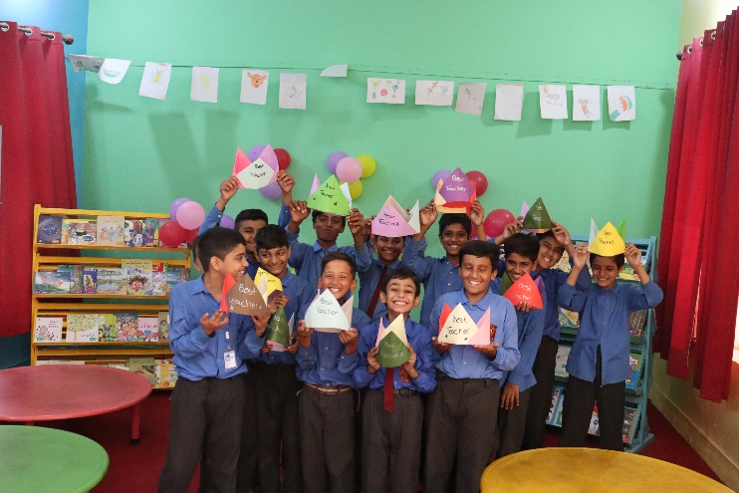
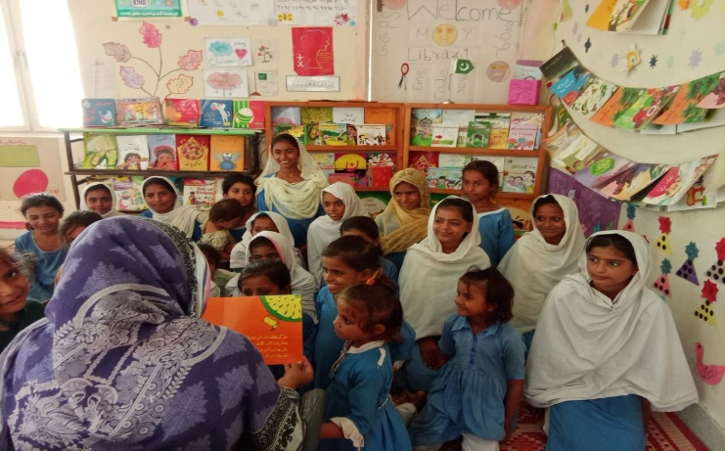
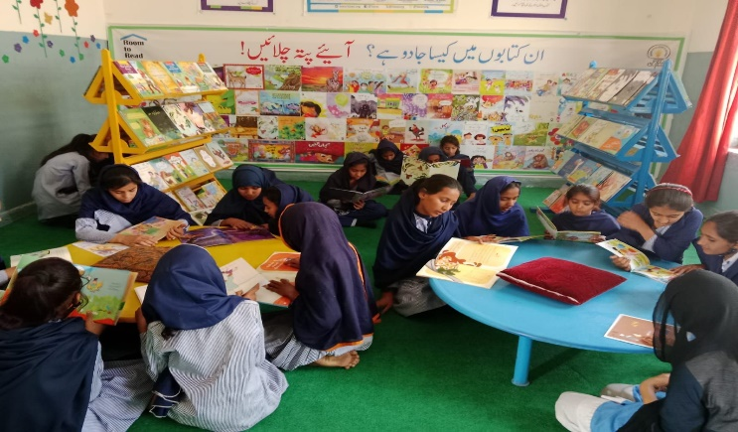
Gearing Up for 2025: Expanding Horizons
For 2025, we are excited to build on our recent achievements and explore new opportunities for advancing literacy through:
Model Libraries in Punjab: Collaborating with SED to establish model libraries in schools on co-invest basis with 50% from SED and 50% from RtR with ITA providing technical assistance and refresher training, supporting the promotion of reading hours in schools.
Author/Illustrator Workshops: Organizing workshops in Islamabad with NBF to engage authors and illustrators, fostering creativity and collaboration for future literacy projects.
"She Creates Change" Videos Dissemination: Disseminating translated versions with the help of pro-bono celebrity voices to ensure impactful and cost-effective reach in multiple languages.

Slide 12
Background
OOSC Multisectoral Roadmap/
5 Years' Strategic Plan
September 2024
December 2024
Client: SELD and UNICEF
Duration : Sept. – December 2024
On 9th May 2024, Prime Minister of Pakistan announced an "Education Emergency" across Pakistan to enroll approximately 26 million children and adolescents (boys and girls) who are currently out of school
Caseload of OOSC/A was significantly increased due the Flood Emergency 2022 as education sector in Sindh was severely impacted due to the devastation of floods.
Current caseload of OOSC/A in Sindh is 7.63 million (4.18 million girls).
In June 2023, Chief Minister Sindh reiterated the GoS’s goal of improving access to equitable, inclusive, and quality education for all.

Slide 13
Context for Multi-Sectoral Strategy
On 16th May 2024, Chief Minister Sindh, Secretary School Education and Literacy Department and UNICEF Country Representative agreed in a high-level meeting to collaborate and develop a Multi-Sectoral Roadmap/Action Plan to address the challenge of OOSS/A in the province.
Multi-sector nature of the intended Roadmap/Action Plan was re-iterated in full consideration that phenomena of OOSCA/ is directly linked with the social norms and behaviors - and when combined with the persistent deficiencies that are external to the education sector
ITA’s participation in this process is in leading Phase 1.

Slide 14
Phase 1- Development of Sindh Multi--Sectoral Roadmap/Strategic Action Plan for addressing the challenge of OOSC/A in Sindh
-
Rapid Assessment of
Sindh Multi
-
OOSC/
Sectoral Roadmap/Strategic Action Plan
A
for addressing the challenge of OOSC/A in Sindh
Aims:
I) Map social and
behavioral determinants why
Situational Analysis
: Data/Deeper analysis of multi
-
communities/parents are not sending
o
sector reason of OOSC/A.
children/adolescent to educational institutes?
2) Develop better understanding of contextual
o
Vision, mission statement, and a paradigm shift
for addressing the challenge.
challenges related to access to education from
Theory of Change
including long
-
o
term outcomes, immediate outcomes, outputs,
OOSC/A.
activities, inputs, assumption, external factors
Goals, multi
-
sector objectives, multi
-
o
sector integrated interventions
(Education,
WASH, Child Protection, Social Behavioral Change, Health, Nutrition, Gender
Multi
norms)
-
Sectoral Workshop with
Implementation Plan
(Gola, objectives, deliverables, implementation schedule,
Diverse Stakeholders:
o
resources, task break
-
dawn, with timelines and responsible entities with budget
and resource allocations)
Aim:
Coordination and delivery mechanism:
Inter and intra departmental
Explore multi
o
-
sectoral challenges and
opportunities for addressing the
collaborations, donors/partners coordination mechanism, resource mapping and
challenge of OOSC/A
resource leverage mechanism,
o
Monitoring and evaluation
(Key Performance Indicators, performance
benchmarks, interim and post implementation review/evaluation, risk
management and mitigation strategies)
o
Communication plan
(Purpose, communication objectives, stakeholders’
identification, communication methods/modalities and tools, feedback
mechanism)

Slide 15
Phase-2: Convene Donors/Partners’ Consortium
to develop a costed Action Plan to support delivery on the Sindh Multi-Sectoral RoadMap
on OOSC/A
-
Preparatory phase for
Expected outcomes
of
Donors/Partners’ Consortium
Donors/Partners’ Consortium
1.
Partnership mapping of donors/ partners
▪
Sensitized/encourage donors/partners to
(Who, what, where)
align strategic thinking around priorities of
2.
Costing and resource/funding gap analysis
GOS OOSC/
A
in the wake of education
of Chief Minister’s Multi
emergency.
-
Sectoral RoadMap
to address the challenge of OOSC/A in
▪
Sharing expertise, coordination for resource
Sindh.
pooling, increased impact, innovation,
3.
Priority areas Government of Sindh seeking
efficiency, policy influence, sustainability,
increased investments form donors/ partners
quality assurance.
4.
Developing draft framework for potential
▪
Foster collaborations for pledging increase
collaboration and coordination.
investments to support delivery on the Chief
Minister’s Multi
-
Sectoral Roadmap

Slide 16
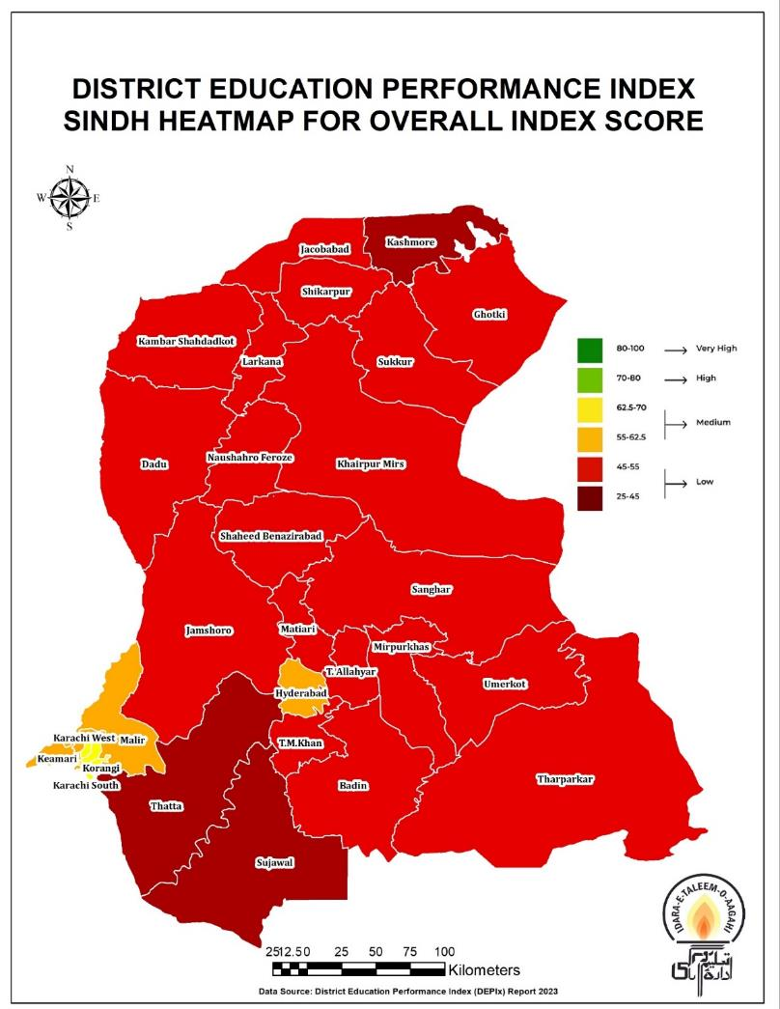
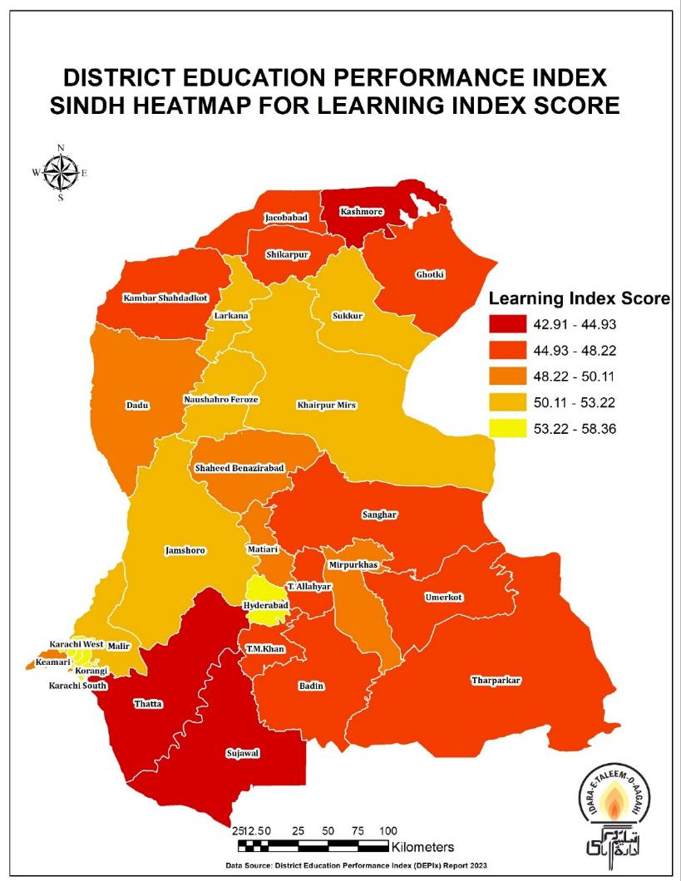
GIS Maps

Slide 17
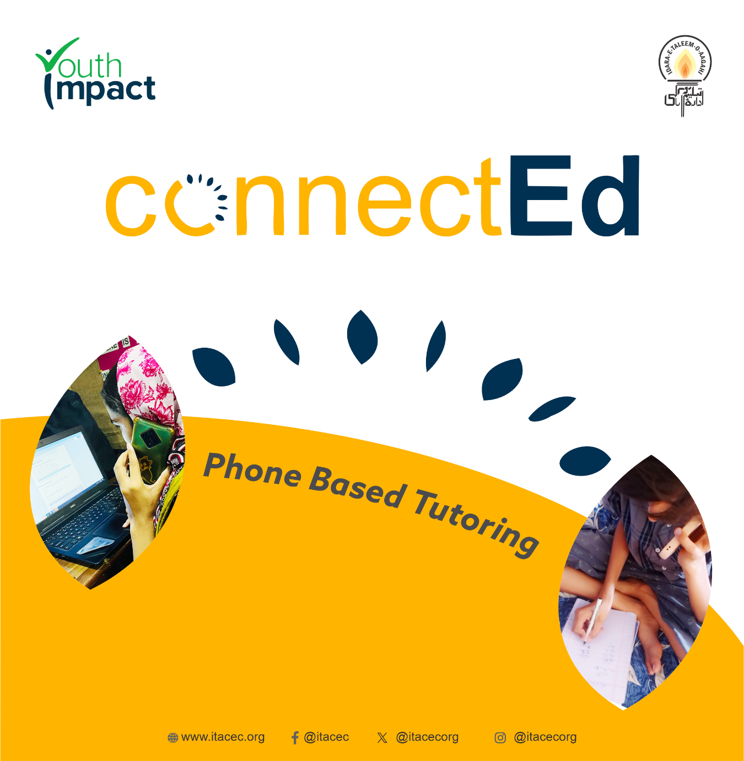
Connected Project: Bridging the Digital Divide in Education through EdTech Remote & Hybrid Tutoring
Objective: Improve foundational numeracy skills in grades 3-5.
Approach: Home-based digital tutoring via SMS and phone calls.
Pilot: Running in Bahawalpur and Kasur (PEF/PEIMA Schools).
Target: 160 students, supported by 13 teachers and facilitators.

Slide 18
Objectives & Key Components
Objectives:
Enhance Numeracy Skills
Increase Parental Engagement
Provide Equitable Access to Education
Key Components:
Digital Tutoring: Weekly tutoring via SMS and phone calls
.Parental Involvement: Regular feedback and support at home.
Monitoring & Assessment: Data-driven decisions based on weekly progress.

Slide 19
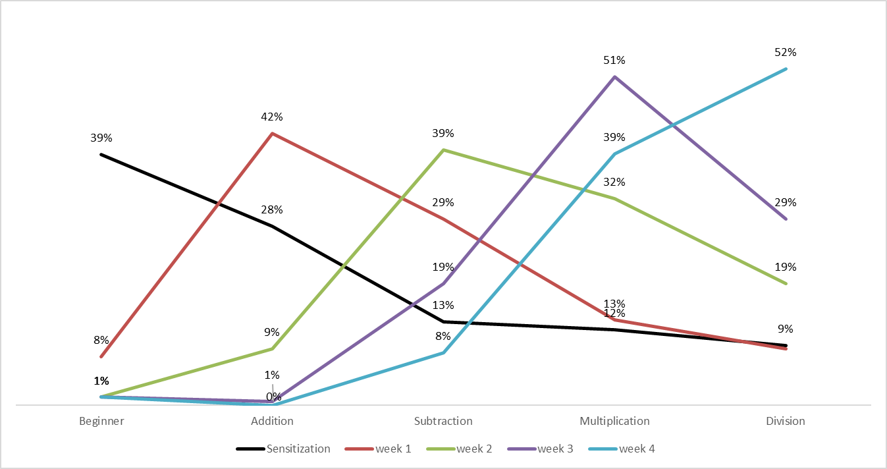
Implementation & Expected Impact
Implementation Process:
Sensitization & Onboarding
Data Collection & Weekly Tutoring
Parental Support
Expected Impact:
Improved Numeracy Levels
Increased Parental Engagement
Equitable Access to Education for Marginalized Students
A total of 163 students were included in the baseline assessment. During the implementation period, the response rate was 98%.
At the baseline (sensitization stage), the majority of students were at the beginning level, meaning they were unable to perform addition. Only 9% of students were at the division level. By week 4 of implementation, the majority of students had progressed to the division level, with 52% able to perform division and only 1% unable to perform addition. This represents a significant improvement from the baseline, where only 9% of students were able to perform division.

Slide 20
Sindh Early Learning Enhancement through Classroom Transformation (SELECT) material DEVELOPMENT with SELD
Duration : April- December 2024 Client: World Bank and SELD Sindh
Development of Supplementary Reading Material (SRM) in Sindhi and Urdu For Grade 3, 4 and 5 in coordination with DCAR PMDC and PRC members
Development of 90 SRM (45 for each grade) including Read Aloud and Levelled Readers for G3 to G5
Material Development Tasks includes:
1. 45 Urdu and 45 Sindhi Read Alouds and Leveled Readers
2. 11 Interactive Audio Visual Instruction (IAVI) videos for teachers CPD in Sindhi and Urdu
3. Development of LMS Digital App for Developed Material Access
4. Development of 60 Scripted Lesson Plans for each grade
5. Development of Teacher Training Manual
Conducting Workshops with DCAR with government-notified PMDC and PRC members for coordination and review of material development

Slide 21
ITA @ 25 Mobilizing Pakistan for Education & Learning
A Series of Activities under Planning for 2025- “ITA@25”
Monthly Events – Webinars - on Key Thematic Areas of ITA’s work with Beneficiaries
A Book on ITA@25
Chapter Contributions by ITA & Partners who have worked closely with ITA over the years (10-12 chapters) word limit being finalized
Eminent Authors
A Fundraising Event with Beneficiaries
Souvenirs for ITA @25 for our partners and ITA Colleagues
ASER Learning App with Solutions scaling up nationwide
Two ITA Flagship Programs to be launched nationwide with Learning & Resilience at the Core – a learning teams approach – parents-students-teachers-youth/community and field
Sanjha Vehra ECCE- and Siyani Sahelian Adolescent Girls (tested)
A Year of Celebrations for Mobilizing a Nationwide Movement with Purpose & Outcomes
Budgets for the Year Long Celebration
Mobilizing Funds for The Year Long Education and Learning /Flagship Programs
Designing an Acknowledgment souvenir for partners (in progress to be shared early October 2024 with the board
Action:
ITA@25 Committee to share with ITA Board the Concept Note by October 5, 2024
Committee Members:
Baela Jamil, Asif Sultan, Abu Bakar, Sahar Saeed, Waqas Bajwa, Sehrish Farooq and Maham Anees

Slide 22
Current Project Updates ASER Pakistan MYRP- Multi-Year Resilience Project (MYRP): Refugees – VSO AAWAZ II (3RD PHASE) 2024-26 Young Omang- MENSTRUAL HYGIENE MANAGEMENT (MHM) PEF-PEIMA Schools through PPP Pakistan Learning Festival DIGITAL LEARNING TOOLS Design & Desktop Publishing

Slide 23
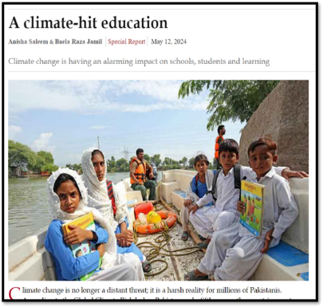
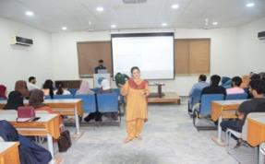
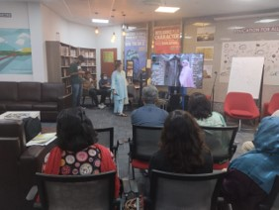
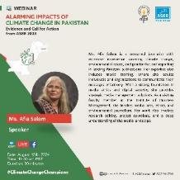
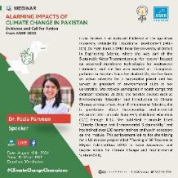
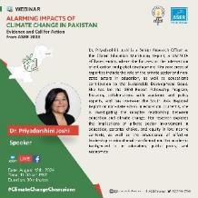
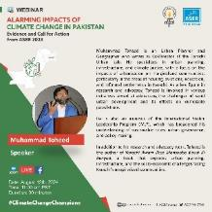
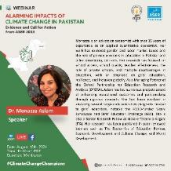
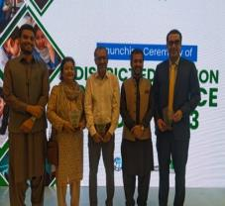
ASER 2023 Dissemination Updates
Advocacy and Dissemination Sessions:
Village Baithaks: 21 village Baithaks conducted in 12 districts to promote data awareness and action.
University Seminars: 4 university seminars organized (IBA Karachi, NUML Islamabad, ITU, and Minhaj University).
Thematic Reports: 08 Thematic Report Cards prepared for topics such as Foundational Learning, Gender, Facilities, Technology, Inclusion, Climate Change to share these insights with broader audiences.
Webinars: Webinar on Climate Change & Education featuring experts like Dr. Monazza Aslam, Dr. Fozia Parveen, Dr. Priyadarshani Joshi, Ms. Afia Salam and Muhammad Toheed.
DEPIx 2023 Launched:
Launched in August, 2024, using ASER Pakistan Rural Data 2023 which measures key education quality indicators; well-received by stakeholders.
ASER Learning Tool APP 2024 to be launched in November 2024

Slide 24
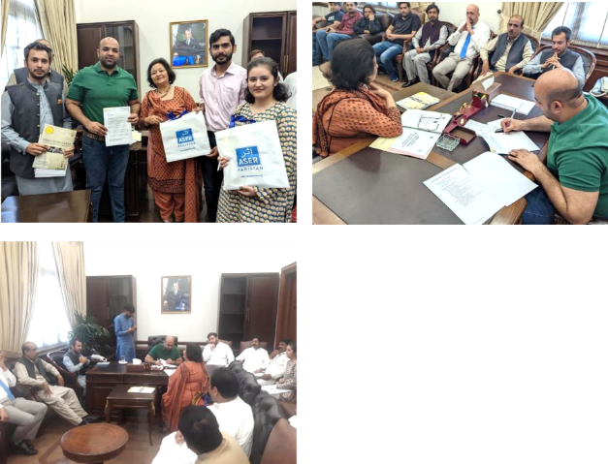
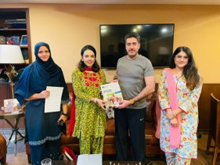
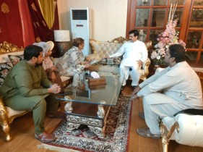
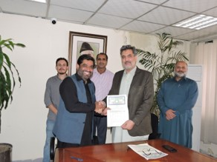
ASER Political Constituencies Survey (8 CONSTITUENCIES) A LONGITUDINAL STUDY 2024 BASELINE; 2026 MIDLINE; 2028 ENDLINE
The ASER Political Constituencies Survey is designed to assess the state of foundational learning (literacy and numeracy) in eight key political constituencies across Pakistan. The survey aims to provide constituency-level data on education, helping to inform local policymakers and stakeholders.
Objective: To gather data on education quality at the grassroots level, enabling more targeted and effective policy interventions. “ARE POLITICIANS SERIOUS ABOUT EDUCATION AND LEARNING IN PAKISTAN? WHAT WAS PROMISED AND WHAT WAS DELIVERED”
Methodology: The mixed-methods approach integrates household surveys with qualitative FGDs to provide a comprehensive picture of foundational learning, gender disparities, and access to education within these constituencies.
Development of Tools & Feedback: Survey tools are reviewed by key experts, including Dr. Tanya Saeed and Dr. Faisal Bari from LUMS, and Dr. Farah and Dr. Munaza Aslam pending final review. Data collection will be conducted using digital tools for greater efficiency and accuracy.
Piloting Focus Group Discussions (FGD): FGD tools piloted to ensure qualitative insights from communities, complementing quantitative data. Early results from FGDs will inform adjustments in survey tools to better capture localized educational challenges.
Expected Outcomes: Results will be used to engage policymakers, ensuring targeted interventions in underperforming constituencies. Findings will be crucial for developing educational policies tailored to constituency-specific needs, helping bridge gaps in education quality and access.

Slide 25
Multi Year Resilience program 2022-2024
The Multi-Year Resilience Program (MYRP) funded by Education Cannot Wait (ECW) and implemented by VSO is nearing its conclusion, with all planned activities successfully achieved. The program has now entered its final phase, focusing on advocacy.
ITA is the Technical Assistance Partner on Learning Solutions, Research and Advocacy
Key accomplishments include training Education Champions on Catch-up Learning Program (CLP) and Early Childhood Education (ECE) content.
Both ECE and CLP education champions, along with formal school teachers, have also received training in Disaster Risk Reduction (DRR) and conducting school safety risk assessments.
Citizen engagement dialogues were held to explore the barriers faced by communities in educating their children. Insights and recommendations from these dialogues were presented to district-level officials to highlight gaps, which will later be raised at the provincial level.
Furthermore, ECE and CLP education champions have also been trained in safeguarding protocols and school codes of conduct.
In collaboration with the Pakistan Institute of Education (PIE), ITA is actively working to develop a standardized tool for assessing foundational learning.
Storybooks, focusing on inclusivity and safeguarding, are being developed to address the challenges faced by refugee children, and these are currently in the writing and illustration phase.
he digital materials are tailored to support both Early Childhood Education (ECE) and Catch-up Learning Program (CLP) modules.
An exposure visit to Gilgit-Baltistan was organized for officials from the Ministry of Federal Education and Professional Training (MoFEPT), the Balochistan and Khyber Pakhtunkhwa Education Departments, and partner organizations. The purpose of the visit was to observe educational interventions in the region with the aim of replicating successful practices in their respective provinces.

Slide 26
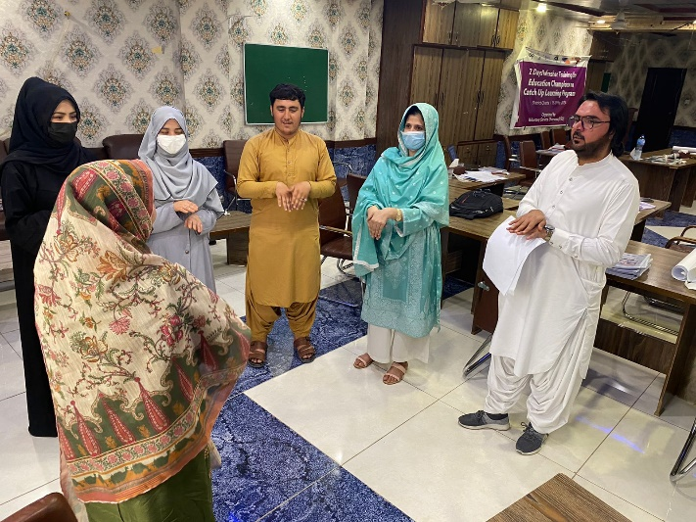
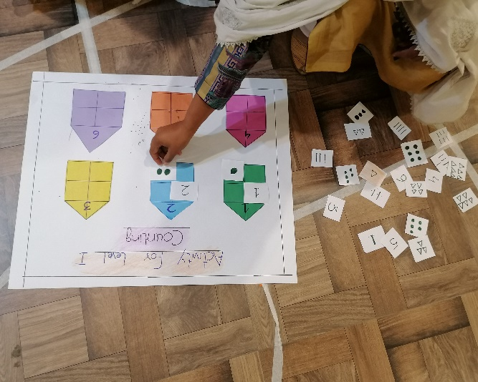
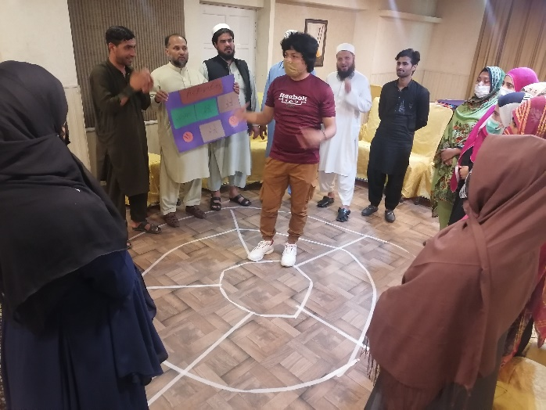
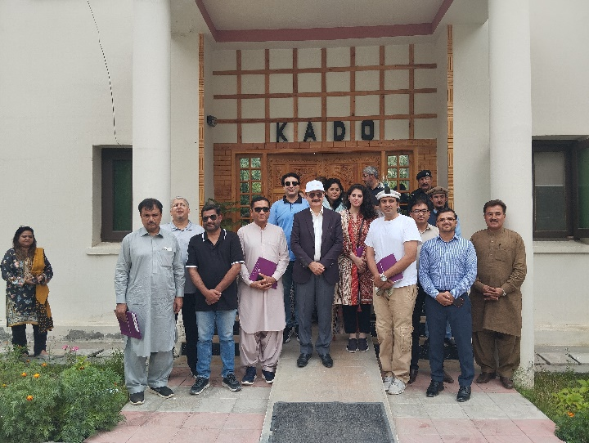
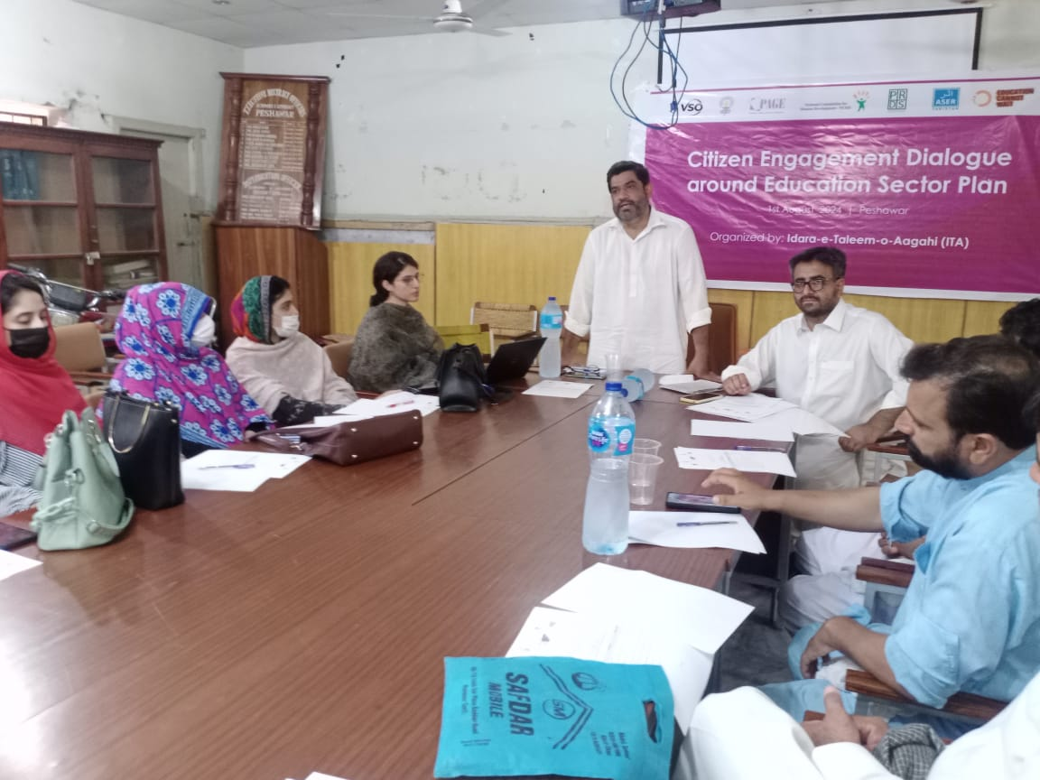
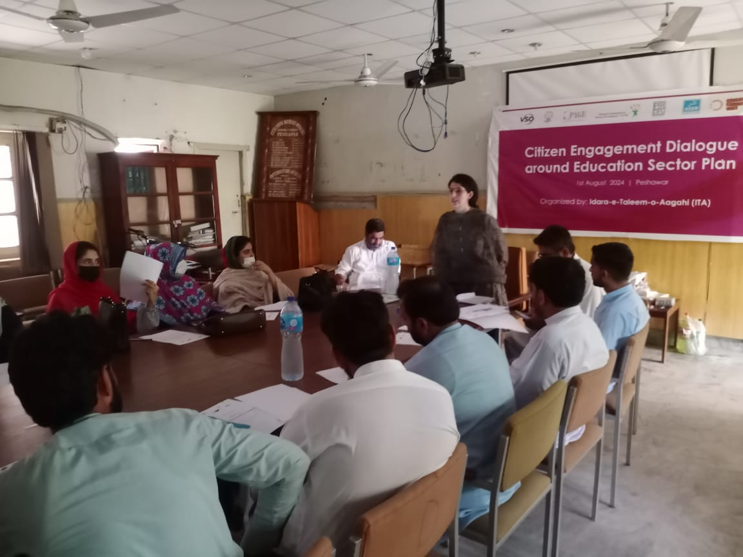
Pictorial Evidence

Slide 27
Aawaz II Programme Overview – ITA’s Contribution in Eradication of GBV, CM and Social Cohesion (Phase 3) TT Singh & OKARA 2024
Introduction to Aawaz II Programme
Recently launched Phase 3 (2024–2026) in partnership with the British Council
ITA's successful implementation of Phase 1 and Phase 2 in Rahim Yar Khan, Okara, and Toba Tek Singh (TTS)
Preparing to implement Phase 3 in Okara and TTS
2. Programme Pathways:
Pathway 1: Changing awareness, attitudes, and behaviors towards intolerance, discrimination, exploitation, and harmful practices.
Output: Enhanced citizen information, voice, and actions against child marriage, gender-based violence (GBV), and social exclusion.
Pathway 2: Increased referrals and citizen engagement on issues of social exclusion, intolerance, exploitation, and harmful practices.
Output: Citizens and communities better able to ensure social cohesion and tolerance.

Slide 28
Key Achievements and Activities in Phase 3
Pathway 1: Enhancing Citizen Awareness and Actions
28 Aawaz Aagahi Centers (AACs) functional in Okara and TTS.
56 Village Forums (VFs) activated with 1301 registered members.
Conducted 112 VF meetings to implement workplans.
Developed 100 Referral Directories, printed and online (in English and Urdu).
Conducted 300+ video screening sessions and disseminated IEC material to 2000+ people.
3 Special Interest Groups (Transgender Person, Religious Minorities and Women With Disability) are active.
Pathway 2: Social Cohesion and Citizen State Engagement
2 District Forums (DFs) functional with advocacy workplans.
100+ Citizen-State Engagement Meetings with relevant departments.
Activated 3 district-level coalitions/alliances.
Facilitated CNIC/NADRA registration for 1000+ individuals, including 50 TGs, 200 females from the majority, and 250 females from the minority community.
Supported PWD Certificate provision for 150+ PWDs.
Responded to 80 early warnings through VFs, AACs, and DSP networks.
FCDO's successful visit and selection of TG resource person for international-level reel recording.

Slide 29
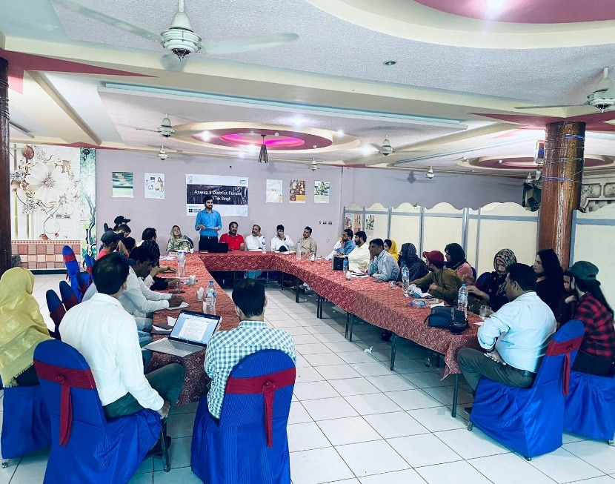
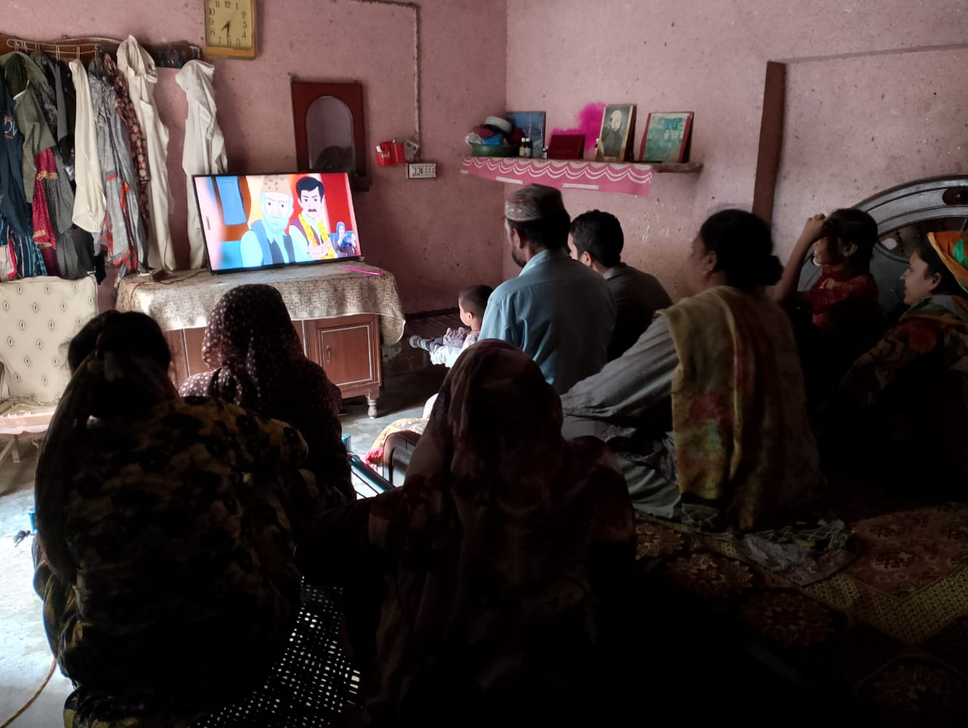
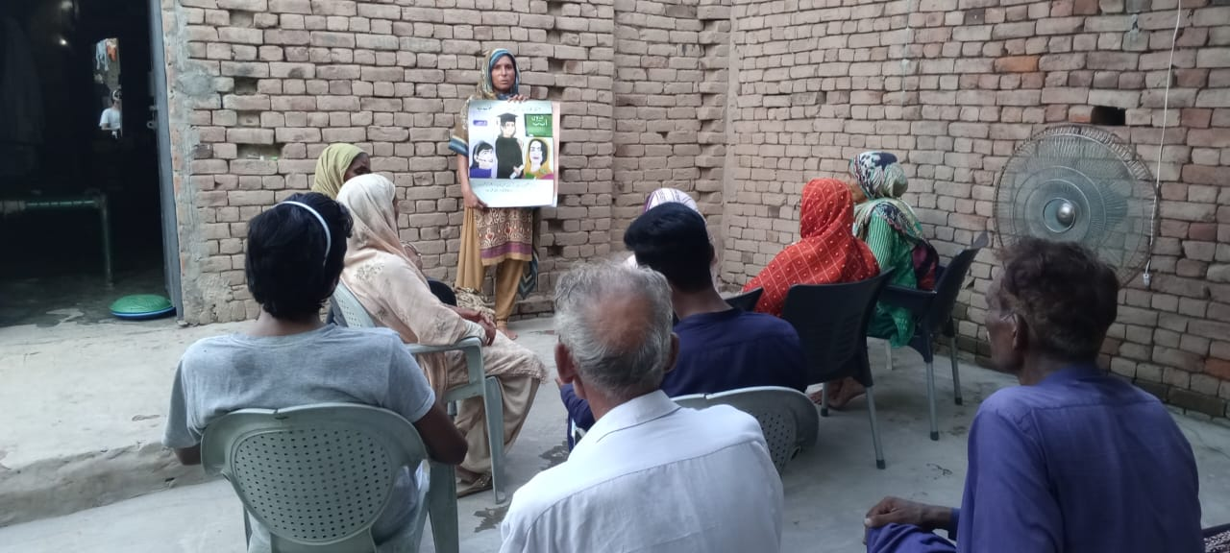
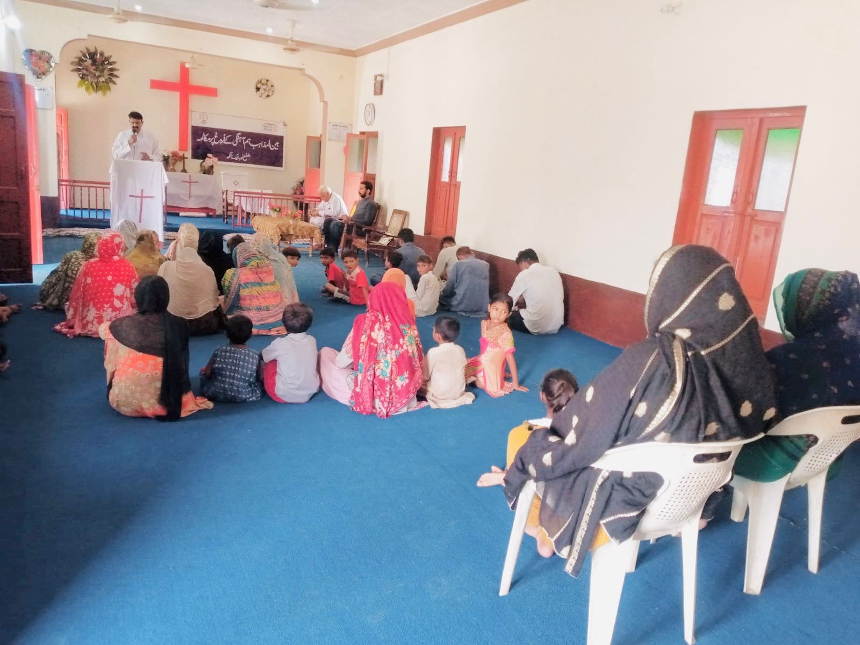
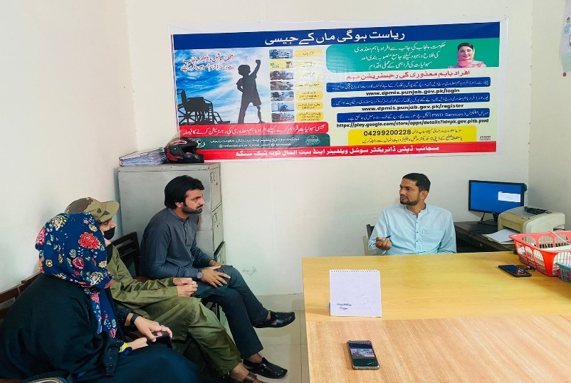
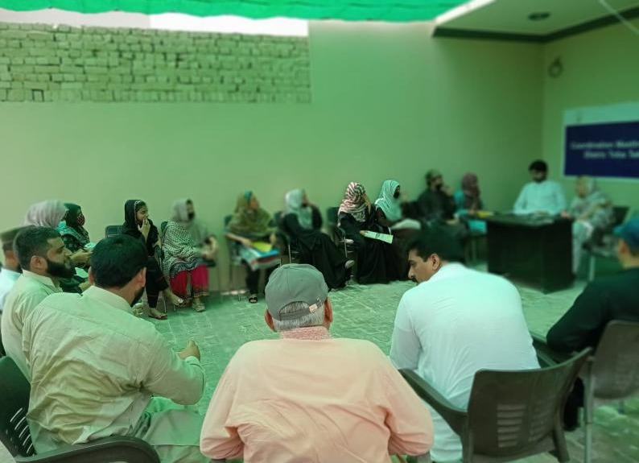
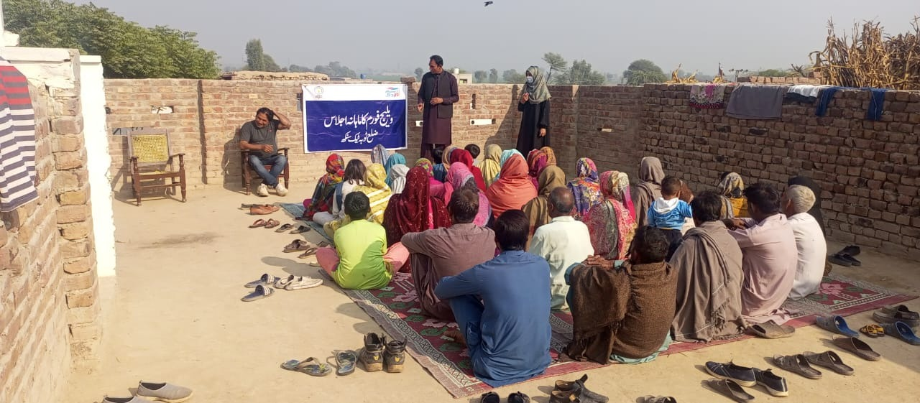
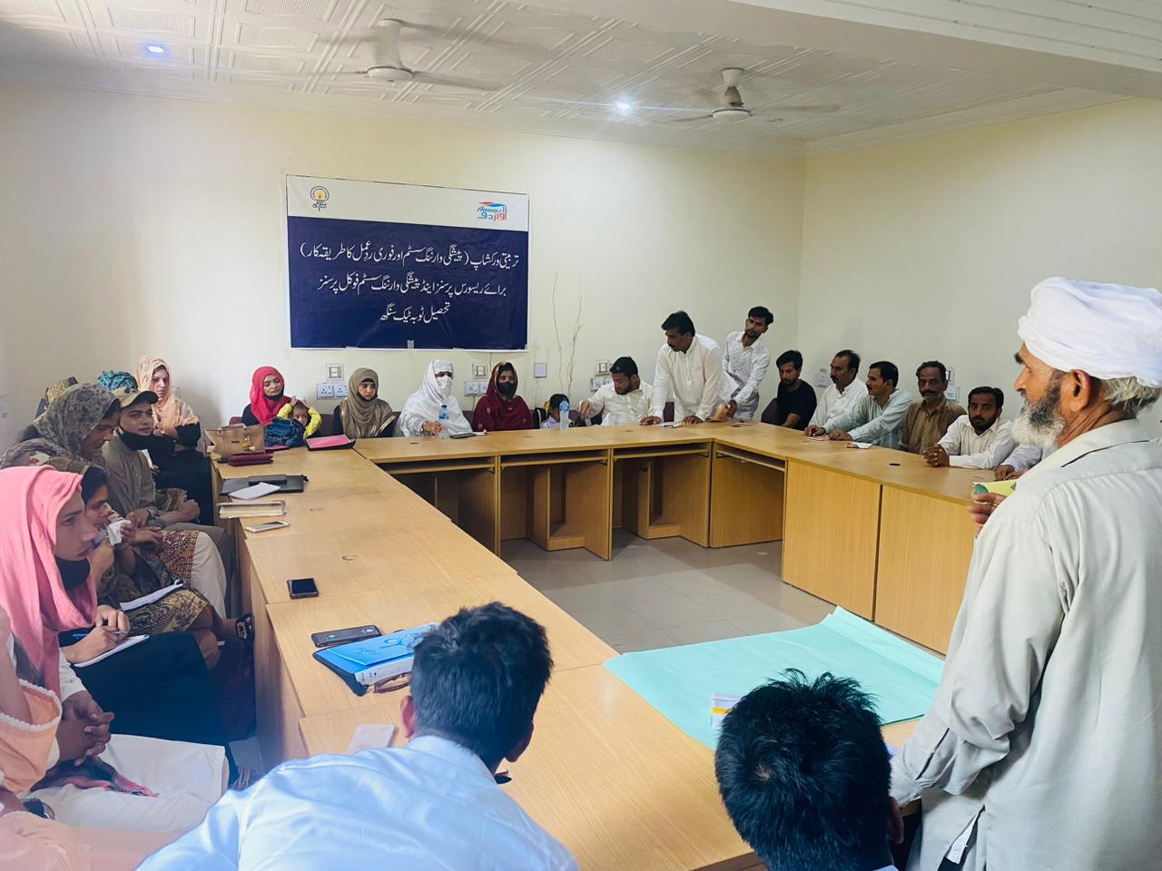
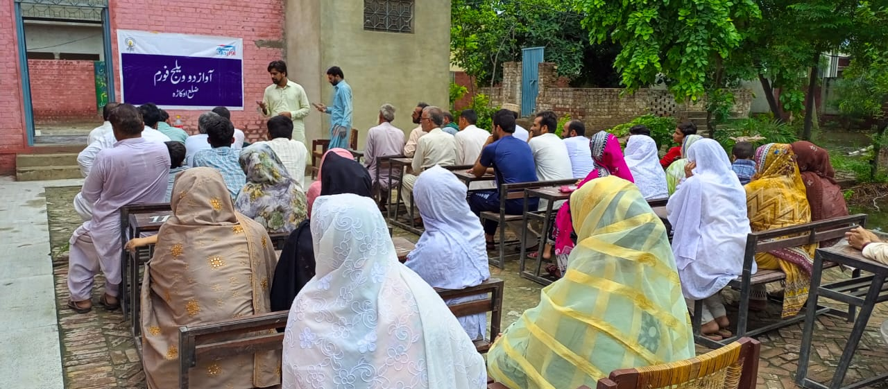

Slide 30
Young Omang: Menstrual Hygiene Management
Young Omang: a consortium of 7 Partners Led by & led by CDA (Chanan Development Association)
ITA, Aahung, Bargad, Rahnuma FPAP, Blue Veins, Indus Resource Cente
Under this consortium, ITA is leading reproductive health and rights with thematic area of “Menstrual Hygiene Management”.
“Embrace” is our industry partner providing donations of sanitary napkins designed for distinctive needs of South Asian women
In phase 2, ITA selected 2 grassroots organizations for providing one year mentorship on Organizational development, capacity strengthening of staff on core and thematic areas, Advocacy, Policy development and networking building.
1. DASTAK based in Islamabad
2. STREET based in Quetta (Balochistan)
Organized 2 capacity strengthening workshops of selected grassroot organizations on
1. Basics of Menstrual Health & Hygiene, SRHR and value clarification
2. Advance areas of MHM including diseases, infections and taboos and designing Advocacy Campaigns and developing policy brief
Advocacy Campaign of Phase 1 “Period Pride” concluded successfully with lots of awareness sessions, competitions and posters and blogs.
Policy Dialogue for Phase 1 organized in Islamabad
Advocacy campaign on Menstrual Health & Hygiene is ongoing in field till 30th September
DASTAK/STREET developed Policy briefs on MH with the help of ITA
Series of lobbying meetings of these selected CSOs with other CSOs, networks, Govt Officials and policy makers planned in Oct. 2024.

Slide 31
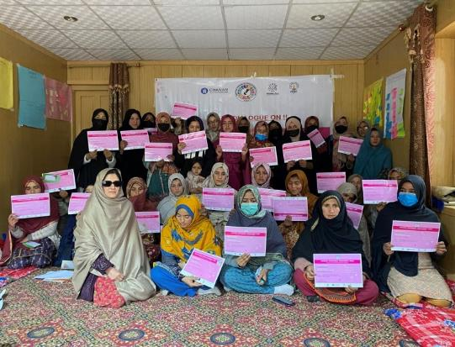
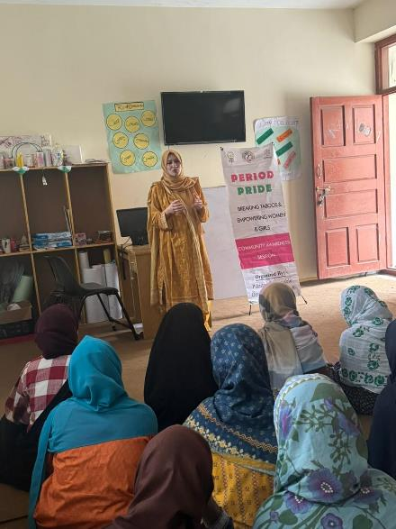
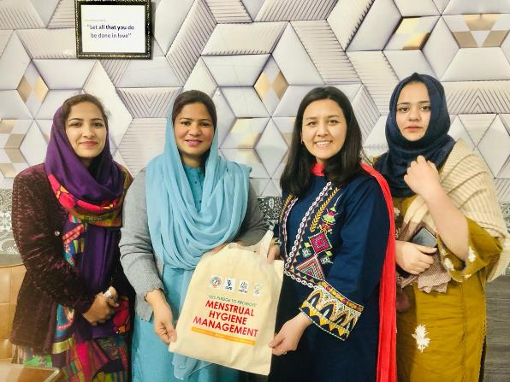
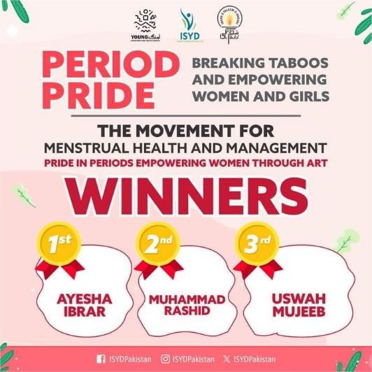
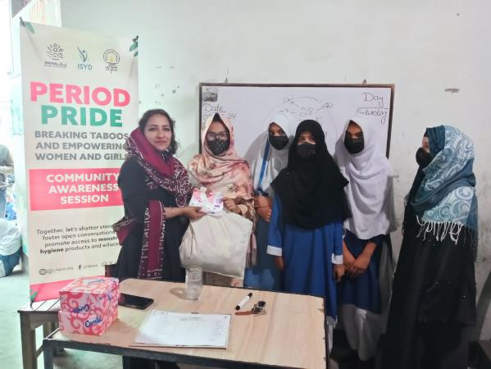
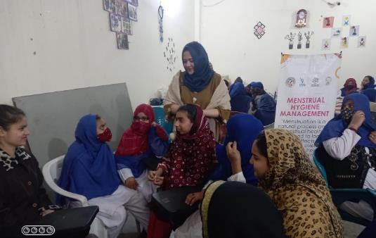

Slide 32
Challenges: Far flUNG areas (School Locations) Less qualified teachers due to financial constraints infrastructure issues Variation in Enrollment over the year- Agri Cycles Community relation building lOW per child cost
PEF-PEIMA - Highlights:
Working in 5 Districts
126 PSSP schools
12 NSP schools
Total Enrolled: 11562
Subject based Teachers’ capacity building training
89% result in QAT 23-24
School Sudharo Program (School Construction)-
Mobilization of funds from Public (Trustees)
Staff replacements ongoing with better skills
Library Corners established in Bahawalpur
Summer camps in all schools with Climate Change focus
Parents engagement activities
Life Skills and Mental Health sessions
Celebrations of Monthly national/international days :Women’s Day, Recycling day, Child Labour Day, Eid, Mother’s day, Independence day, Literacy / youth day etc.
138 Punjab & 14 schools in Sindh = 152 Total Schools

Slide 33
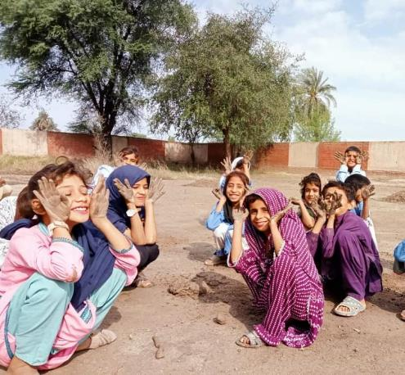
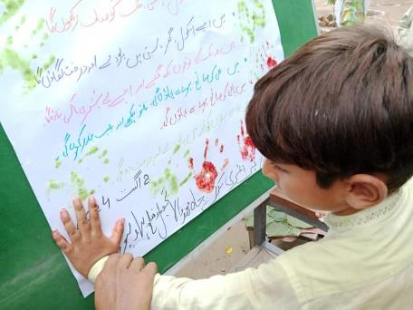
Summer School Images

Slide 34
The Next Generation PLF

Slide 36
What is the NextGen PLF
Purpose:
Engage children (3-16 years) in diverse learning experiences beyond classrooms.
Introduce youth (17-24 years) to learning and earning opportunities through industry and innovation.
Emphasize critical thinking, creativity, collaboration, and environmental responsibility.
Focus Areas:
Technology & AI
Climate Change & Environmental Stewardship
Health, Nutrition, & Well-being
Financial Inclusion & Digital Entrepreneurship
Arts, Culture, & Heritage
Format:
Interactive sessions, keynote talks, workshops, exhibitions, and industry showcases.
Platforms for learning innovations, counseling, and networking with professionals.

Slide 38
NextGen PLF Update
Dates:
November 19-21, 2024
Venue:
Islamabad, Pak China Friendship Center (Venue booked)
Funds Collected:
VSO 2.4 Million
LGS . 5 Million
Next Steps:
Secure more sponsors.
( Inputs/Links needed)
Finalize event schedule and logistics.

Slide 39
DesIgn for ChAnge
Ms. Baela Raza Jamil has been chosen to represent Pakistan in the Design For Change Global Network.
DFC is the largest global movement harnessing the power of children to create positive change, The movement is spearheaded by a global network of passionate community leaders, teachers, schools, children, and principals who are committed to instilling the 'I CAN' mindset in every child.
Using the simple and proven framework of 'Feel, Imagine, Do, Share' ( FIDS ), children around the world are empowered with the skills to design a more desirable and sustainable future - Today!
Previously, the Samina Saad Education Foundation served as Pakistan's representative within the DFC Global Network.
The Award Ceremony of the 2023 cycle will take place in Dubai in November 2024.

Slide 40
ITA’s Digital Presence
ITA Digital Team's Current Projects
Video Series:
Menstrual Hygiene Awareness
Mahol Saheliyan - Climate Change Series
*(Please click on the video to watch)
Interactive Educational Content:
11 Interactive Audio-visual Instructions (IAVI) Materials
Digital Platforms:
SELECT SELECT LMS-Based App
ASER App

Slide 41
Digitalization at ITA- UPDATES
DIGITAL MOBILE APPS
Working on Upgradation of ASER Survey Mobile App
Completed UI/UX phase of ASER-FLN Mobile and the development team is working on its finalization phase which will be completed in December and ready for piloting
In process of hiring the development team for our Mobile App based on our SELECT Project.
Plan to develop an ERP Software to digitalize our internal Systems processes and procedures e.g HRM, Inventory, Finance, Travel etc.
In-house creation of Digital content for our digital platforms
Digital Learning Content And Materials
Digital Marketing and Outreach
Implementing Google analytics tools to better understand audience/users behavior
Optimizing SEO, email campaigns, and social media for broader reach of our content and campaigns.
Creating a content strategy that focuses on engagement and community-building.
Creating YouTube playlists for better understating of the viewers and also optimizing the ITA’ channels
Cybersecurity Enhancements
Strengthening data protection policies (firewalls, encryption, two-factor authentication)
Infrastructure Modernization We are currently using following given Microsoft services and plan to upgrade legacy/upgraded licenses based systems (e,g., Servers, software), also plan to buy the paid services of Microsoft Operating systems. Cloud Based Services (Microsoft) Microsoft Education A1, A3, and A5. 6 Microsoft accounts ( five A3 and one A5) 500 free Microsoft A1 for Faculty accounts

Slide 42
Desktop Publishing & design dept
PLP 28 Punjabi & Saraiki books
12 new books
PMIU Books Sales to School Education Department (9000 schools by end of 2024)
PLF Islamabad poster and design
ASER District Directories
SELECT Project Sindh material
SRM Punjab - TaRL Material - TaRL KP and South Punjab
ConnectEd
MHM / Youth project material
Monthly newsletters
Social media posts and campaigns
International days & events
Webinars and activities designed material

Slide 43
GOVERNANCE & EAD UPDATES
Lahore High Court has declared EAD as Null and Void (Copy of decision is attached)
Now We have to wait for next development on subject matter to start applications for new projects
We will keep board update on new development (Appeal or New legislation)
ITA's compliance are upto date as per applicable framework
https://itacec.org/document/2024/2024LHC3763.pdf

Slide 44
Thank you

