Slide 1
Early Learning Partnership Systems Research
COVID-19 Research Sindh

Slide 2
Early Childhood Education in Sindh
Provision
For children ages 3-5
Mostly center-based and formal
Public (free, but not compulsory) and private
Parental Engagement
High interaction with parents for learning at home
Low availability of play and learning materials at home
Relatively higher degree of negative child discipling
Access
45% of children aged 3-5 attending ECE in Sindh (ASER 2019)
COVID-19 school closures: Mar-Sep 2020, Dec-Jan 2020, Mar- 2021
ECE generally low-priority in distance learning measures and response efforts
Notes:
Reference: Bureau of Statistics Punjab. 2018. Punjab Multiple Indicator Cluster Survey (MICS) 2017-18 Findings Report. BOS Punjab. [PDF] Available at: https://bos.punjab.gov.pk/system/files/MICS%20SFR_Final_Vol1_0.pdf. [Accessed 03 August 2020].

Slide 3
Research Study: Impact of COVID-19 on ECE
Assessing short and medium-term effects of the pandemic on early learning systems, especially:
Children’s participation in learning activities at home
Quality of parent-child interactions at home
Uptake of distance learning measures
Role of teachers in supporting learning at home

Slide 4
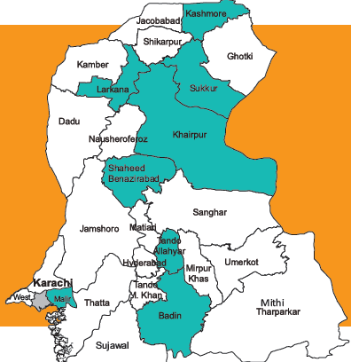
Research Design
Mixed Methods Research
Caregiver/Parent Response (n=1690)
Head Teacher/ECE teacher (n= 108)
Child Assessment (n=1819)
Quantitative
Desk Review

Slide 5
Key Findings

Slide 6
ECE Response During COVID-19
ECE not built into initial response efforts by federal government but incorporated later on by provincial government
Planning and Implementation
Difficulties in data collection. Assessment system is work in progress
Obtain
Limited information on level/scope of learning during the lockdown through government-backed distance learning initiatives
ECE Financing
Limited cashflow problems experienced by schools/School Heads
Return to School
Only 6% of schools/School Heads reporting attendance of more than 75% for period of survey (October-December 2021)

Slide 7
Return to School

Slide 8
Children’s Participation in Learning Activities

Slide 9
Children’s Participation in Learning Activities
Caregivers’ Engagement in Learning Activities in past 15 days
Child’s Gender | Played with child during last 15 days? | Read books or looked at picture books with child during last 15 days? | Told stories to child during last 15 days?
Girl | 64% | 53% | 61%
Boy | 69% | 61% | 67%
Total | 66% | 57% | 63%

Slide 10
Disability Prevalence by Gender
 | With Disability | No Disability
Boy | 5.3% | 94.7%
Girl | 3.7% | 96.3%

Slide 11
Child Learning Outcomes

Slide 12
Child Learning Outcomes

Slide 13
Child Learning Outcomes

Slide 14
Uptake of Distance Learning Measures
Comparatively higher participation in low-tech distance learning interventions including printed materials, television, text messages and radio (based on caregiver responses, n= 1690)

Slide 15
Uptake of Distance Learning Measures
Teacher perceptions: less than half of the school going ECE population utilizing distance learning facilities

Slide 16
Teacher Support in At-home Learning
High teacher support (n=90)

Slide 17
Key Takeaways
Prioritization: The limited prioritization of ECE during the pandemic highlight the need to develop a more coherent, entrenched, and formalized ECE-specific strategies at a systems’ level that can mitigate the negative impact of emergency situations and ensure high outcomes in other times.
Coherence of response: Need for a separate budget head and developing mechanisms for collecting data for early years
Learning at home: There is inherent potential in play-based learning. The high prevalence of play-based learning at home with parents, with guidance from teachers, is an opportunity to engage parents further to ensure that the learning environments for children are well-developed at both the class-room and household level.

Slide 18
Key Takeaways
Teachers: Despite the challenges faced during the pandemic, evidence of teacher engagement. There is thus scope for further progress in this regard.
Equity & Inclusion: Limited access to distance learning during this period. Nevertheless, the participation in distance learning via radio, and printed materials was comparatively high, indicating a sustained effort by the ECE service-providers to keep children engaged. While there is reason for optimism with regards to government’s efforts in ECE during the pandemic, there are also challenges.
Return to school: Evidence from the data indicates enrolment loss and a significant drop-out ratio, which in turn requires a systems-level response to early learning in the province.

Slide 19
Thank You

