Slide 1
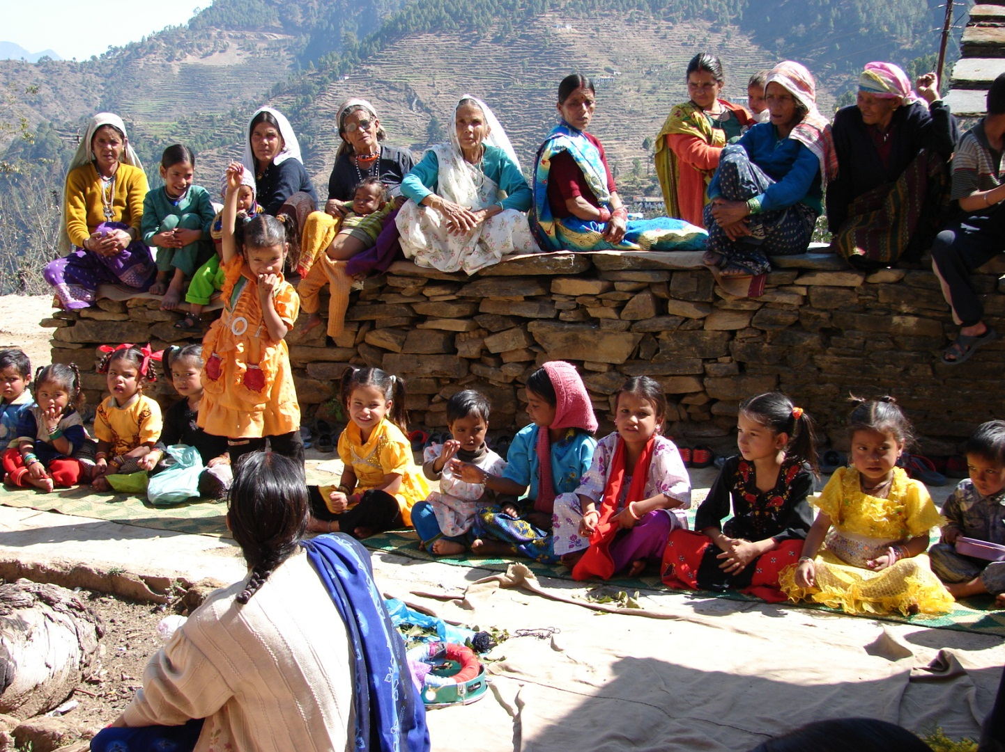
Community driven models

Slide 2
Why do we need community-driven models?
General feeling that high level changes in policy and huge investments have not produced commensurate results
Sense of cynicism and alienation at the local level
Lack of space and engagement between community and policy makers
Academia seemed largely irrelevant in villages.

Slide 3
What Community involvement is not
Top-down replication e.g. one theme being implemented by several NGOs (contractors)
Village committees (fights for power and distribution of money),
Research 'extension' (like agricultural extension etc.).
village community not a romantic concept, deeply stratified
Important to take people as they are and build around it, not as we ‘expect‘ people should be.

Slide 4
Why education
Education a key process involving and engaging the whole community rather than just catering to a few individuals
Education is non-conflicting unlike income generating projects which benefit a few
A mix of practical work and classroom learning---- action and learning are inextricably linked
Learning without action is theoretical rote learning and action without learning is not sustainable

Slide 5
Background
To start with the core group leadership must be of impeccable character, with no personal interest or hidden agenda. understanding, patience and humility are required
Early 1990s was also a time when a great deal of thought was going into primary education
National educational policy 1986 and Supreme court orders re environmental education
Government was proactive about supporting ngos

Slide 6
How did we proceed
Go out and meet local people and listen to them
Find out
what is it that people want
what can they do
who are they
can they be trusted?
Start small. Small is beautiful
In our case, the people, specially women, wanted an educational and care centre for their children.

Slide 7
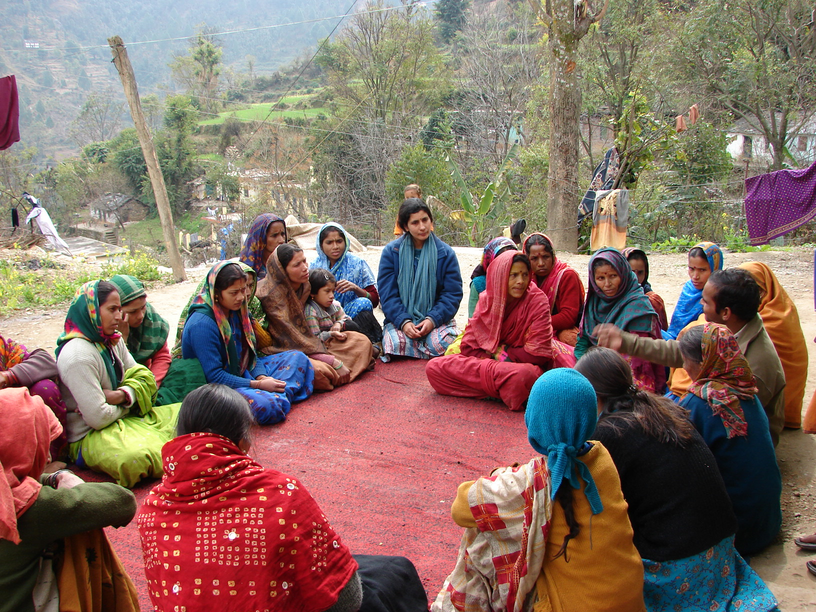

Slide 8
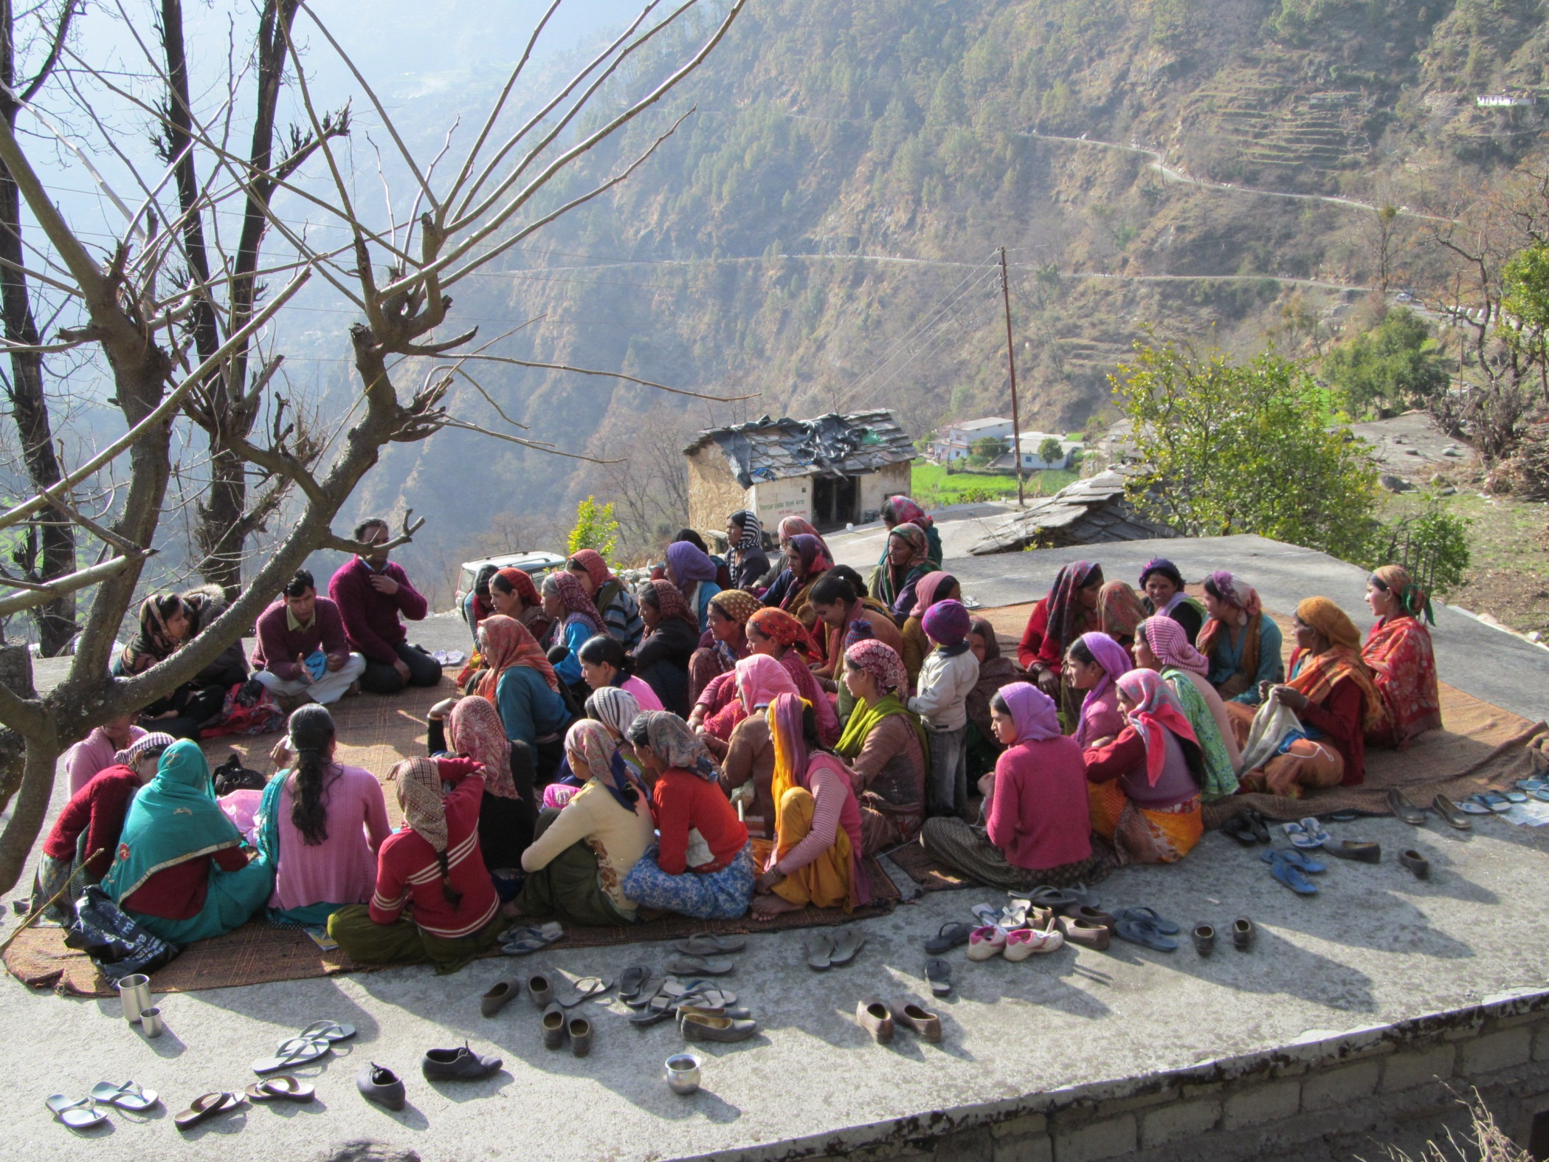

Slide 9
Why balwadis or pre-school education
Remote and difficult of access villages, two decades ago no educational facilities
Male migration to the cities
Women left behind in the village with children and elderly people: sharing multiple responsibilities
Pre-primary education was acceptable to the Government for financial support
Whilst the need for and usefulness of early childhood activities is well accepted and researched by educationists, the need and usefulness of community engagement is less clear.

Slide 10
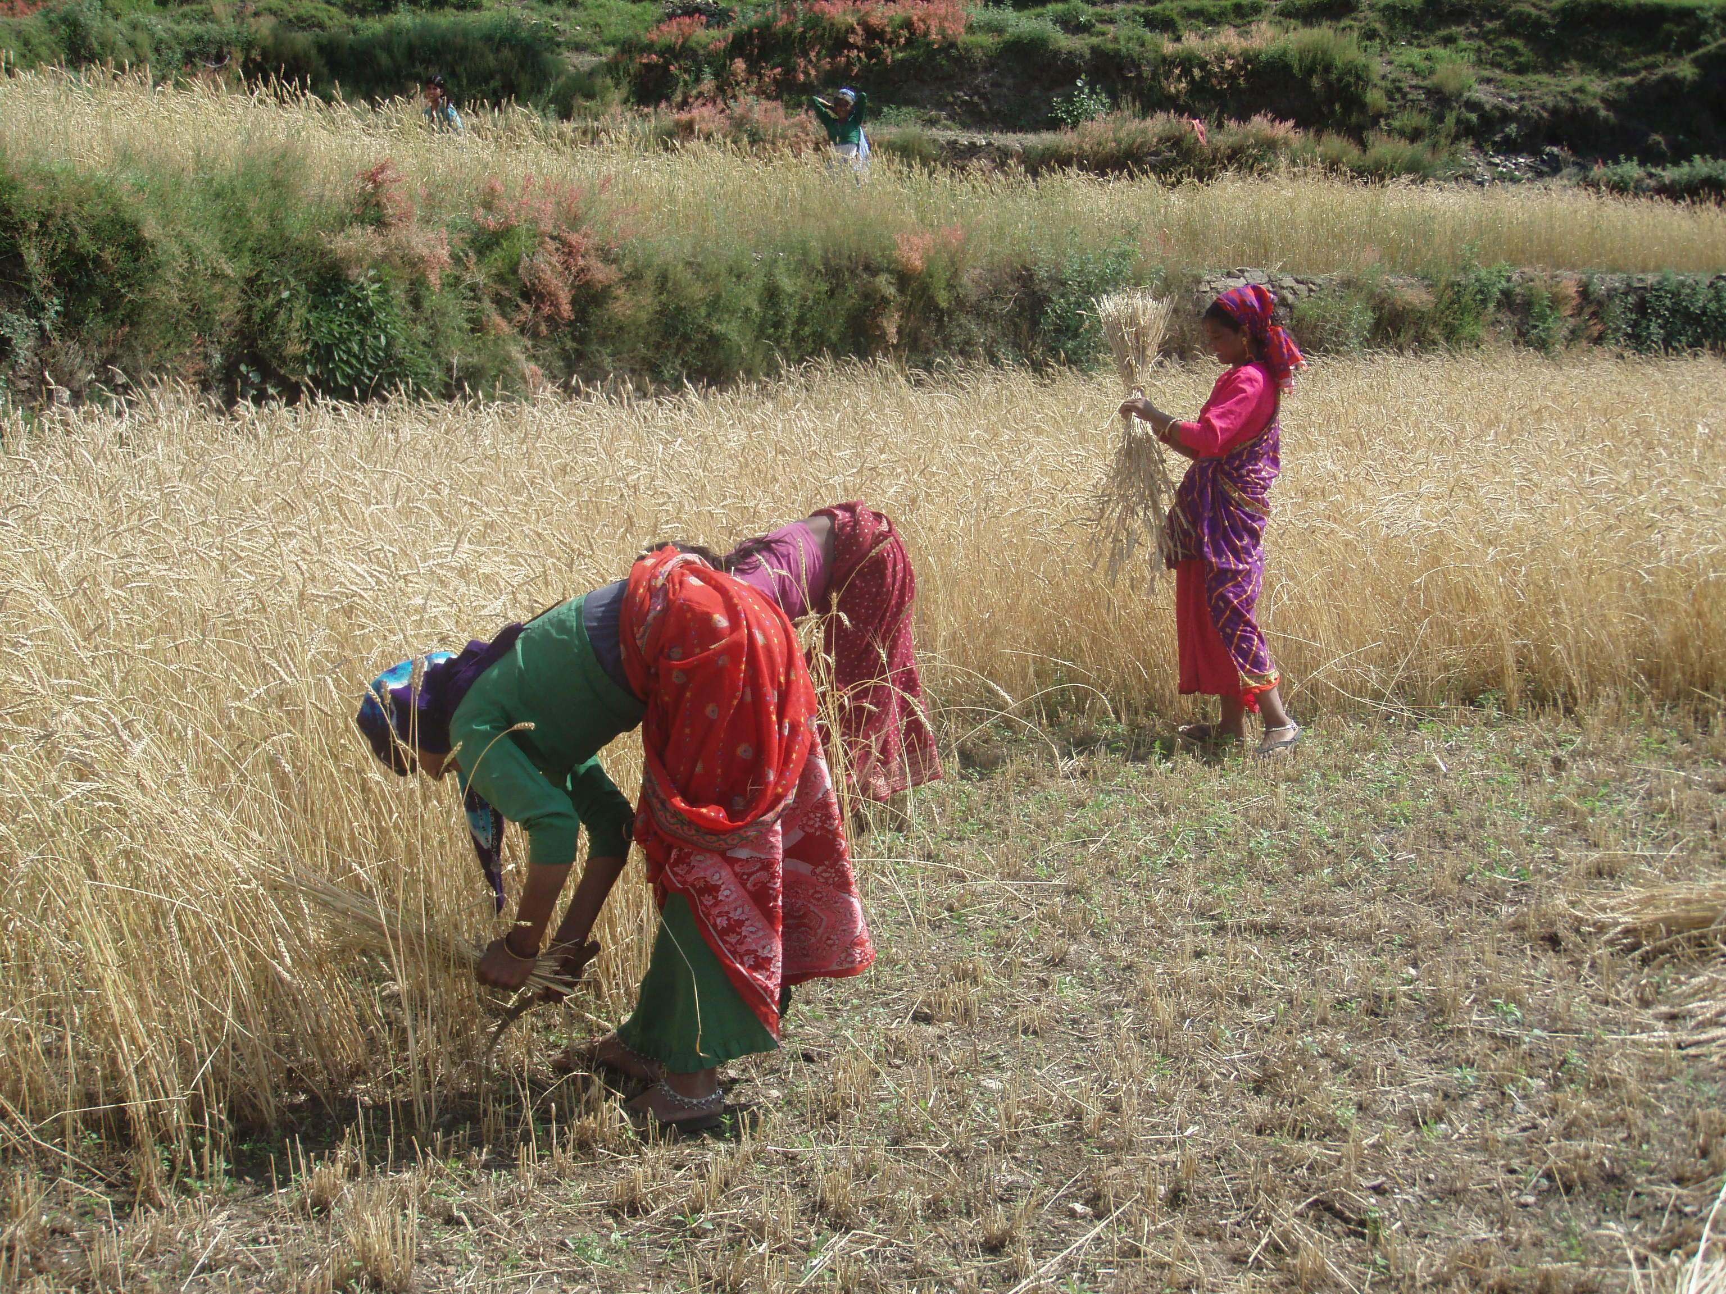

Slide 11
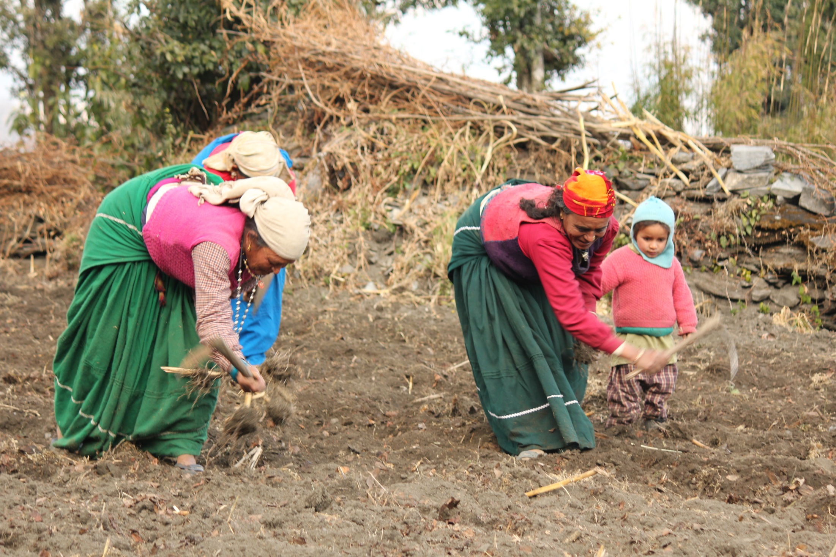

Slide 12
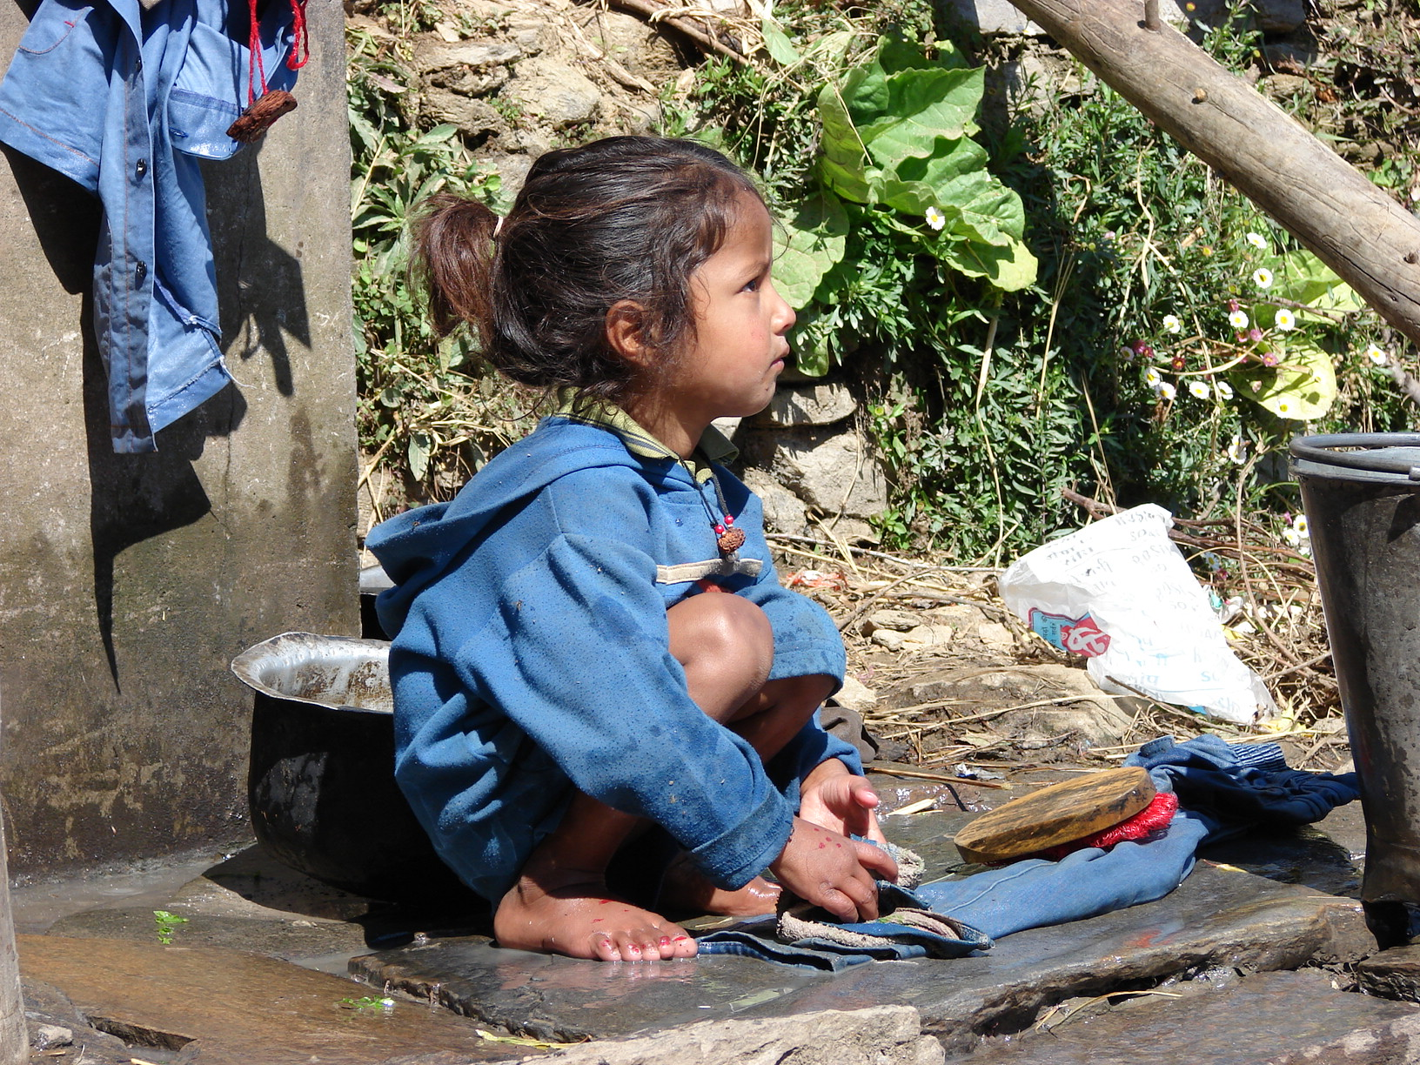

Slide 13
Community participation and ownership of centres
The CBOs, balwadi shikshikas (pre-school teachers), focal point for community mobilization
Selection of shikshikas:
The community itself had to come together to select the shikshika from the village
Shikshikas were, notably, not outsiders with formal background in education
Training/orientations would expose them to play-based learning, and the ways of interacting with communities especially parents and women’s groups
Explaining to them the balwadi programme
Work with parents to ensure the children arrived at school clean
Tiffin from home would be shared and eaten together by all children
Children across caste lines sharing food

Slide 14
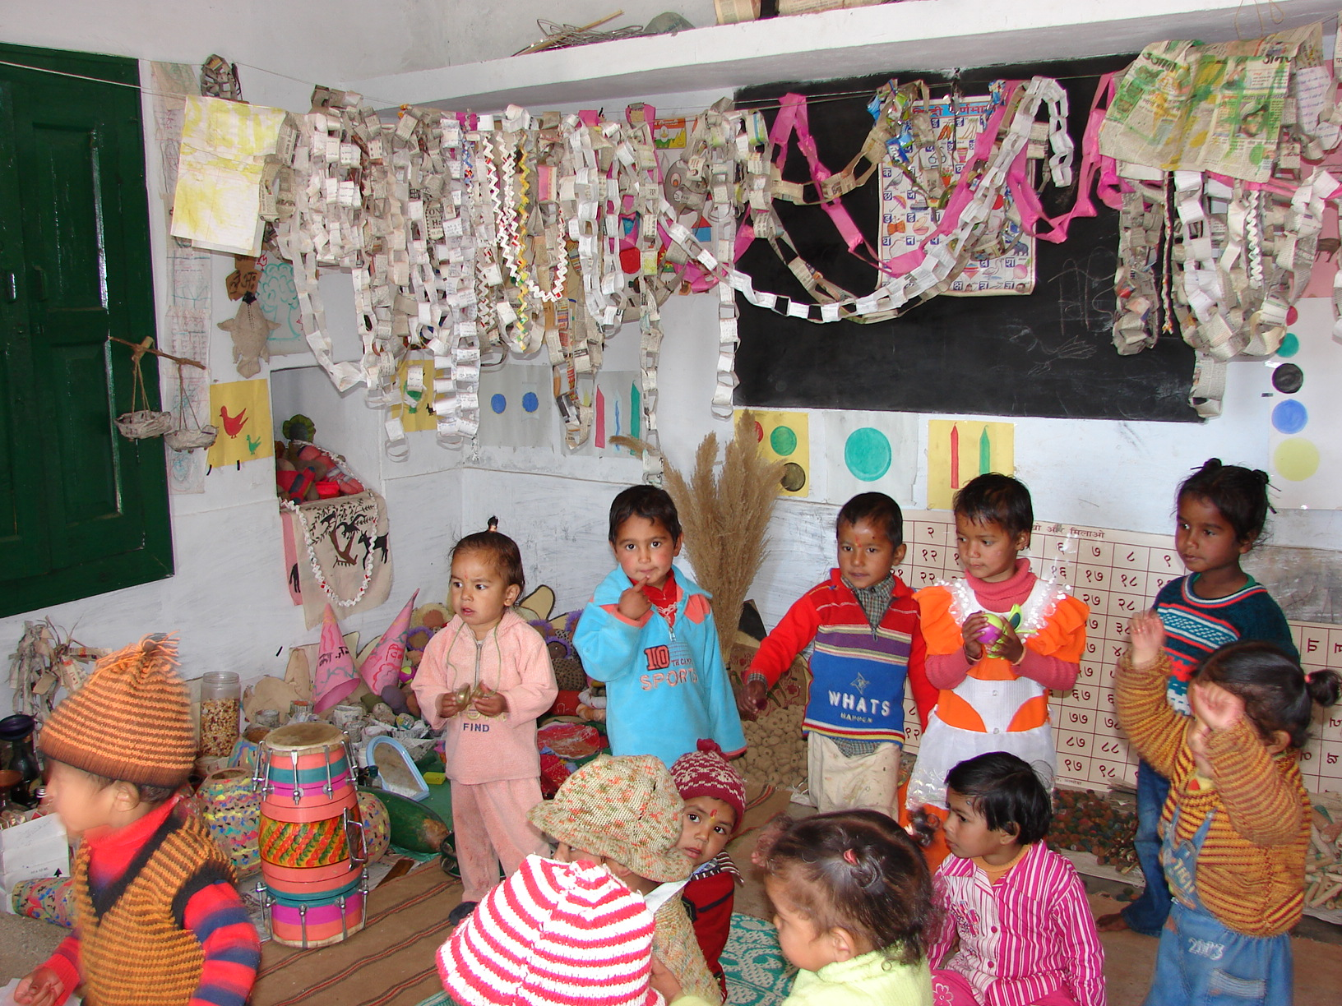

Slide 15
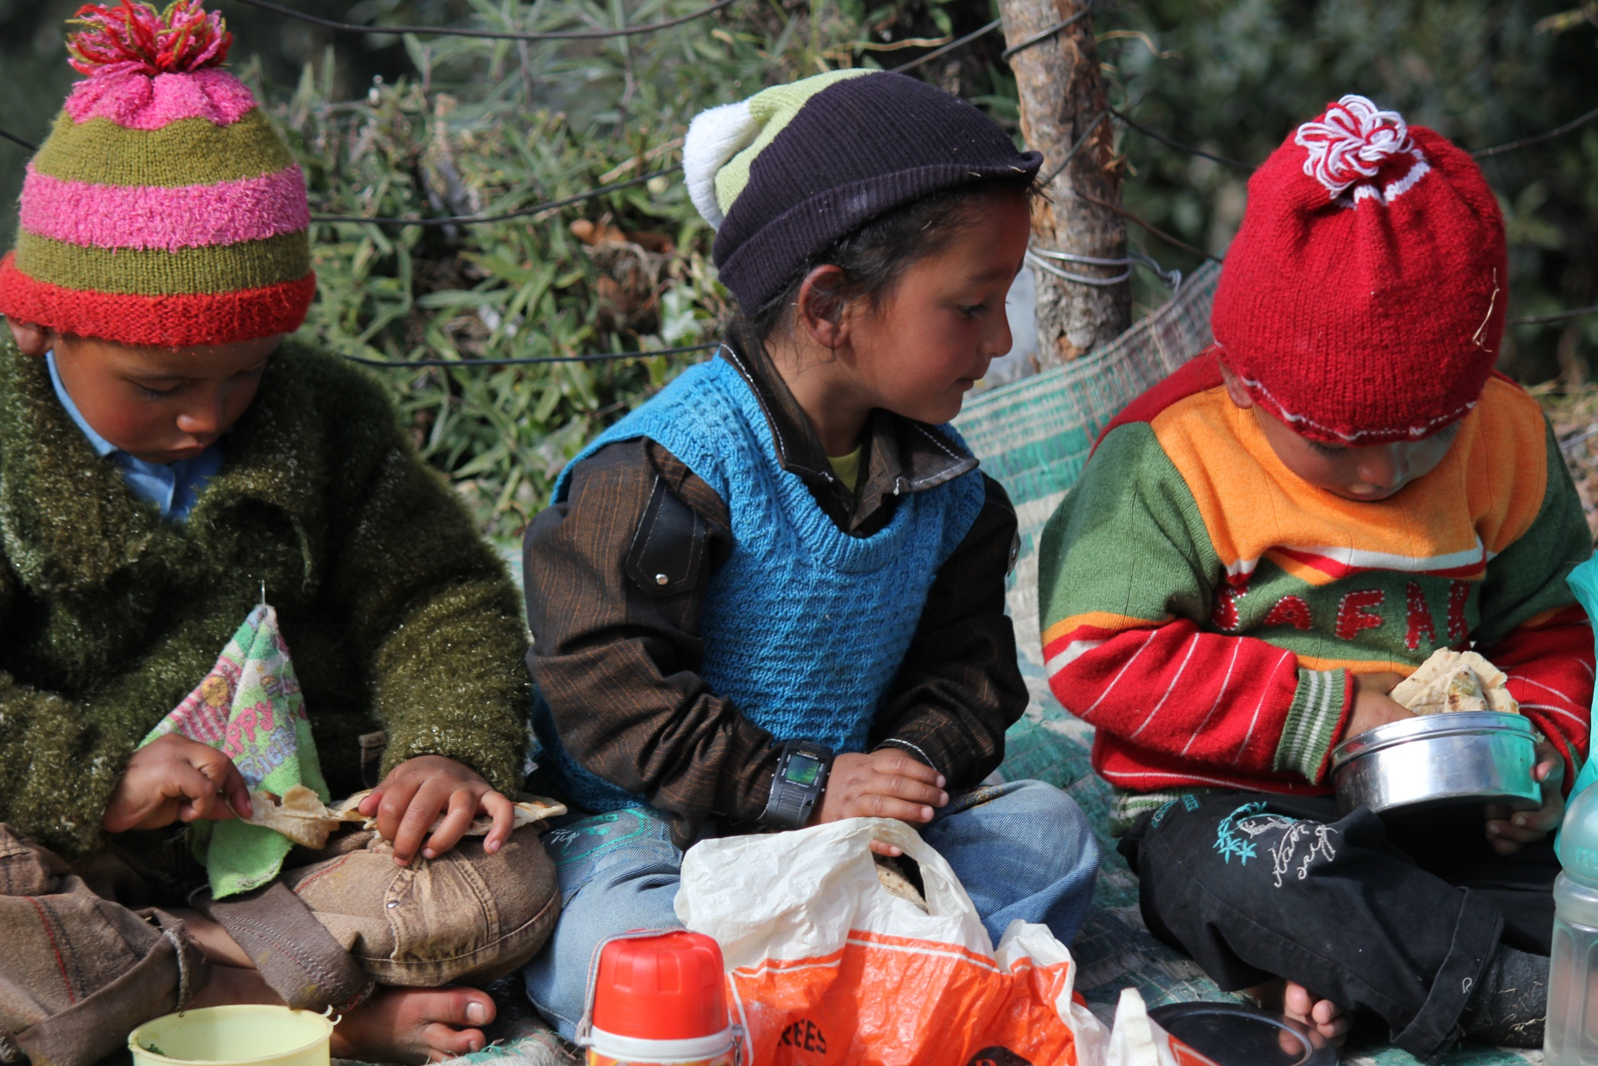

Slide 16
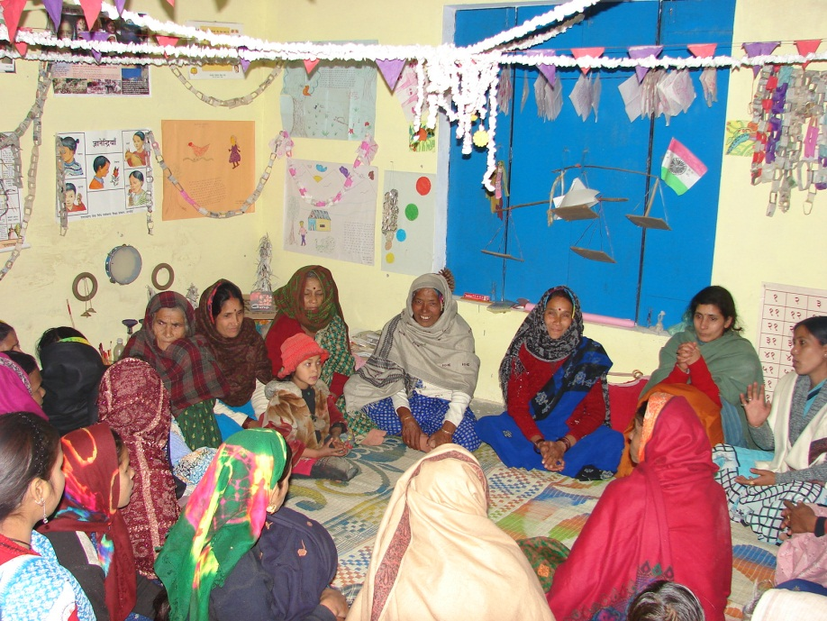
The balwadi teacher had to convene a village group to conduct the day-to-day management and oversight of the balwadis.
Representatives of all households in the village were brought together, whether they had children in the balwadi or not
From the beginning, balwadis and women’s groups were seen as a product of the community and not just the USNPSS (for instance, the community itself had to provide or build the room for the balwadi).

Slide 17
The net effect of the process:
A sense of ownership by the community (in contrast to government interventions) and a first experience in coming together to achieve common goals as a village
Women started meeting and discussing issues related to education for their children and then subsequently they became involved in the everyday functioning, monitoring and maintenance of balwadis
The process laid the foundation for getting together, engaging in dialogue and taking decisions. The balwadi became “theirs”.

Slide 18
The “space” thus provided was used for some action in the village:
Discuss issues that women were concerned about
Natural resources management, installing toilets, health and nutrition, alcoholism among men, activism against mining, government cultivating pine in the forest etc.
By involving all the households (though the level of participation of all may not be the same), the rich and upper caste could not dominate
Negotiations and discussions were time consuming but lead to a more stable and organic growth of community engagement in issues relating to them

Slide 19
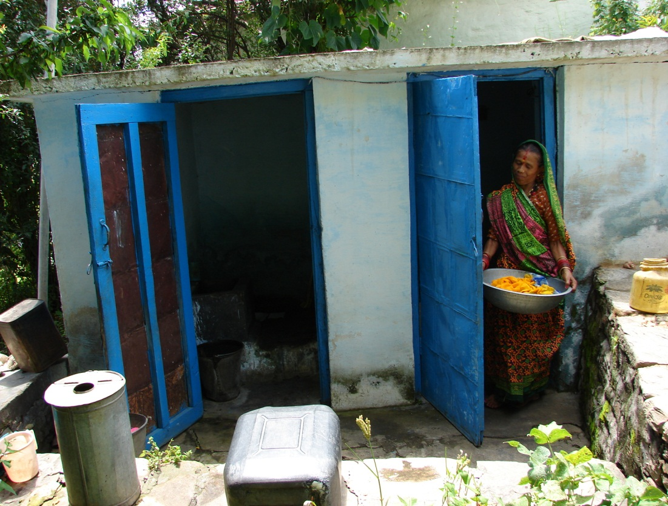
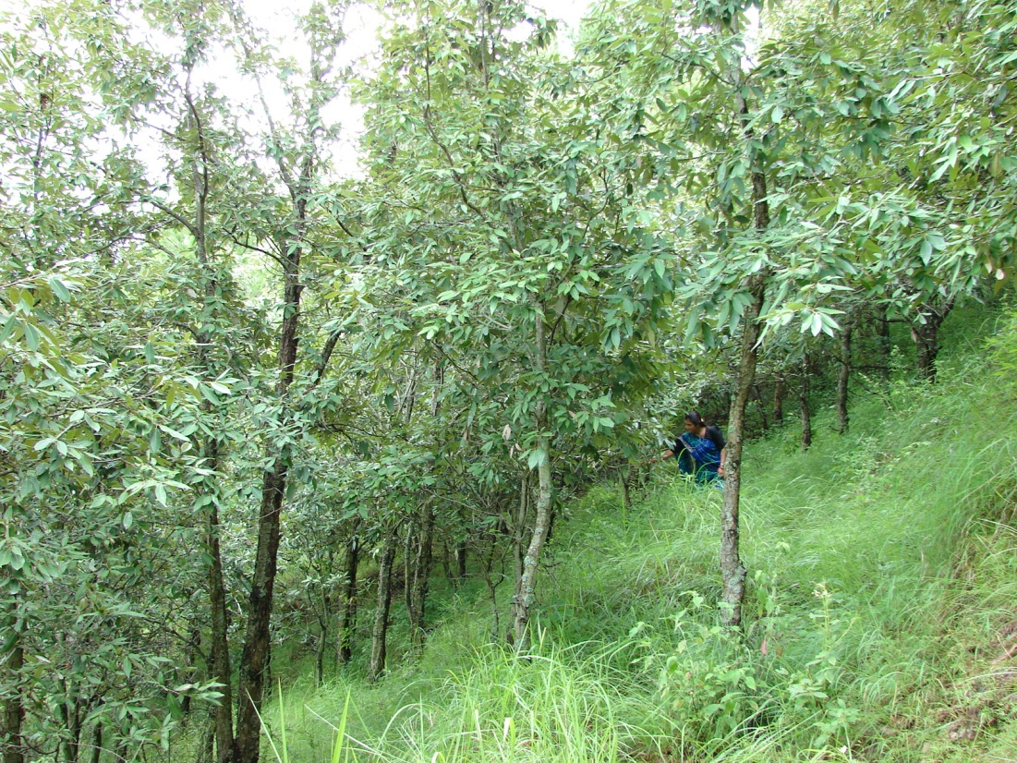
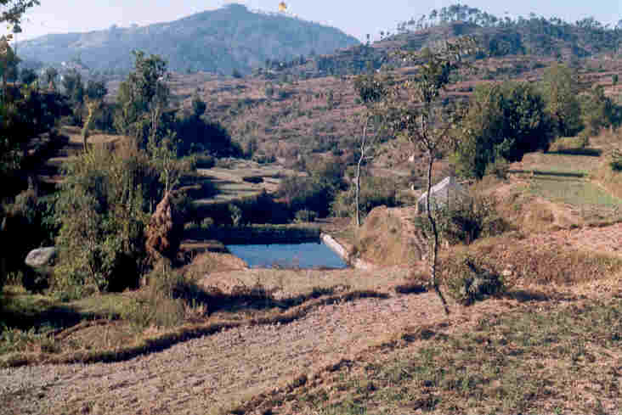
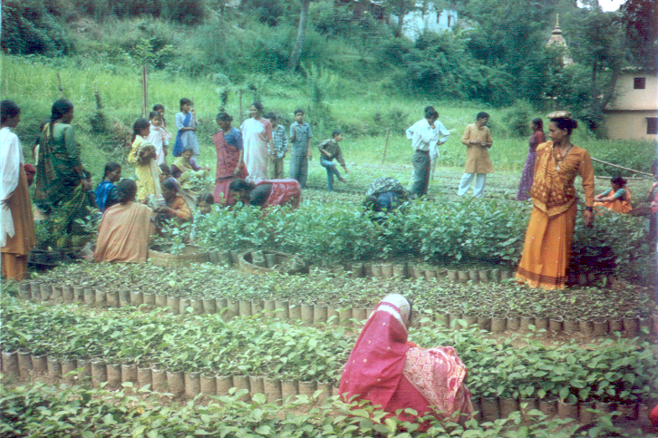

Slide 20
Role of USNPSS:
Act as a facilitator
By reinforcing norms of equality and inclusion through debate and negotiation
By building networks across villages
Supporting each other through conflict and confrontation
Inputs of training and funds
All this was empowering for the community.
Also initiated programmes for older children e.g. evening centres, environmental education in schools, adolescent education

Slide 21
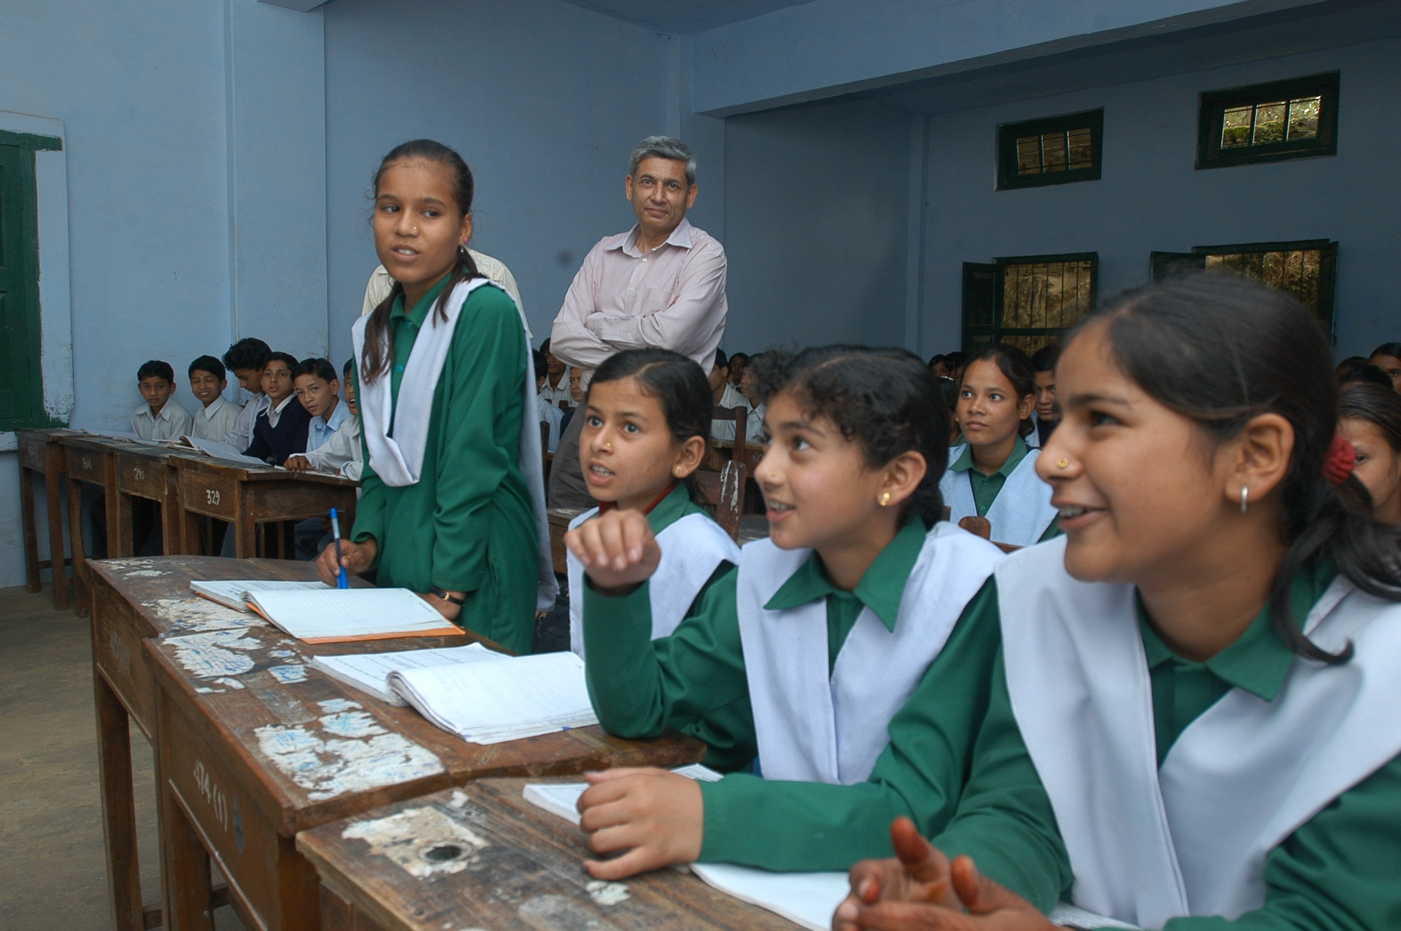

Slide 22
This is not to say that the balwadi per se led to the empowerment of the women in the community, but rather, the engagement of communities in an intervention like the balwadi with real involvement and bottom-up organization allowed capacity building for a variety of self-determined collective activities
The process led to a profound social change in the status of women in society, including their status in their own homes, communities and their own self-image.
Women were now discussing various issues including political empowerment by active roles in the gram sabha and gram panchayat.

Slide 23
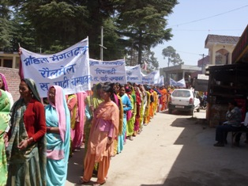

Slide 24
Some benefits of community learning through relationships and networking:
an efficient way to help multiple villages at once
replication occurring through “1000 flowers blooming” model rather than deliberate dissemination
different tactics among participants can inspire questioning and open new perspectives
a way to construct new identities or break down old ones (e.g. caste, patriarchy)
requires enough time for mutual understanding and trust
needs shared values (culture, language) and a commitment for change
Regardless of aims, community learning is a key approach, whether the issue is climate change, literacy, health, political conflict etc.

Slide 25
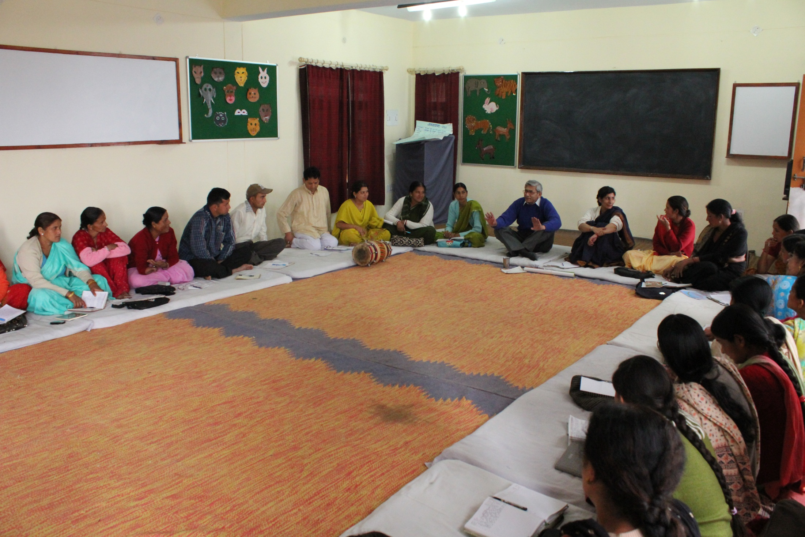

Slide 26
Role of others
(outside community network and USNPSS):
Expertise and funds
but engagement is brief---confined to the project
provision of funds or professional expertise on education or development issues does not necessarily lead to commitment and action
or learning by community
The process should allow enough time for mutual understanding and building of trust: shared values (also culture? language?)

Slide 27
For USNPSS, legitimacy with both outsiders and locals has been a key achievement along with staffing with local/unusual people.
Community needs and response from USNPSS are tightly linked
Empathy and sympathy are part of the way of working
There is solid intellectual content but there is also emotional connect that encourages personal growth
Scale seems to be a by-product, not a goal

Slide 28
Bridging the communications gap between village and government by virtue of an ability to communicate with both in their own languages. This does not mean translations in Pahari (the local dialect), Hindi or English
The gap which we appear to be bridging is a whole way of thinking and action
An organization which is not completely village based, not an expert outsider “doing development”…….but one that connects the two.
Perhaps an ngo (for lack of a better word)…

Slide 29
The role of NGOs perhaps calls for a clearer identity:
NGOs dependent on Government or major donors, foreign and Indian, for funds.
Very few of them are presently working on the basis of demands raised by communities or on their own experiences in working with them
They are less expensive to run than Government departments is obvious- they cannot afford to pay the staff at the same scales as Government
They are possibly more effective in their small scale and limited outreach.

Slide 30
But do they really serve a useful purpose other than
providing part time low paid employment to some people
“agitations” or “protesting” against Government failures in the implementation of its own programmes.
And yet in the existing state of affairs, it would clearly be a mistake to apply the usual economic criteria in their evaluation,
whether positively in respect of their cheapness
or negatively in respect of the small scale of their achievements.

Slide 31
What some NGOs have clearly demonstrated
a people-oriented approach to problem solving
same programmes, which, through government channels, often have to be counted as failures.
success in motivating people to act for the common good
counts far more than the material achievements themselves
as the people gain confidence in their collective abilities
affirm their community solidarity
and feel the road is open for further action.
This view is entirely consistent with the concept of human development.

Slide 32
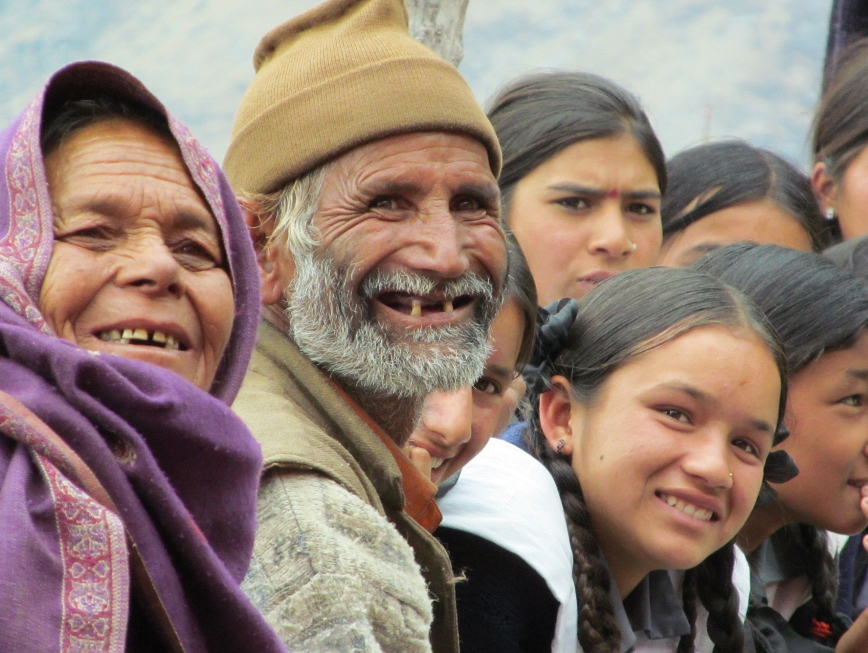

Slide 33
It is not that they do not face hostility or come up against formidable road blocks.
By contrast, the attitude of government departments
and their manner of implementation
are aggravating peasant apathy and leading to cynicism
a most dangerous social symptom especially for a poor country like ours.

Slide 34
Civil society organizations and their contribution to intellectual thought:
Over the last decade or two it is becoming increasingly clear that it is the civil society organizations which are raising ferment in society with new ideas
Academic institutions, which should normally be the center of such activities, seem to have acquired some other role
Very difficult for the state as well as academicians to accept the ideas being generated from outside their own circles
This observation is of great importance because the well-being of a society depends on the generation of honest ideas
I emphasize the word honest because intellectual corruption can be far more debilitating for society than financial corruption.

Slide 35
And finally, where do we stand now
With the universalization of education and ECCE
Doubts about ngos
State being the major and the only implementer
Everyone is trying to ‘change the world’ with ONE solution
Limiting the space for the generation of new ideas, innovative approaches
Leading to the end for people like us…

Slide 36
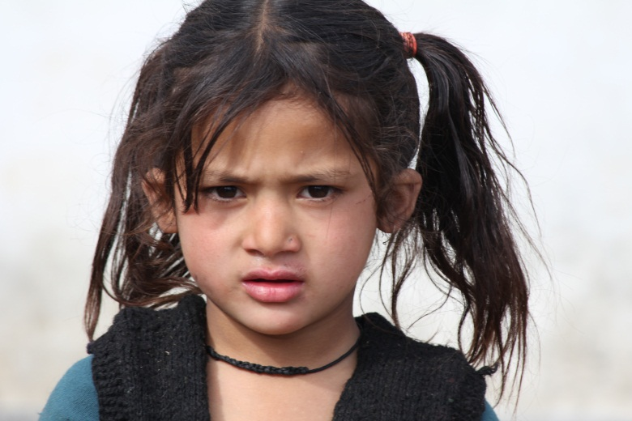
Lalit Pande Uttarakhand Seva Nidhi Paryavaran Shiksha Sansthan Jakhan Devi, Mall Road, Almora, Uttarakhand Tel : +91-5962-234430 Fax : +91-5962-231100 e-mail: usnpss@sancharnet.in; an.lalit@gmail.com url: http://www.ueec.org.in
Thank You
Presented by

