Slide 1


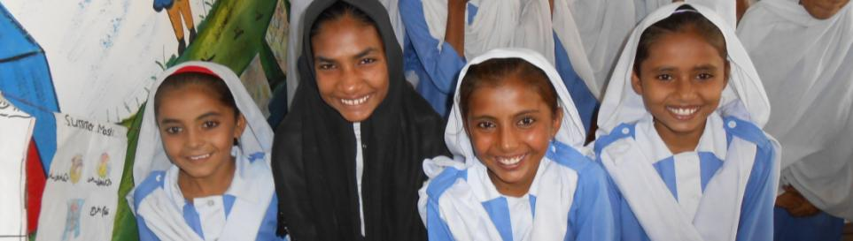
Progress Updates
November , 2012
CHILDREN, ESPECIALLY GIRLS
AGED 2-12 HAVE ACCESS TO
QUALITY EDUCATION
WITH IMPROVED INFRASTRUCTURE AND
SAFE LEARNING ENVIRONMENT

Slide 2
Division of Presentation
Part I - Scope of Dubai Cares Funds, Components and Geographical Focus
Part II- Policy Environment : national – provincial – Punjab and Sindh
Part III- Progress by Components
Part IV- Opportunities/Synergies Challenges and Way Forward

Slide 3
Part I -
Scope of
Dubai Cares Funds, Components and Geographical Focus

Slide 4
Funds, Duration & Components
Funds Allocated: US $ 1,635,001
Date of operation: April, 2011 – June 30, 2013
Proposed duration of operation: 27-30 months
Component I
School Rehabilitation
Component II
Back to School Kits
Component III
ECD Day Care Centre

Slide 5
Project Summary Grid
Province | Districts | Component I School Rehabilitation |  |  | Component II Back to School Kits |  | Component III ECD Day Care Centre
 |  | WSIP* Schools w/const. | WSIP Schools w/o const. | Catch Up Program for Out of School Children | WSIP with School Support | Children’s Uniform School Kits | ECD Day Care Centres
Sindh | Shikarpur | 20 | 85 | 200 |  | 1000 | 4
Punjab | Multan | 20** | -- | 1000 | **
 | Rahim Yar Khan | 10 | 60 | 200 |  | 1000 | 4
 | Muzaffargarh | 20 | 85 | 200 |  | 1000 | 7
TOTAL |  | 70 | 230 | 1600 | -- | 3000 | 15
Total Schools = 300 |  | 300 |  | -- |  | -
Total Beneficiaries |  | Students = 75,000 WSIP = 70,000 OOSC= 1,600 ECD= 3,000-4,000 |  | Head Teachers = 300 Teachers = 1100 LHWs /Para Ts. = 500 |  | SMCs = 600-900/3000 Mothers = 3000-4500 Community= 335,000-500,000
*Whole School Improvement Program, ** 20 Schools with minor repairs shifted to WSIP Schools w/Const.

Slide 6
Beneficiaries Reached
Beneficiaries | Planned Numbers | Reached So Far
Children (6 months – 12 years) | 75,000 (60% Girls) | 64, 860
Head Teachers | 300 | 302
Teachers/Para/LHWs | 1200 / 1500 | 1,354
Mothers | 3,000 – 4,000 | 1,200
School Councils /SMCs | 600-900 / 3000* | 600 / 2,240
Community Members | 335,000 – 500,000 | 422,239
* From each SC/SMC 2-3 members are being trained out of average 07 members

Slide 7
Budget and Expenditure Summary
Budget Head | Total Project Budget | Cumulative Expenditures till October 2012 | Remaining Budget | Projected Expenses till June 2013 | Under spent /(Overspent ) till June 30, 2012
Component 1
i. School repair construction & Furniture | 670,719/- | 455,666/- | 215,053/- | 215,053/- | Nil
ii. Remaining Heads (Cumulative) | 605,882/- | 400,000/- | 205,882/- | 205,882/- | Nil
Total Component 1 | 1,276,601/- | 855,666/- | 420,935 | 420,935 | Nil
Component 2 | 120,000/- | 45,238/- | 74,762/- | 74,762/- | Nil
Component 3 | 237,844/- | 122,122/- | 115,722/- | 115,722/- | Nil
Grand Total | 1,622,904/- | 1,023,026/- | 599,878/- | 599,878/- | Nil
Percentage Utilization |  | 63% |  | 100%

Slide 8
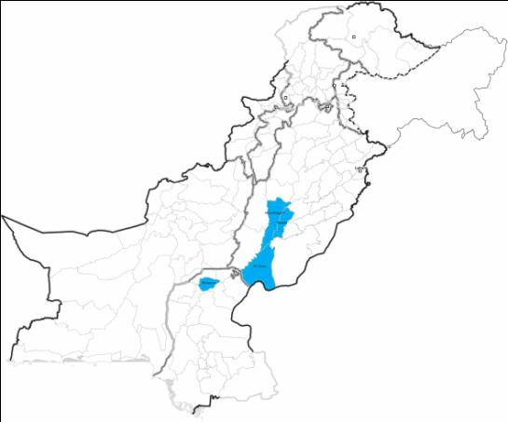
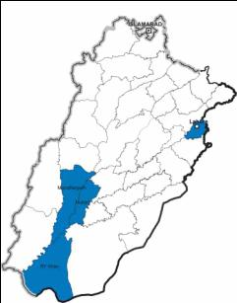
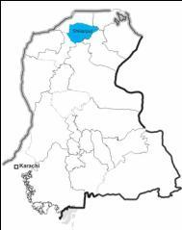
Project Mapping
Provinces & Districts
Punjab
Pakistan
Target Districts
Multan
Muzaffargarh
Rahim Yar Khan
Shikarpur
Jalalpur Pirwala
Kot Adu
Zahirpir
Sindh
Shikarpur

Slide 9
Part II -
Policy Environment –
National & Provincial
Punjab and Sindh

Slide 10
National
After the 18th amendment in the constitution of Pakistan, in April 2010 education has been devolved entirely to the provinces.
Policy, Curriculum, Language, Standards, Textbooks, Teacher Training; Learning Outcomes ; Financing etc.
Article 25-A requires that the State shall provide free and compulsory education to all the children of the age of five to sixteen years.
Law for 25 -A only developed at the Islamabad Capital Territory (ICT) still to be passed by the lower house or the National Assembly

Slide 11
Islamabad Declaration Sept 16, 2011
A National Education Conference at the Prime Minister Secretariat in Islamabad. Presided by the PM and attended by the Governor of Khyber Pakhtunkhwa (KPk), Chief Ministers of Punjab, Sindh, KPK and Balochistan, the Prime Minister of AJ&K, provincial education ministers, Federal Minister of Finance, Deputy Chairman of the Planning Commission, senior education officials and representatives of key educational institutions.
A ‘Joint Declaration on Education’, signed by PM & provincial authorities,
(i) The Federal and Provincial Governments reaffirm their commitment to Education as a priority;
(ii) National Education Policy 2009, subject to such adaptations as are necessitated in view of the 18th Constitutional Amendment, shall continue to be a jointly owned national document;
(iii) Education is a fundamental right of all children aged 5-16, guaranteed through Article 25A of the Constitution of the Islamic Republic of Pakistan
(iv) Each province/area shall develop an Action Plan which shall commit to appropriately raising allocations for education, set priorities according to provincial needs of access and quality of education and provide implementation strategies/processes with time frame and key indicators; ensuring fulfillment of constitutional needs with respect to education and meet the international commitments including targets of the MDGs & EFA

Slide 12
Punjab
Punjab Government: Road Map To Reforms – led by the Chief Minister
  Every child enrols in school
  Every child is retained in school
  Every child learns and makes progress
Using ASER 2011 Benchmark Data
DFID- Mc Kinsey providing Technical & Budgetary Support
Donors: World Bank; DFID; CIDA; UNICEF; Dubai Cares
Implementers: Plan, Save the Children; ITA; Oxfam; BLCC

Slide 13
Most out-of-school children are in the Rural-South
Enrolment for children aged 5-9
Jhelum
Chakwal
Sialkot
Rawalpindi
Gujranwala
150,000 out of school children
Attock
Rawalpindi
Narowal
Chakwal
Jhelum
Attock
Mianwali
Gujrat
Gujrat
M.B. Din
Lahore
Sargodha
Sialkot
M.B Din
Khushab
Hafizabad
Gujranwala
Narowal
Hafizabad
Bhakkar
Chiniot
Nankana
Sahib
Shekhupura
Toba tek singh
Lahore
Faisalabad
Jhang
Faisalabad
Kasur
Layyah
T.T.
Singh
Kasur
Nankana sahib
350,000 out of school children
Okara
Khushab
D.G. Khan
Muzaffargarh
Khanewal
Sahiwal
Pakpattan
Okara
Jhang
Vehari
Sheikhupura
Multan
Lodhran
Sargodha
Bahawalnagar
Mianwali
Rajanpur
Bhakkar
Bahawalpur
Khanewal
Chiniot
300,000 out of school children
Rahimyar Khan
Multan
Sahiwal
Pakpattan
Vehari
Layyah
Above 90%
Bahawalnagar
85-90%
Muzaffargarh
Bahawalpur
500,000 out of school children
80-84%
D.G. Khan
Lodhran
Below 80%
Rahimyar Khan
Rajanpur
SOURCE: Oct-Nov 2011 Nielsen household survey

Slide 14
Sindh
Sindh Government : Developing an Education Sector Plan (ESP) - Funded by Global Partnership for Education – GPE – 13 thematic groups (SESP) ITA in 4 of them
Donors:
  World Bank; EU; USAID; DFID; UNICEF; Dubai Cares
Implementers:
  Save the Children;TRC; Hands; ITA; OXFAM; IRC

Slide 15
What is GPE?
Global Partnership for Education (GPE) a multilateral partnership devoted to getting all children into school for quality education
GPE’s mission is to support countries in achieving the EFA goals:
Expanding early childhood care and education
2. Providing free and compulsory primary education
3. Promoting learning and life skills for young people
4. Improving learning and life skills for adults
5. Achieving gender parity and gender equality
6. Improving the quality of education
GPE has provided an indicative grant allocation for Sindh, an amount of US$ 65.9 million for which Sindh has constituted
  A Local Education Group (LEG)
  Is developing a 3 year education sector plan (katchi- class 12)
  Preparing a GPE grant design

Slide 16
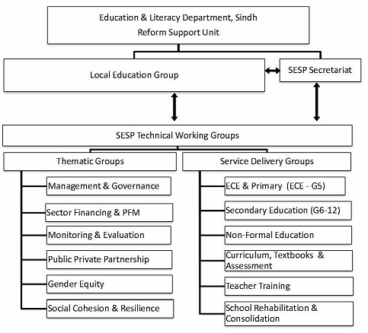
SESP Planning Structure

Slide 17

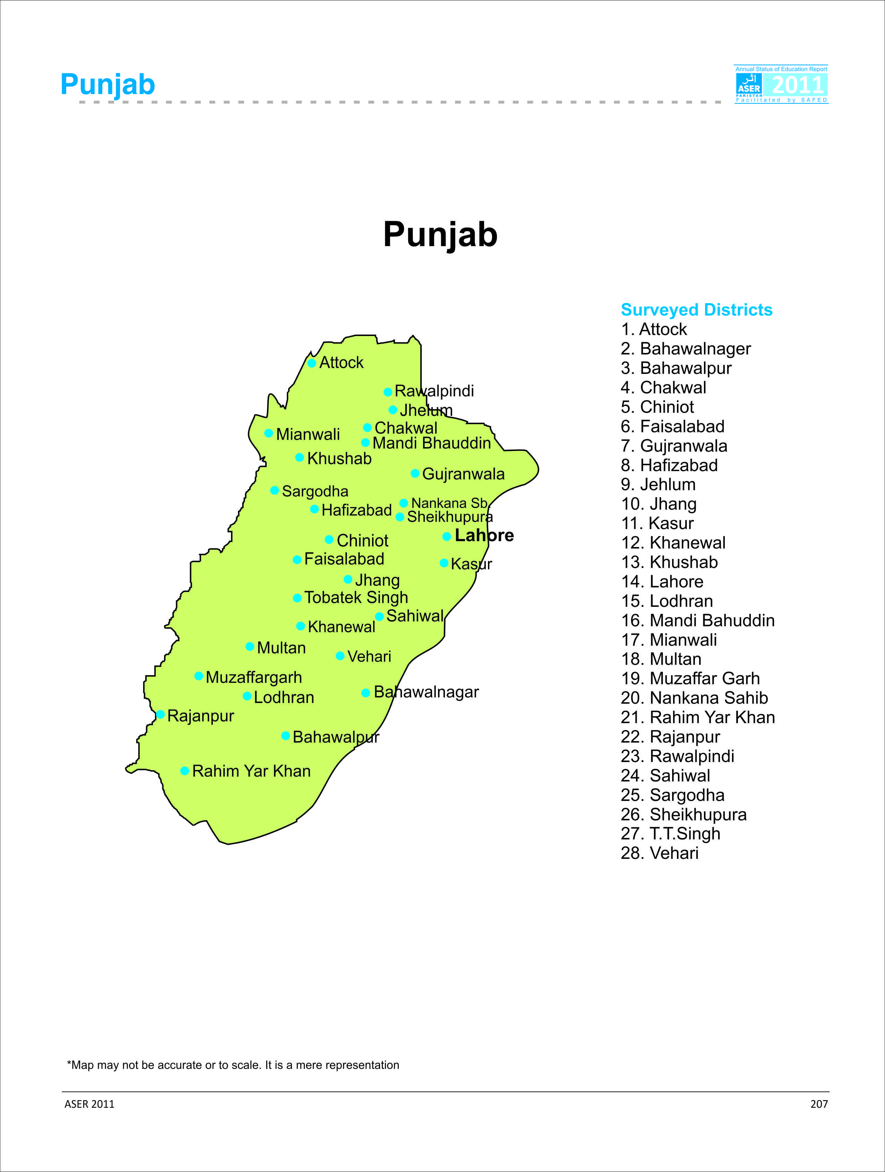
ASER 2011 - Punjab
28 Districts Surveyed in Punjab
ASER 2011 Districts | Literacy Rank** | ASER 2011 Districts | Literacy Rank **
Rajanpur | 37 | Khushab | 18
Muzaffar Garh | 36 | Multan | 17
Chiniot* | 33 | Mianwali * | 16
Lodhran | 32 | Nankana Sahib * | 14
Rahim Yar Khan * | 31 | Attock * | 13
Bahawalpur | 29 | Mandi Bahuddin | 12
Bahawalnager | 28 | Sheikhupura | 11
Jhang * | 26 | Faisalabad * | 10
Khanewal * | 25 | T.T.Singh * | 8
Vehari | 23 | Gujranwala | 6
Hafizabad | 22 | Jehlum | 5
Kasur * | 21 | Chakwal* | 4
Sahiwal | 20 | Lahore * | 3
Sargodha* | 19 | Rawalpindi* | 2
** Source: PSLM Pakistan 2010-2011
15 districts with * were surveyed in 2010 as well.

Slide 18
Key Findings ASER 2011 - Punjab
16% Children out of school aged 5-16 years old
85% teachers attend government schools
81% students attend Government schools
Almost 39% children in class 5 will graduate without class 2 level competencies in
Urdu , 49% in English and 54% Arithmetic
Girls access and learning lower than boys
tuition centres /shadow schooling in public sector(16%) & private sector (30% )
Missing facilities persist particularly In Primary schools:
Toilets ( 30%) , Drinking Water, (20%), Boundary Walls (24%)
Mothers literacy highly correlated with children’s access and learning ..
in Punjab (30 %)

Slide 19

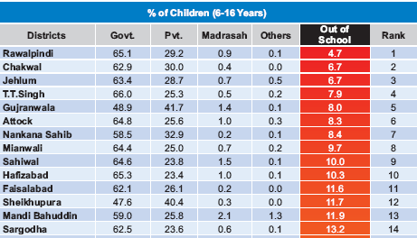

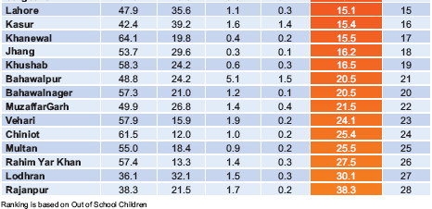
District Wise Enrollment
Among the 28 districts surveyed, Rajanpur has the highest number of out-of-school children (38%), followed by Lodhran.
Rawalpindi has the lowest number of out-of-school children (4.7%)

Slide 20
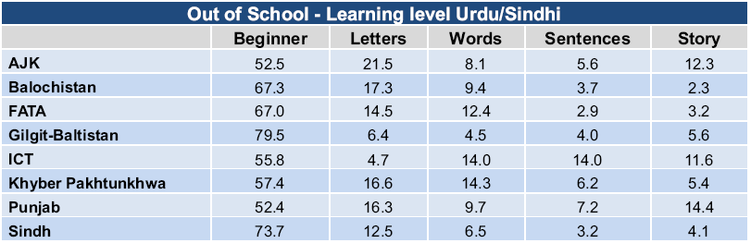
Learning Levels for Out of School
Children in Punjab
14% of out-of-school children could read a sentence in Urdu.

Slide 21
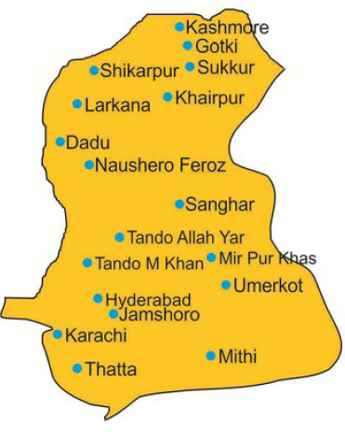
18 Districts (17 Rural + 1 Urban)
Surveyed in Sindh
ASER 2011 Districts (17/23) | Literacy Rank**
Thatta | 22
Tando Muhd Khan | 21
Kashmore | 20
Mithi* | 18
Umerkot* | 17
Ghotki* | 15
Jamshoro | 13
Tando Allah Yar | 12
Shikarpur | 11
Larkana | 9
Khairpur* | 8
Sanghar | 7
Mirpurkhas* | 6
Nowshero Feroze | 5
Sukkur* | 4
Dadu | 3
Hyderabad | 2
Karachi | 1
* 6 districts were surveyed in 2010 as well.
** Source: PSLM Pakistan 2010-2011

Slide 22
Key Findings ASER 2011 - Sindh
30% Children out of school aged 5-16 years old
85% teachers attend government schools
62% students attend Government schools
Almost 59% children in class 5 will graduate without class 2 level competencies in
Urdu /Sindhi, 80% in English and 76% Arithmetic
Girls access and learning lower than boys
tuition centres /shadow schooling in public sector(3%) & private sector (18% )
Missing facilities persist particularly In Primary schools:
Toilets ( 67%) , Drinking Water, (52%), Boundary Walls (31%)
Mothers literacy highly correlated with children’s access and learning ..
in Sindh (only 26 % Literate Mothers)

Slide 23
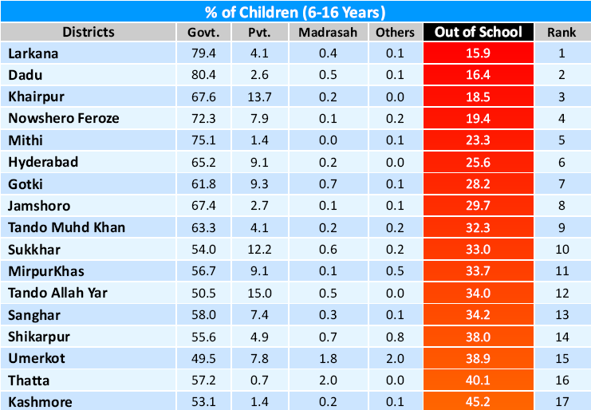
District Wise Enrollment
Among the 17 districts surveyed, Kashmore has the highest number of out-of-school children (45%), followed by Thatta.
Larkana has the lowest number of out-of-school children (16%)

Slide 24
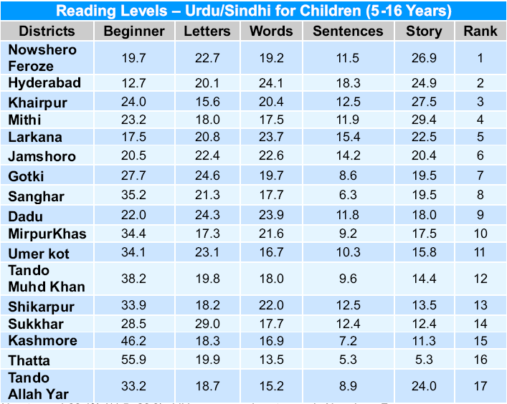
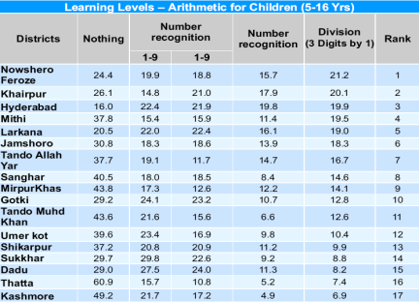
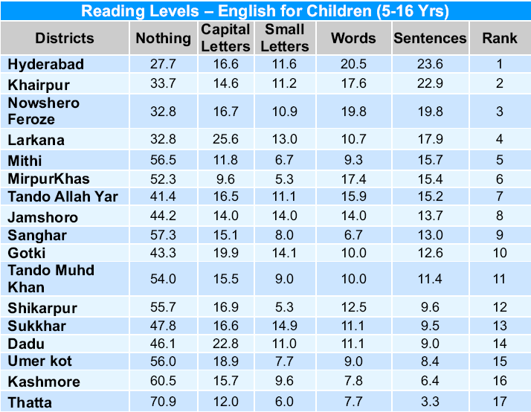
Learning levels
NowsheroFeroze ranks highest in Reading Levels (Urdu/Sindhi) and Arithmetic level
The consistently better districts in all three subjects include
  NowsheroFeroze
  Hyderabad
The consistently worse districts include
  Kashmore
  Thatta

Slide 25
Part III
Progress by Components

Slide 26
Component 1: School Rehabilitation :
As part of Comprehensive WSIP
Outcome 1: Children have access to improved infrastructure and safe learning environment
Output 1.1: Physical rehabilitation of 50 girls’ primary schools
Output 1.2 50 schools are supplied with learning materials, furniture and para teachers
Outcome 2: Issues relating quality of education are addressed
Output 2.1 300 schools, teachers and school councils provided quality inputs for learning, ECE, DRR, hygiene, life skills and environmental education
Output 2.2 Health/WASH / Enrichment programs
Outcome 3: Catch Up Program for out of school children
Output 3.1 Catch up program for 1000 vulnerable children 8-12 in afternoons
1A
1B

Slide 27
Interventions & Inputs for WSIP
School Re-construction /Repair
Furniture
Learning materials : ECE to Primary School Kits
Para teachers where needed
Training: Subject Content Areas, ECE, School Health & Hygiene, DRR & CFS
School Enrichment Program
Reading Clubs Health Clubs
Summer Schools, Girls Clubs
School Councils (SCs)/SMCs Strengthening & DRR
On-Site School Support by Field Staff (Education Promoters)
Research & Tracking Learning

Slide 28
Enrollment Trend
Sr. # | District | # of Schools | Baseline Enrolment | Current Enrolment | Change in Enrollment | % Change
1 | Multan – JPPW | 21 | 2,648 | 2,997 | 349 | 13%
2 | Muzaffargarh - Kot Adu | 106 | 20,330 | 22,705 | 2,375 | 12%
3 | Rahim Yar Khan - Zahir pir | 70 | 9,749 | 12,401 | 2,652 | 27%
4 | Shikarpur | 105 | 13,982 | 18,225 | 4,243 | 30%
 | Total | 302 | 46, 709 | 56, 328 | 9,619 | 21%

Slide 29
School Rehabilitation
Kot Adu - Muzaffargarh
Construction completed in 06 Schools and furniture provided
Construction work in progress in all 14 Schools
Zahir Pir - Rahim Yar Khan
Construction completed in 05 Schools and furniture provided
Construction work in progress in all 05 Schools
Shikarpur
Construction work in progress in all 20 Schools

Slide 30
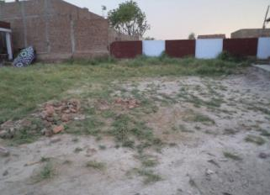
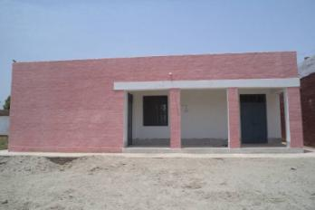
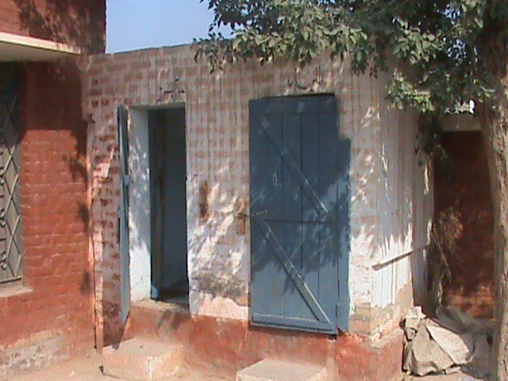
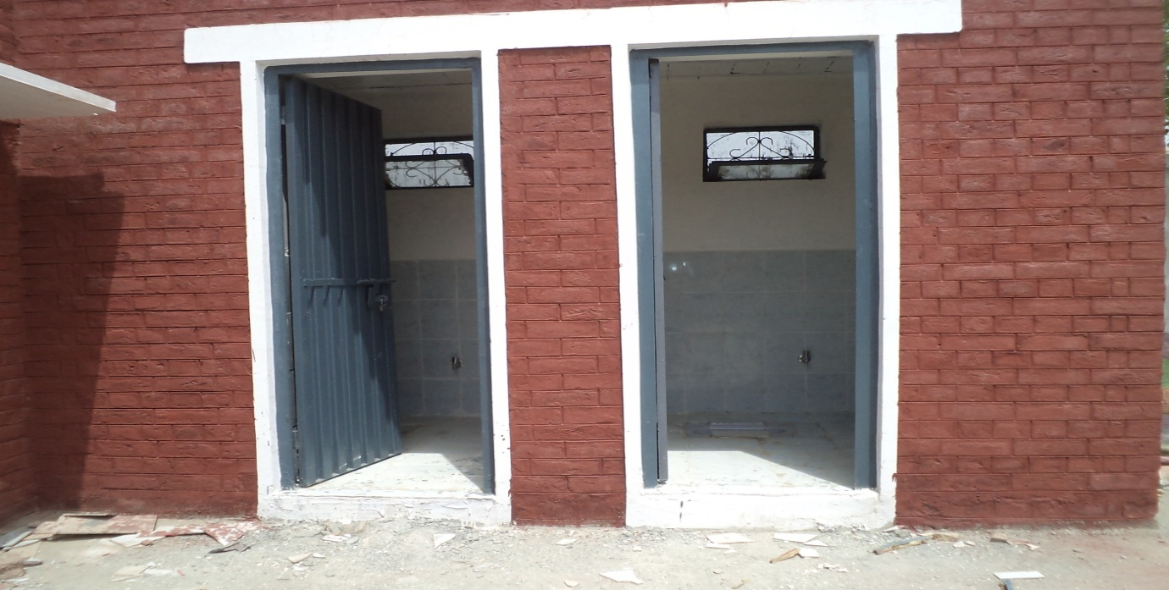
New Room
Pre-Construction
Post Construction
GGHSS Zahir Pir R Y Khan
Toilet
GGPS Hoot Wala Kot Adu

Slide 31
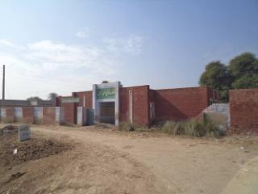
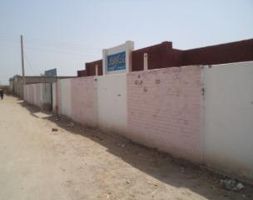
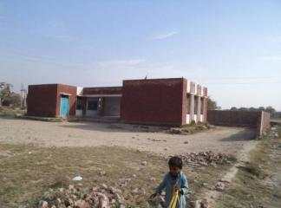
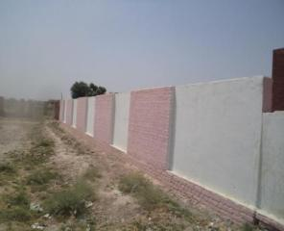
Boundary Wall
Pre-Construction
Post Construction
GGPS Jam Majeed (Zahirpir)
GGPS Abdullah Khan (Zahirpir)

Slide 32
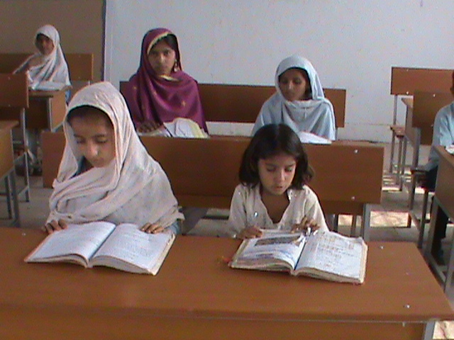
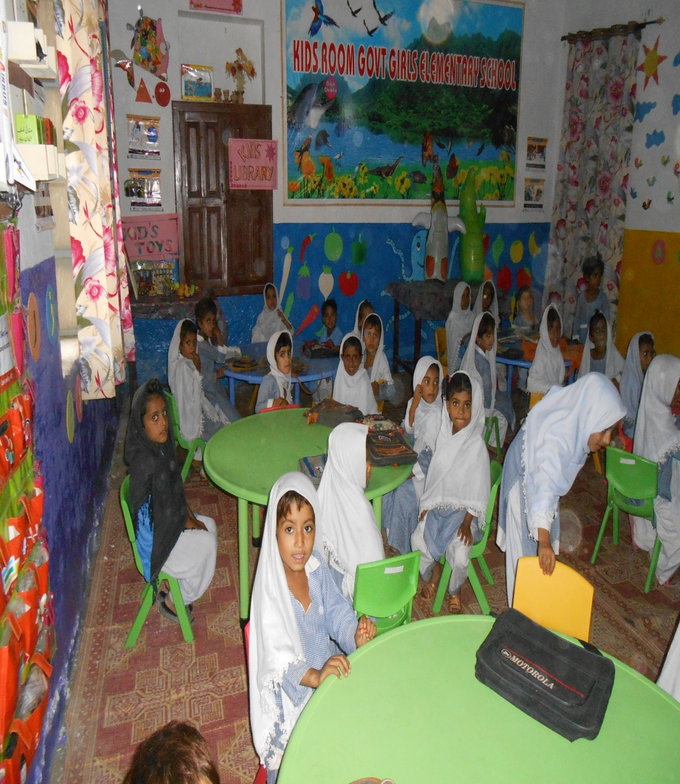
Provision of Furniture

Slide 33
Provision of Para Teachers in Partner Schools
District | Number of Para Teachers Provided | Number of Schools Provided with Para Teachers
Shikarpur | 22 | 22
Zahirpir | 40 | 40
Kot Adu | 40 | 35
Jalalpurpirwala | 12 | 11
Total | 114 | 108
Note: Provision is for 100 teachers in 50 Schools

Slide 34
Teaching Learning Material
School Learning Kit | Distribution
Science Kit | 70 (50 + 20) Partner Schools with Construction
Reading Kit | All 300 Partner Schools
Health Kit
Sports Kit
ECE Kit

Slide 35
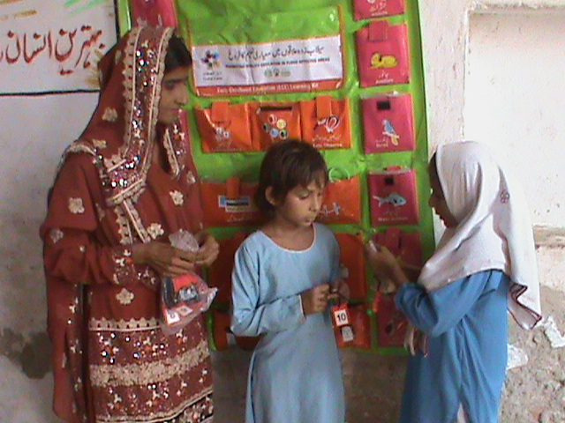
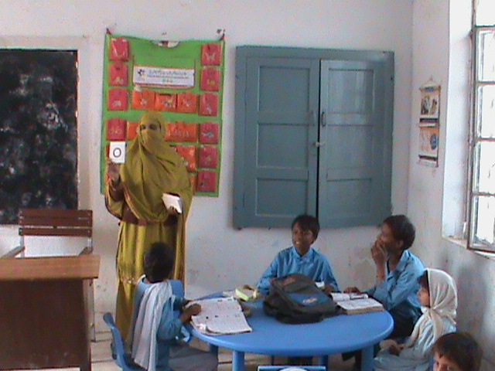
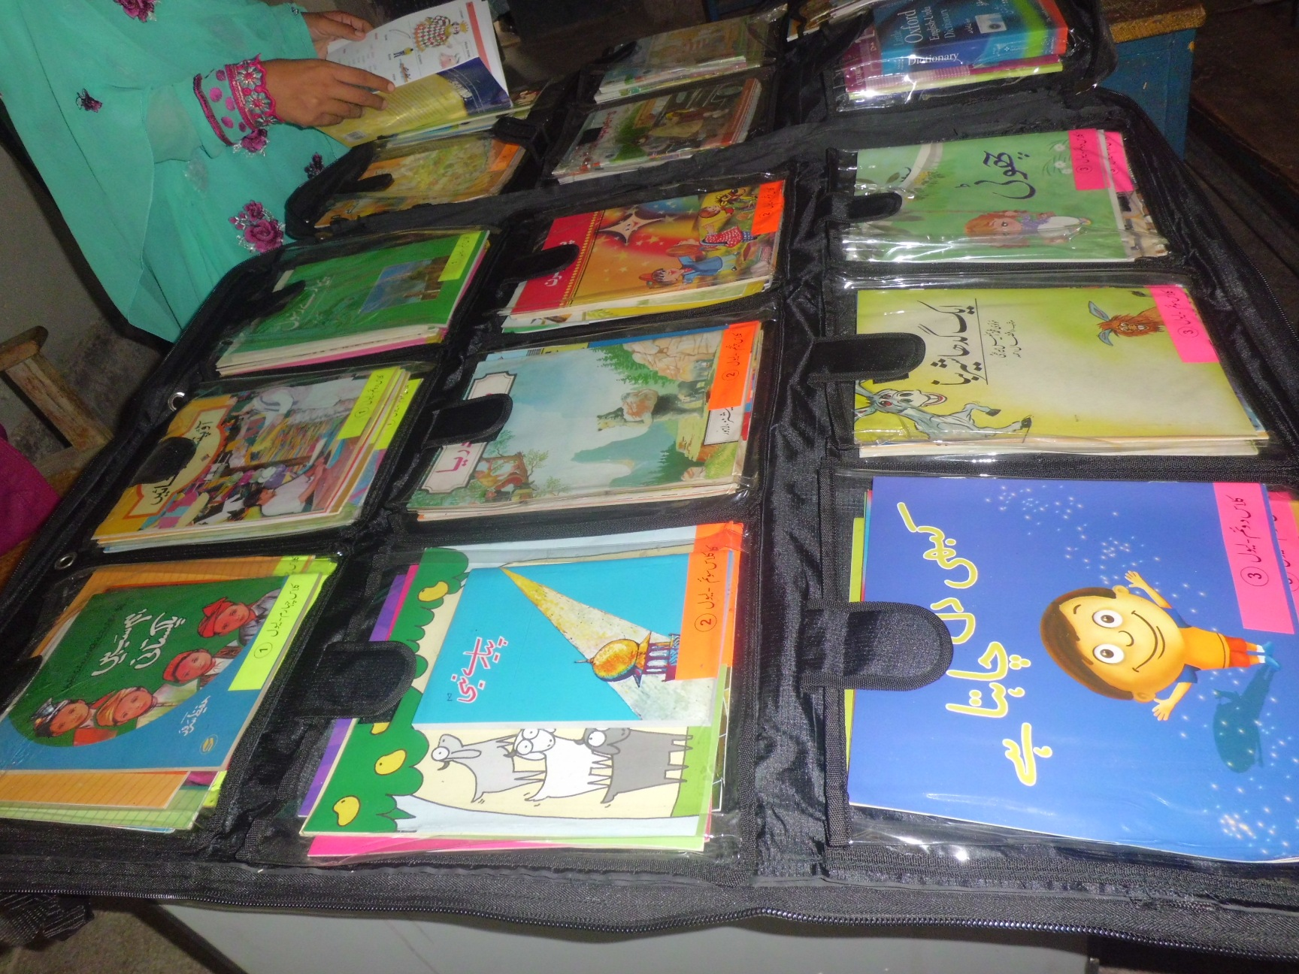
Distribution of Learning Kits
ECE Kit
Reading Kit

Slide 36
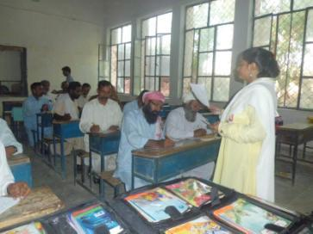
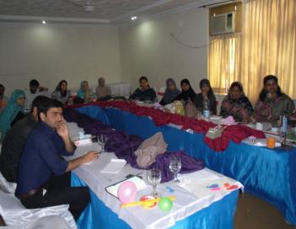
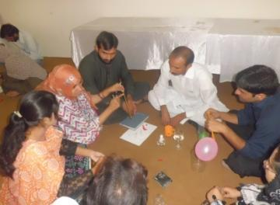
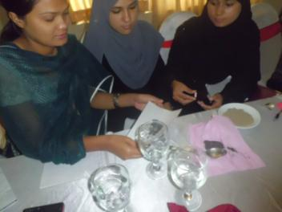
Effective use of Teaching Learning Materials (TLMs)
Orientation Session of Teachers

Slide 37


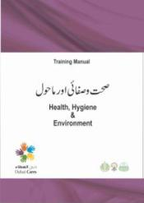

12 Days Teachers’ Training
In collaboration with Dubai Cares, Directorate of Staff Development (DSD), Punjab, Reform Support Unit Sindh and District Education Departments
  Areas of Training
  Subject Based Training: English,
  Mathematics, Science;
  Early Childhood Education (ECE);
  Health and Hygiene (H&H);
  Disaster Risk Reduction (DRR)
Project District | No. of Teachers Trained
Shikarpur | 133
Zahirpir | 120
Kot Adu | 189
Jalalpurpirwala | 37
Total | 479

Slide 38
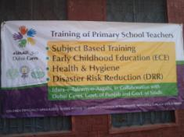
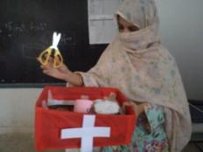
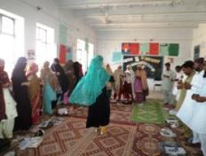
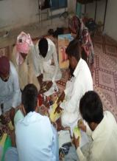
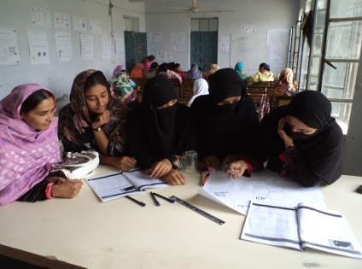
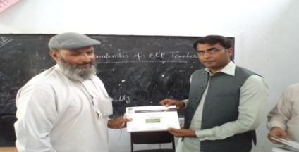
2 Weeks Teachers Training
Two Weeks Teacher Training was done on ECE, H&H, DRR and six day subject (Science, Mathematics & English) Based Training in GGES Umer Pur No. 2 JPPW
Trainees During group work
Mr. Rao Tasleem, DMO, R Y Khan distributing certificate among Trainees

Slide 39
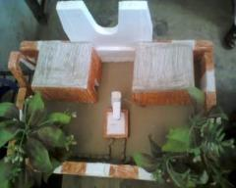
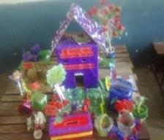
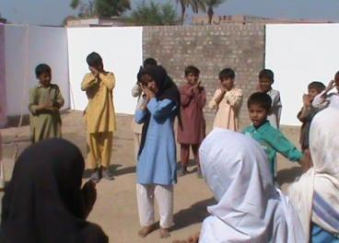
Summer School 2012
Themes of Summer School
“Promoting Understating of managing Natural Disaster-DRR through Active Citizenship Skills”
“Promoting reading for learning and literacy through Phonics based method-CPB
Activities
Story Telling
Performance on Story
Paintings/posters
Model Making
Essay Writing
Speech Competition
Health & Hygiene Activities.
Role Play
Big Book
ASER Tools Assessment
Open House
Students of GMMS Obhaichran

Slide 40
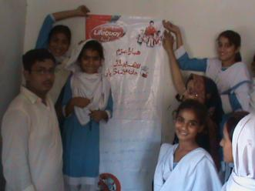
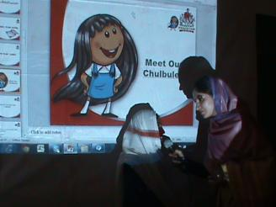
Synergies: Healthy Pakistan Mission(HPM)
Lifebuoy- Mobilizing CSR
Phase-I: Phase-I started 1st March, 2012 and ended 31st June,’12, 62 schools covered
Phase-II: 50 Schools targeted in Phase-II, completed Oct. 2012
Shikarpur

Slide 41
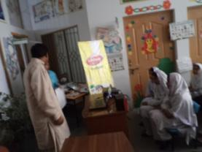
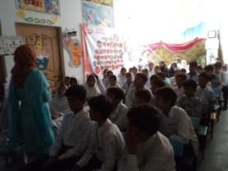
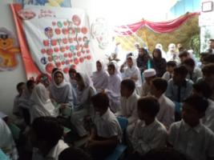
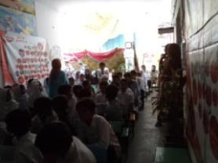
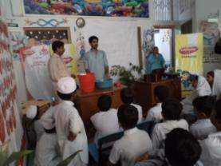
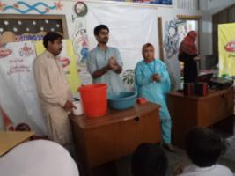
Healthy Pakistan Mission
Kot Adu

Slide 42

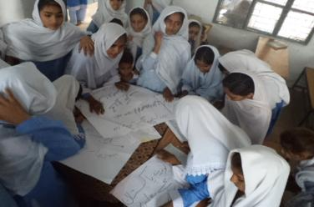


Girls Clubs..
A Tribute to Malala
Girls club members of GGPS Canal Colony& GGPS Gaji Wala (KOT ADU)

Slide 43

Girls Club Roles & Responsibilities
Girls Club members to participate in a range of supervised activities and social events. As a member, you must promise to abide by the Club’s rules;
Contribute to a supportive and positive environment that ensures everyone enjoys being a member of Girls Club.
Contribute to take care of School Health & Hygiene issues: Check School’s cleanliness and implementation of Health Checklists; monitoring students’ uniform and hygiene conditions and award stars – Green, Red, and Black accordingly).
Participate in Enrollment Drives and to track the dropouts from the school
Take part in SC meetings, ensuring student needs are reflected in SDP (School Development Plan)
Respect the rights of everyone to be treated as individuals and to be fair, honest and considerate to others.
To be part of a Club where everyone has the opportunity to participate and accept responsibility for their own actions.

Slide 44
Application Form for Girls Club
Member details
Please provide the following information so that we can contact you. We will only use these details to contact you about the Club. We will not share your personal details with any third party.
First name____________________________ Last name________________________________
Address_______________________________________________________________________
Date of birth______________________________ Class/Grade___________________________
School Name __________________________________________________________________
Member’s consent
I have read and understood the Youth Club’s Rules and agree to abide by them. I understand that if I break the rules, my membership could be suspended or withdrawn at any time. My photographs on social media networks, posters and brochures etc can be used.
Your signature
__________________ Date______________
Principal’s consent
We need to know if your principal/head is happy for you to attend the club. Please ask your principal/head to complete this page of your application form. Please sign below to consent to your student attending the Youth Club
Consent
I have read and understood the Girls Club’s Rules and agree to allow my student to be part of it.
I also agree to take photographs of student involved in Girls Club’s activities. These may be used in displays and for promotional activities in the vested interests of students e.g. in magazines, newspapers, on the internet or on posters and leaflets.
Sign of Principal: ________________ Name of Principal: _________________
For officials use only
On behalf of ITA, I approve the membership of _____________________________ in the Girls club.
Welcome to the CLUB…!!!

Slide 45



Girls’ Club Badges & Sashes- Our Pledge

Slide 46
Component I-
Advocacy

Slide 47




School Council & Community Meetings
Annual SDP meeting with the involvement of School Council, Teachers and Students

Slide 48




International Literacy Day
Walk on International Literacy Day at Zahirpir

Slide 49






International Disaster Risk Reduction Day
International Day of Disaster Risk Reduction was celebrated in GGES Darkhan Wala, Jalalpurpirwala with participation of: Students, Community & ITA Representative

Slide 50






Protest Against Attack on Malala Yousaf Zai
The Girls in Protest & Prayers like everyone in Pakistan against the Brutal Attack on Malala Yousaf Zai – October 2012

Slide 51
Component I-B
&
Component II

Slide 52
Component I-B : Catch Up Program for Out of School Children (OOSC )
  Catch Up Program: 1000 (1600) out of school recently drop out children be
  provided an accelerated second chance program for mainstreaming into
  primary/ elementary schools.
  Program Design– Chalo Parho Barho (let’s read & grow) an accelerated
  catch up program for out of school children and in school children at risk
  of dropping out using the CAMAL Methodology
  Multan – Jalalpur Pirwala = 1000 children (20 villages)
  Muzzafargarh – Kot Adu = 200 children (01 village)
  Rahim Yar Khan – Zahirpir = 200 children (01 village)
  Shikarpur = 200 children (01 village)
CPB taking place in government schools as mainstreaming is easy
Launched on 8th September 2011 Int’l Literacy Day 100 teachers trained
20 flood affected schools Jalalpur Pirwala /Multan to be supported with a mini school improvement program
Girls = 600 Boys = 400
Duration = 6 months. (3 times testing incl. baseline)
CPB was pilot tested from January – July 2011

Slide 53

Progress on
Catch Up Program for OOSC*
Project Location | Target Group | Male | Female | Total
Multan – JPPW | OOSC* | 351 | 472 | 823
 | OOSC and at risk children | 2,426 | 3,248 | 5,674
Muzaffargarh - Kot Adu | OOSC | - | 121 | 121
Rahim Yar Khan - Zahir pir |  | 46 | 77 | 123
Shikarpur |  | 140 | 51 | 191
Total |  | 2,963 | 3,969 | 6,932
Achievement far exceeds the planned target of 1600
This was possible due to synergies and support for low cost learning materials adapted from Pratham's Read India (ITA's partner) and ITA's own fundraising for the floods and CPB in 2011
*Out of School Children

Slide 54
Component II:
Back to School Kits for Children & Schools
School Uniform and Kits to 3000 children in flood affected schools in Shikarpur (1000), R Y Khan (1000) and Muzzafargarh (1000) of Component 1 A
Providing essential basic school and educational materials to enable quality learning where out of school children mainstreamed see note below
Note:
- 20 schools shifted to Jalalpur Pirwala flood affected schools (component 1 B)

Slide 55
Progress on Component II-School Kits
Districts | Number of Kits Distributed
Shikarpur | 978
Rahim Yar Khan – Zahirpir | 1,000
Muzaffargarh – Kot Adu | 921
List of Items:
Uniform (Girls, Boys) 70% girls and 30% boys
School Shoes (Girls, Boys)
School Bags with DC Signage
Note Books (English, Urdu, Math)
Stationary Pouch (Scale, Sharpener , Lead pencil, Eraser)
Another 1,500 children to be provided with school kits and 4,500 children with sweaters

Slide 56



Slide 57





Slide 58
Component III
Early Childhood Development (ECD) centres
Sanjah /Panjoh Vehra
“Our Courtyard”

Slide 59
ECD Centres / Sanjha Verah* in Flood affected districts
Establishing 15 comprehensive early childhood development (ECD) community based centers catering to 3000 children (Ages: 06 months/2 year to 5 years) and their mothers. The interventions include support for maternal and child health and nutrition, learning stimulation, good parenting and strong social supports for care givers making a case for a stronger sustainable schooling cycle.
Early Childhood Development is an all-embracing concept, embedding maternal and child health and nutrition, good parenting, strong social supports, and interaction within and outside the home from birth to eight (UNESCO, 2007).
*Sanjha Verah is the name given to ECD centers by mothers and teachers of South Punjab

Slide 60




ECD Centres / Sanjha Verah
“SANJAH/ PANJHO VEHRA/O”(SV/PV) literally translated as
“OUR COURTYARD”
In Seraiki & Sindhi
conveys several meanings :
an abode of togetherness , protection and development, ownership, community participation and empowerment;
SV is a holistic
Early Childhood Development approach, for Strong Early Foundations for children and mothers /care givers

Slide 61
Sanjah/Panjho Vehra : A Multi-sectoral program for children (0-5) and Mothers: Health, Nutrition ,Protection, Governance, Education, Skills & Women’s Empowerment`
Program Duration : September 11- July 13) supported by Dubai Cares (first centre opened in Jan. 2012)
Target groups : Children (06 months – 4+ years) and mothers /care givers
SV Centre Staffing: ECD teachers, Lady Health Worker (LHW), assistant – doctor weekly visits
Health & Nutrition : Immunisation, Growth Monitoring, Parenting and Healthy Food cooking
Equipped with : Age and developmentally appropriate furniture, play materials, stimulating Teaching Learning Material (TLMs).;
Mainstreaming children : In nearby primary schools (public and private) with better readiness skills
Skills/Livelihoods : Mothers/siblings for enhancing livelihoods; TEVTA certified courses
An enabling safe space for mothers to return to work , rebuilding homes and reconstructing their lives. ECD a cost effective sustainable intervention provided by the local community,/govt. And managed by Mothers’ Committees called “Sanjh”
Districts | ECD Centers | ECD Staff | Beneficiaries
Shikarpur | 04 | Staff = 6 (Centre Manager, Lady Health Worker, Teachers & Assistant, Maid) | Children: 800: Mothers: 400 In each district (Shikarpur & Zahirpir)
Rahim Yar Khan | 04
Muzaffargarh | 07 |  | Children = 1400; Mothers = 700

Slide 62
Enrolment Status - ECD /SV Centers
Sr. | District | No. of Centers | No. of Enrolled Children | % Girls | Mainstreamed Children in Govt. School
1 | Kot Adu -Muzaffer Garh | 7 | 800 | 60 | 59
2 | Zahirpir- Rahim Yar Khan | 4 | 400 | 60 | -
3 | Shikarpur | 4 | 400 | 50 | -

Slide 63
ECD - Mother & Child
Community Learning Centres (CLCs)
Elements :
Child’s Records/Birth, Immunisation Cards
Health & Growth milestone monitoring
Nutrition
Safe Play Areas
Tracking child’s learning milestones: Physical, Cognitive, Emotional & lanugage
Early stimulation and readiness skills
Timely School Enrolment
Life skills (DRR) Rights based learning & gender empowerment
Governance – Mothers’ Committee – decision making body
Community /government ownership and sustainability
Locations: a) On Community owned /leased sites
b) On Government Model Villages – School land

Slide 64
SV – An Initiative about
Unique Partnerships for the Child
Child
TEVTA/PVTC/ Skills & Livelihoods – Micro Credit & Enterprise (IP)
Schools Dept/Private - Primary
ITA Mobilizing Partners and Learning
Social Safety Nets – Mothers-families (IP)
Community
Land/Building 10-20 years –
Health Dept– LHWs Basic Health Units, Health & Nutrition Supervisors MNCH - Mothers
CSR Nutrition/hygiene
Knorr & Lifebuoy
Model Villages/Schools –Govt.

Slide 65










Safe Learning Environment:
Health & Nutrition:
Monitoring of Developmental Milestones, vaccination
Cooking by Mothers –Nutritious food for Children

Slide 66






Learning Activities with children
Use of ECE Kit
Self Introduction
Concept of Family
Local and national festivals
Basic mathematical concepts
Story telling
Identification of fruits & vegetables
Profession
Shapes
Concept of Light & heavy
Rhymes and Lories
Games with Toys & Puppets
Role Plays
Group Work
Life Skills based Activities
Face to Face Time
Greeting Circle
Creative Art
Health Activities
Cooking Activity –Nutirtion etc

Slide 67

MoU signed with phrsp-health Department for engaging LHWs & Health and Nutrition Supervisor

Slide 68
Health Activities Undertaken by LHW in the Centers
Sessions with Children on:
Healthy Habits of
Hand Washing
Face Washing
Regular Bathing
Combing / hair brushing
Teeth Brushing
Neat and Clean dress
Vaccination
Height & weight Activity
Medical screening
Celebration of Global hand Washing Day
First aid provision
Standard Health Action Plan
Regular Sessions with Mothers & Children
Sessions with Mothers on:
Parenting
Reproductive Health
Breast feeding
Cleanliness
Precautions and medication in Pregnancy
Healthy Diet
Safe Methods of Family Planning
Viral infections
Fever-primary health issues
General diseases
Pregnancy
Diarrhea
Usage of first aid box

Slide 69




Capacity building sessions & Trainings
DATES | NO. OF DAYS | No. OF TEACHERS | No. of LADY HEALTH WORKERS | Training Venue
30th Nov-3rd Dec 2011 | 3 | 28 | 8 | Govt. High School No. 2, Kot Addu, District Muzaffargarh
4th-5th June 2012 | 2 | 14 | - | Govt. High School No. 2, Kot Addu, District Muzaffargarh
16th-17th July 2012 | 2 | 30 | 15 | Govt. High School No. 2, Kot Addu, District Muzaffargarh District Office ITA Shikarpur Govt. Girls High School Zahir Pir RYK
20th-22nd Sep 2012 | 3 | 30 | 15 | District Office ITA Shikarpur Training Hall of Guest House

Slide 70



Vocational Training Course for Mothers
3 months beauty care course has been successfully completed by the first batch of local females in the ECD Center Basti Malook by a certified trainer of TEVTA

Slide 71
Transitions :ECD –Primary & Post Primary School
-Catching Early: 3 Pillars of Education First Initiative
Every Child in School,
Improve Quality of Learning
Foster Global Citizenship
ECD -SV
ECD- Sanjah Vehra - 6months -56 months
ECE/Primary
ECE-Primary School -
Post Primary Middle
Post Primary /Middle School
5-10 years
11-13 years
Sanjha Vehra - connecting families, communities and learning

Slide 72
Part IV
Opportunities - Synergies
Challenges & Issues
Way Forward

Slide 73
Opportunities & Synergies
Linkages with Government initiatives -
  School Health & Nutrition Supervisors- Punjab
  Reform Support Unit/Provincial Policy Implementation Unit : Sindh & Punjab sector planning
  ECE in Punjab – inputs to the strategy and implementation
  Model Villages access and allocation of sites - Punjab
Linkages with CSR – UNILEVER BRANDs & Telenor
  Lifebuoy – Health & Hygiene
  Knorr – Nutrition
  Beauty Brands - Technical Vocational/Livelihoods
  Telenor – Youth Volunteers
ITA’s Projects: ASER; Children’s Literature Festivals; TVET

Slide 74
New Schemes Punjab 2012-13 budget http://www.punjab.gov.pk/system/files/Annual_Development_Program_2012_13.pdf
No. 14 Introduction of Early Childhood Education in 1000-Primary Schools in
Punjab with highest enrolment & Improvement of Environment of Schools
to convert them into Child-Friendly Schools = Rs. 100 million
EDS12-09099900001-0007
Un-Approved Punjab
No. 17 : Rehabilitation of Schools in Flood Affected 13-Districts: Muzaffargarh & RYK Rs. 500.000 million
EDS12-09078800001-0009
Un-Approved
Nos. 48, 54, 58 , 59 : Provision of Missing Facilities in Schools of District Multan, Muzaffargarh, RYK and Chiniot

Slide 75
Issues & Challenges
Recent Heavy Rainfall in Sindh
  Project activities suffered due to emergency situation in Shikarpur during September 2012. Efforts were put into relief work at target localities
  Rehabilitation of affected partner schools in Shikarpur
  Distribution of Back to School Kits at Shikarpur and some other project locations
Strategizing for sustainability of ECD Day Care Centre

Slide 76
Way Forward
Strategy for Sustainability of Project Interventions :
  Working in close collaboration with Provincial & District Education Departments
  Planned Intense capacity building of School Councils / School Management Committees on their Roles & Responsibilities and DRR

Slide 77
ANNEXES

Slide 78
Organogram District for WSIP/OOSC &ECD
District Manager
Education Promoter
(5)
Finance Officer
(1)
Admin Officer
(1)
Support Staff
(2)
District ECD Coordinator/
Education Promoter (1)
ECD Centre Coordinator
(5) 1 per centre
Lady Health Worker (5) 1 per centre
ECD Teacher (10) 2 per centre
Assistant Teacher (5) 1 per centre
Support Staff (5) 1per centre
Doctor
Part Time

Slide 79
Organogram for ECD – CLC Program
District ECD Coordinator/
Edu. Promoter
ECD Centre Coordinator (5) 1 per centre
Lady Health Worker (5)
1 per centre
ECD Teacher (10) 2 per centre
Assistant Teacher (5)
1 per centre
Support Staff (5) 1per centre
Doctor- Part Time
6 core staff supported by
Dist. Coordinator & Trainer & Doctor
Provincial & District Technical Steering Group

Slide 80
DC Program Team – Provincial Office
Sr. # | Emp. Name | Designation | Location
1 | Mr. Amjad Imtiaz Sheikh | Project Manager | Head Office 41-L, Model Town Extension, Lahore
2 | Mr. Saheem Khizer | Documentation & Research Officer
2 | Mr. Ihsan Hashmi | Manager Admin & Procurement
3 | Mr. Muhammad Asif Sultan | Manager Finance
OOSC Program & WSIP to end in January 2013 - Multan
Sr. # | Emp. Name | Designation | Location - Multan
1 | Mr. Adnan Omer | Overall in-charge | Jalalpur Pirwala Office Govt. Girls Higher Secondary School, Jalalpurpirwala, District Multan
2 | Mr. Ricky Bhatti | Tehsil Coordinator
3 | Ms. Aqsa | Education Promoter
Continue

Slide 81
DC Program Team – Field Offices
Sr. # | Emp. Name | Designation | Location
1 | Muhammad Waqas | District Manager | Zahirpir Office Govt. Girls Higher Secondary School, Zahirpir, Tehsil Khanpur, District Rahim Yar Khan
2 | Mr. Farooq Ahmad | Tehsil Coordinator
3 | Mr. Rashid Nawaz | Finance Officer
4 | Ms. Nabila Ayaz | Education Promoter
5 | Ms. Sehresh Khan | Education Promoter
6 | Ms. Razia Parveen | ECD Coordinator
1 | Muhammad Naveed | District Coordinator | Kot Addu Office Govt. High School No. 2, Kot Addu, District Muzaffargarh
2 | Mr. Baqir Abbas | Senior Education Promoter
3 | Ms. Lubna | ECD Coordinator
4 | Mr. Humaira Irum | Education Promoter
5 | Mr. Kashif | Education Promoter
6 | Ms. Shagufta | Education Promoter
7 | Muhammad Mahboob | Site Engineer
8 | Mr. Imran Hussain | Admin & Finance Officer
Continue

Slide 82
DC Program Team – Field Offices
Sr. # | Emp. Name | Designation | Location
1 | Mr. Syed Faisal Shah | District Manager | Shikarpur Office Govt. Boys Primary School Sindhi Saddar, District Shikarpur
2 | Mr. Majid Khan | Education Promoter
3 | Mr. Waqar Rasheed | Education Promoter
4 | Ms. Mahreen Yameen | ECD Coordinator
5 | Ms. Aliya Soomro | Education Promoter
6 | Mr. Suhail Ahmed Channa | Admin Officer
7 | Mr. Shahid Hussain | Site Engineer
8 | Mr. Yasir Abbas | Finance Officer

Slide 83
Thanks

