Slide 1


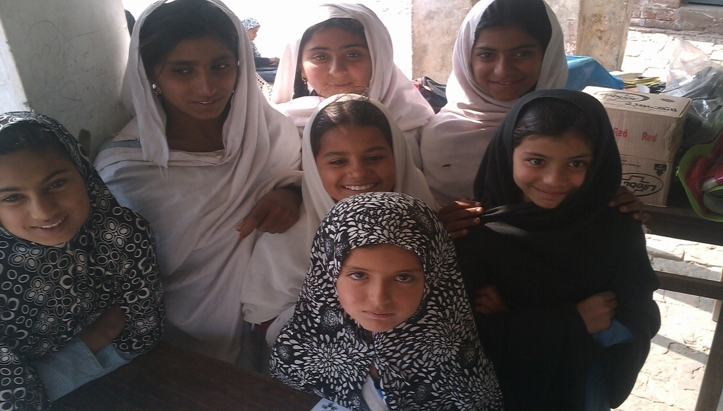
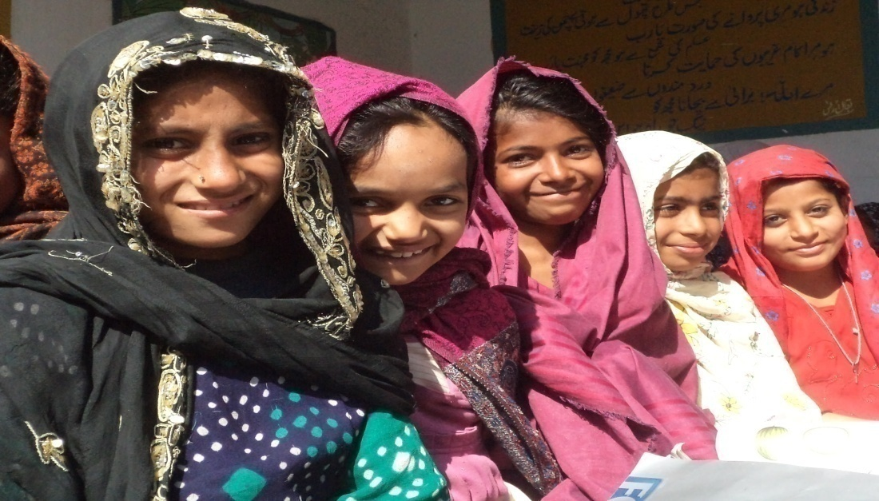
Project Achievements
CHILDREN, ESPECIALLY GIRLS
AGED 2-12 HAVE ACCESS TO
QUALITY EDUCATION
WITH IMPROVED INFRASTRUCTURE AND
SAFE LEARNING ENVIRONMENT
April 2011 – June 2013

Slide 2
Target Areas / Project Districts
Punjab
Sindh
Muzaffargarh
Shikarpur
Rahim Yar Khan
Multan
Focus on flood affected localities and schools, especially girls’

Slide 3
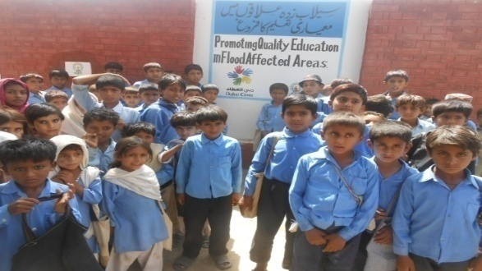
Beneficiaries | Planned Numbers | Reached So Far
Children (6 months – 12 years) | 75,000 (60% Girls) | 71,980

Slide 4
Project Beneficiaries
Beneficiaries | Planned Numbers | Reached So Far
Children (6 months – 12 years) | 75,000 (60% Girls) | 71,980
Head Teachers | 300 | 305
Teachers/Para/LHWs | 1200 / 1500 | 1,354
Mothers | 3,000 – 4,000 | 1,200
School Councils /SMCs | 600-900 / 3000* | 600 / 2,240
Community Members | 335,000 – 500,000 | 468,590
* From each SC/SMC 2-3 members are trained out of average 07 members

Slide 5
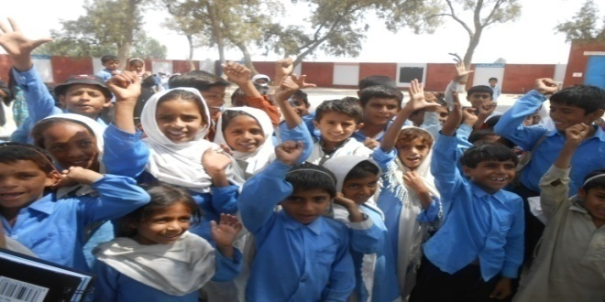
Component 1
School Rehabilitation - provision of missing facilities
Appointment of 128 Para Teachers
Provision of Teaching Learning Material (TLMs)
Capacity Building / trainings of teachers / School Councils
Girls’ Clubs
Chalo Parho Barho (CPB)
School Accountability Card

Slide 6
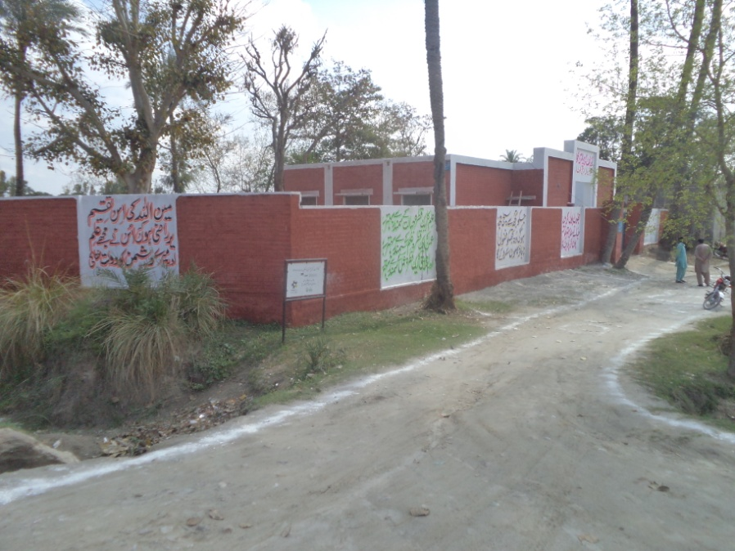
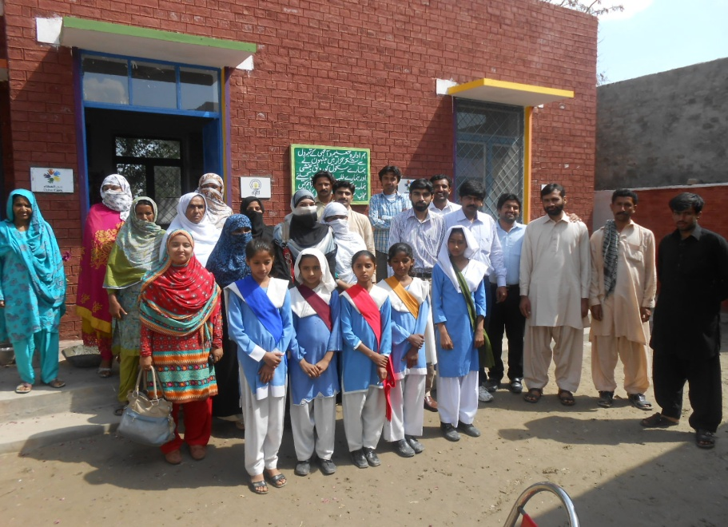
Physical Rehabilitation of Partner Schools at Kot Addu
22 Government schools were construction / renovated

Slide 7
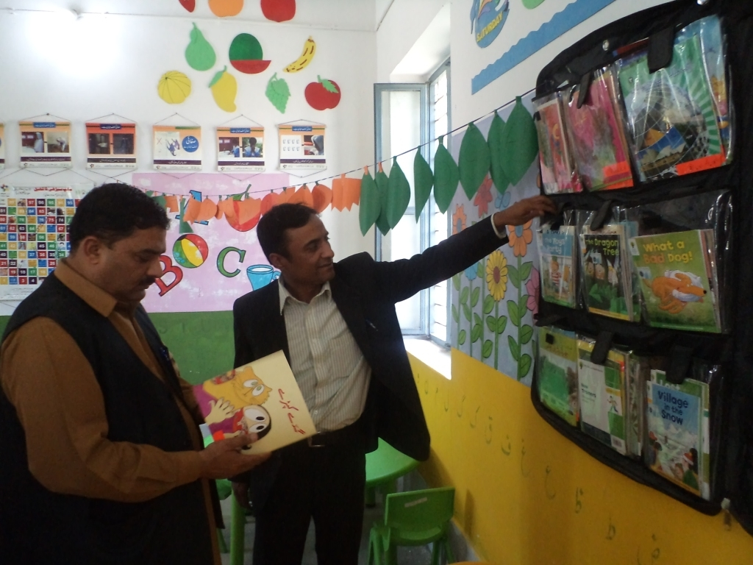
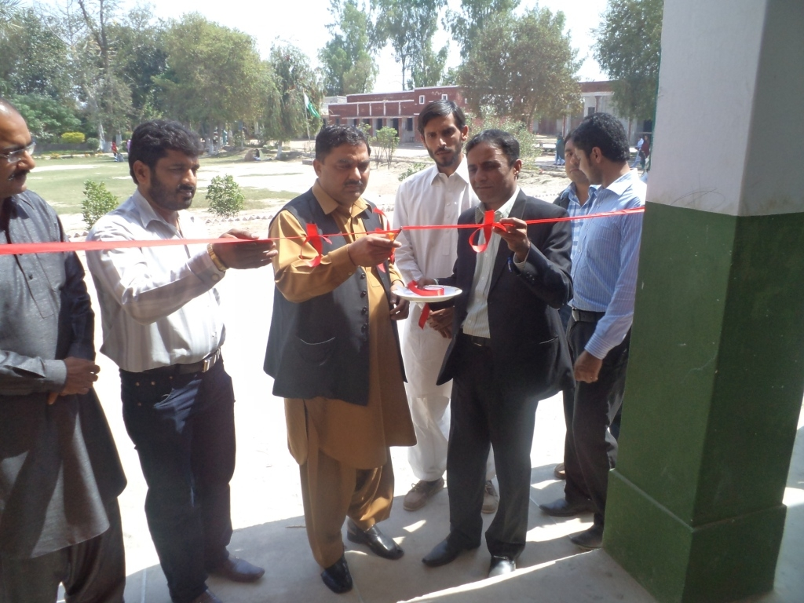
Physical Rehabilitation of Partner Schools at Zahirpir
10 Government schools were construction / renovated

Slide 8
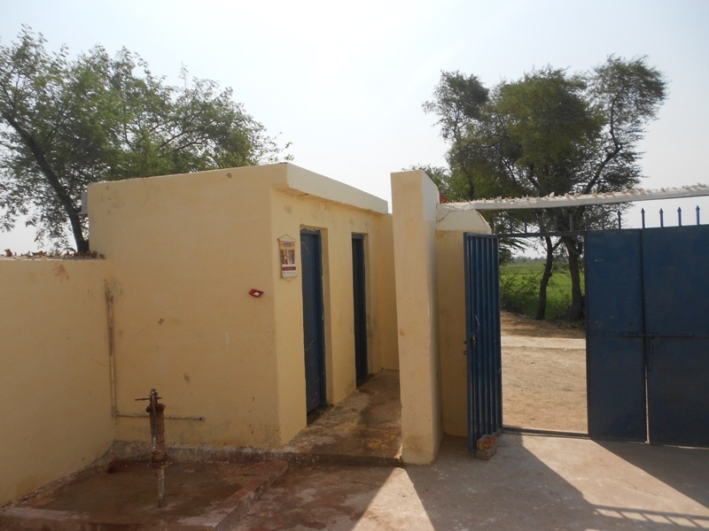
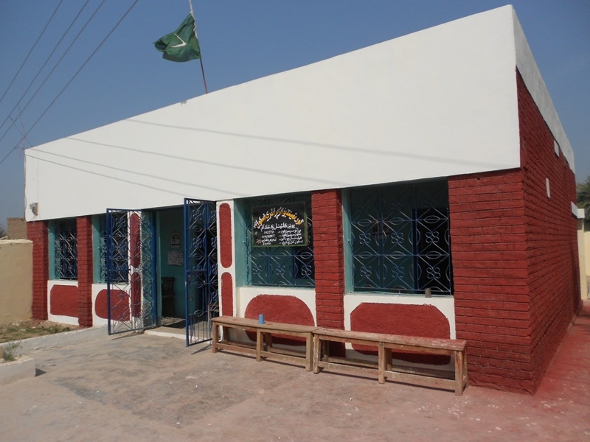
Physical Rehabilitation of Partner Schools at Shikarpur
22 Government schools were construction / renovated

Slide 9
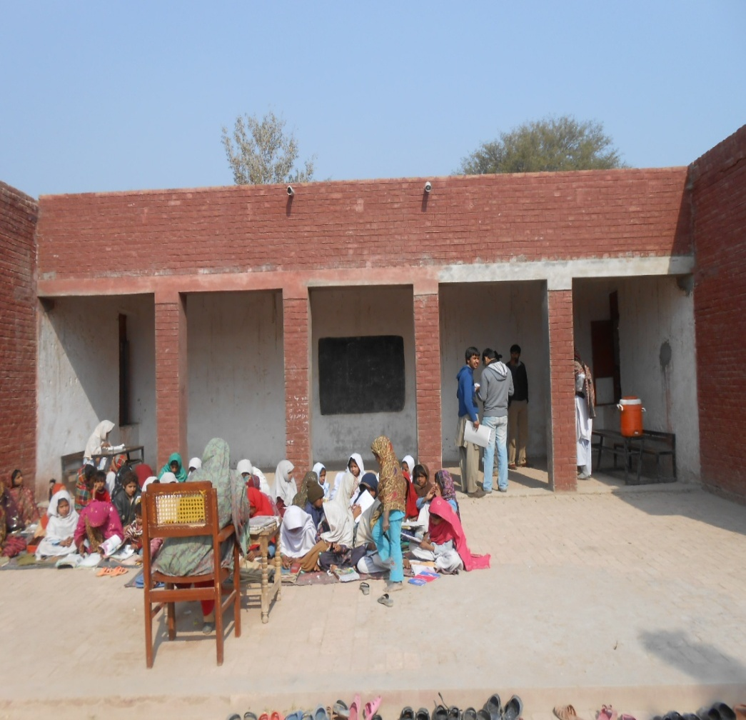
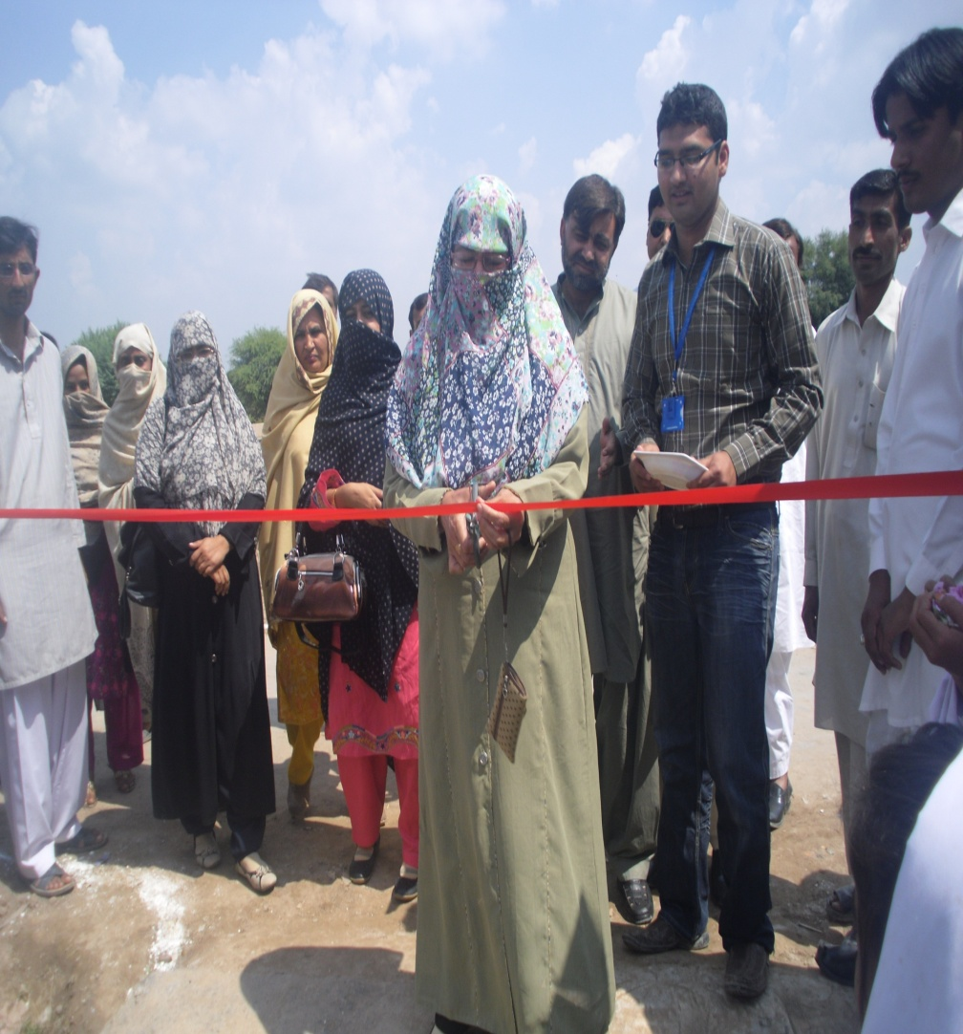
Minor Repair & Maintenance of Partner Schools at Jalalpurpirwala
21 Government schools were with Minor repair & Maintenance

Slide 10
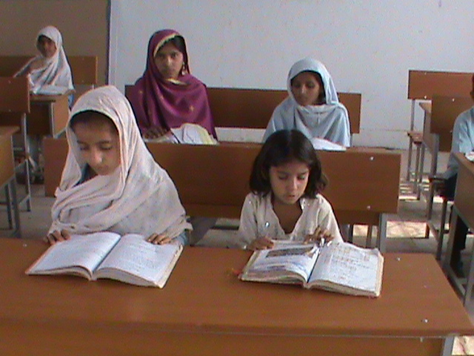
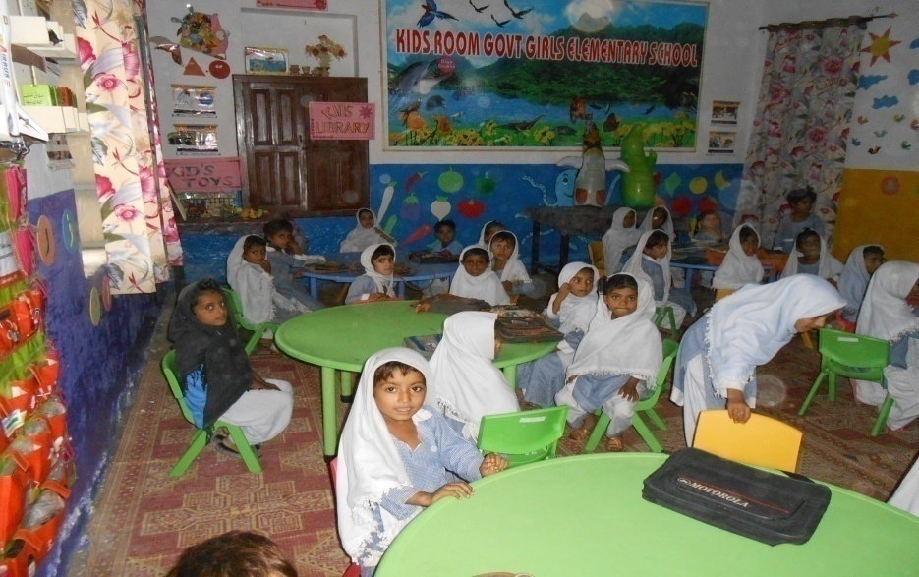
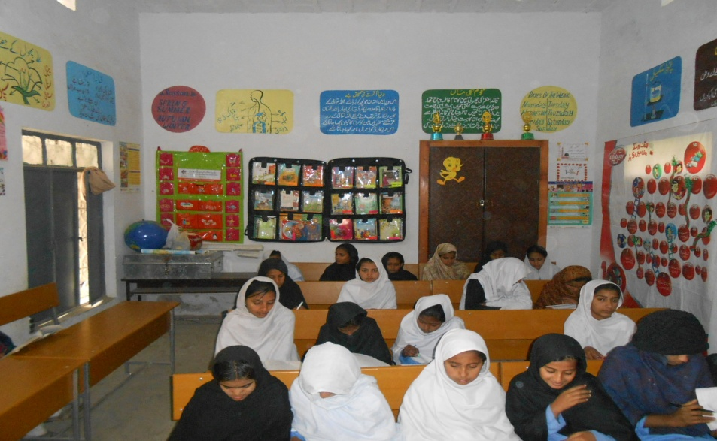
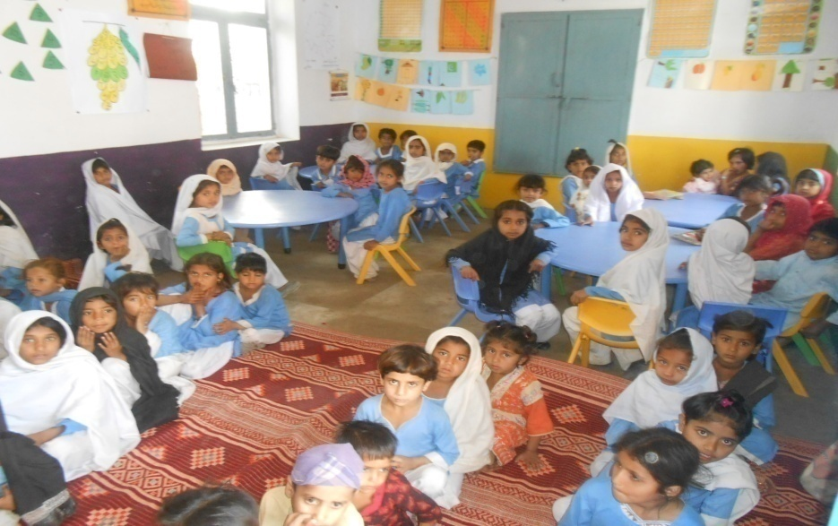
Provision of Furniture
72 Govt. schools were provided furniture …

Slide 11
Teaching Learning Materials
School Learning Kit | Distribution
Science Kit | 70 (50 + 20) Partner Schools with Construction
Reading Kit with Globes & Maps | 302 schools
Health Kit
Sports Kit
ECE Kit

Slide 12
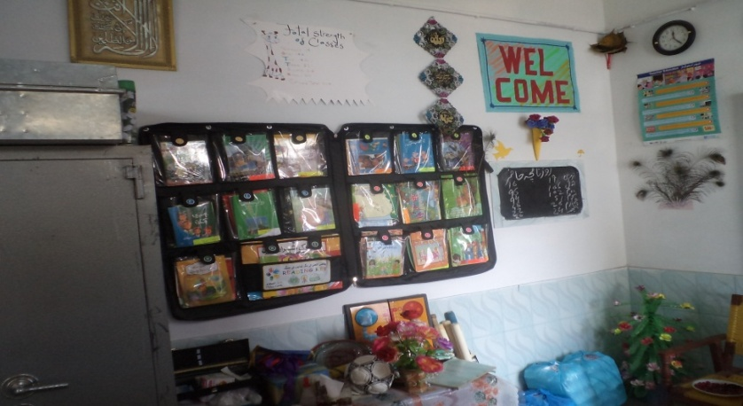
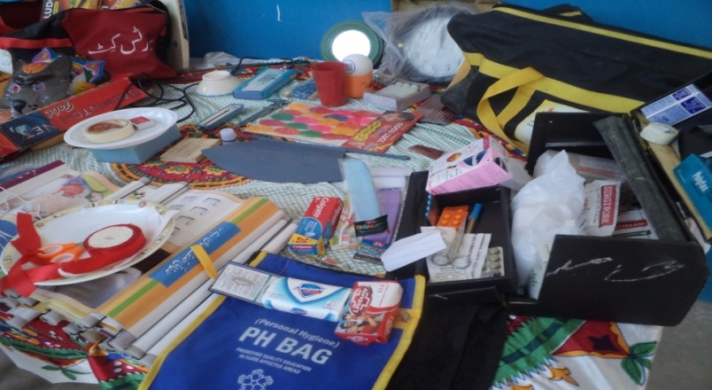
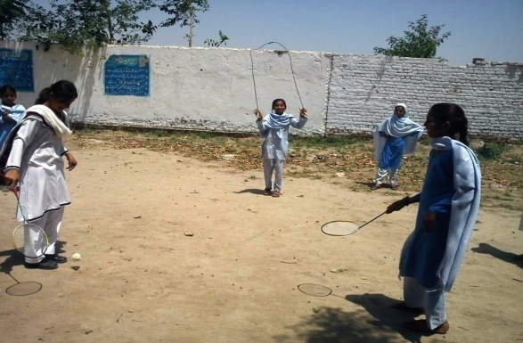
Pictorial View Of Kits
Reading Kit
Health Kit
Sports Kit

Slide 13

Girls Clubs..A Tribute to Malala
The roles and responsibilities of the club are as following:
To take care of Health & Hygiene issues: To check School’s cleanliness and implementation of ITA’s Health Checklists
To participate in Enrollment Drives and to track the dropouts from the schools
To take part in SMC’s meeting and to make sure that SDPs are made according to the wills of students

Slide 14
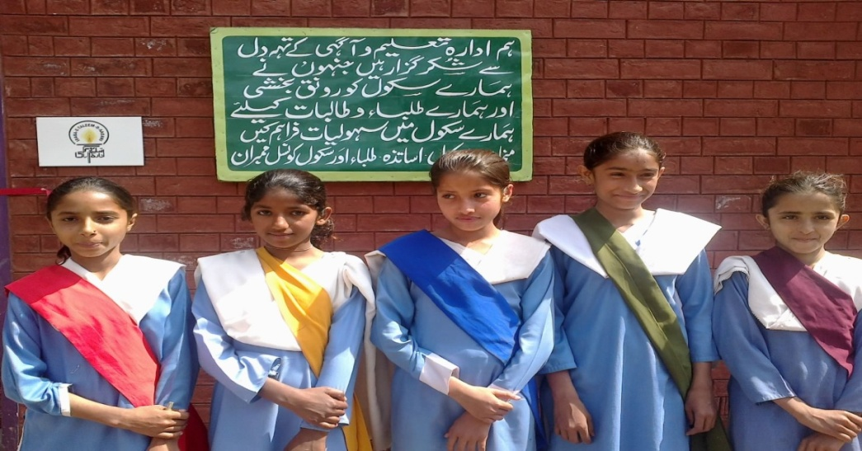
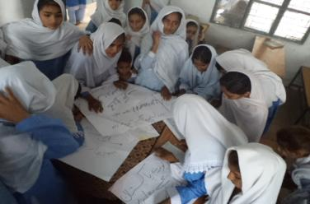
Pictorial View of Girls Club

Slide 15
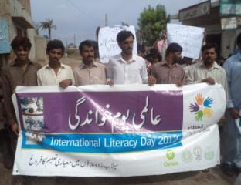
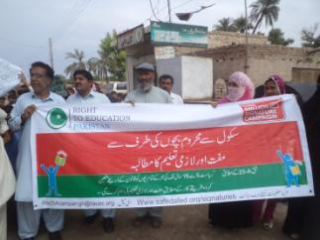
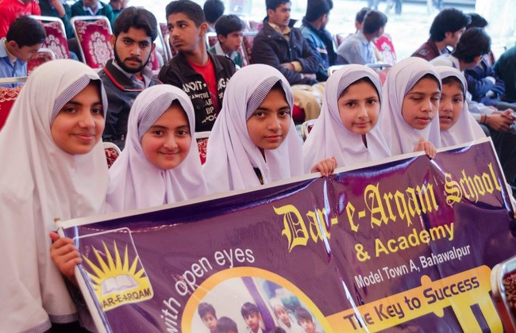
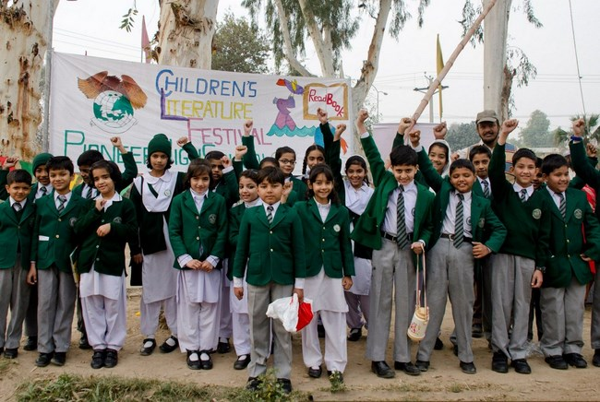
Celebrating International Advocacy Days
Children’s Literature Festivals

Slide 16

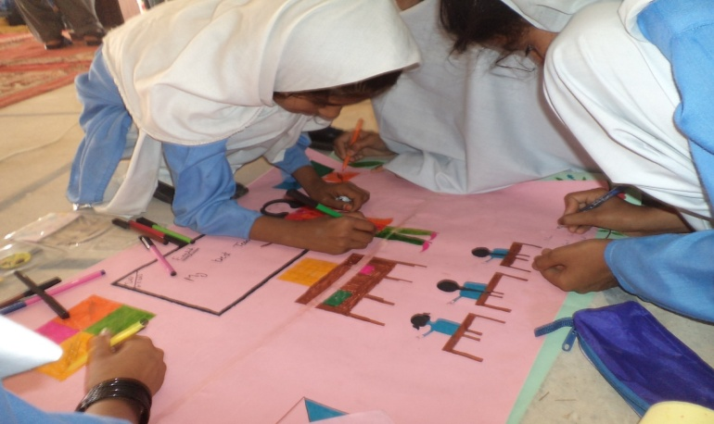
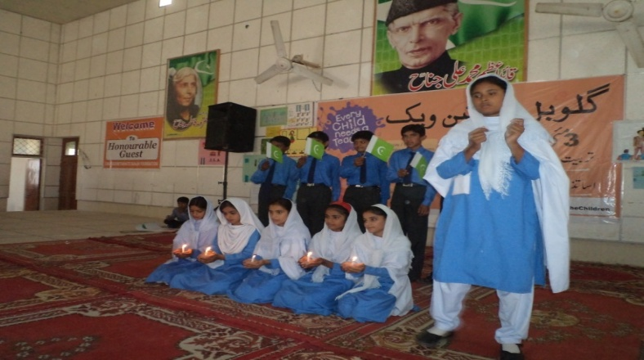
Policy Dialogues based on ASER findings
Essay / Creative Writing Competitions
Drawing & Painting Competitions
RTE Campaigns – Signatures of OOSC
District Level Competitions

Slide 17
Enrollment Trends …
Districts | Baseline Enrollment | End May 2013 Enrollment | Absolute Change in Enrolment | % Change in Enrolment
Kot Adu | 17147 | 20611 | 3464 | 20%
Zahirpir | 10343 | 11712 | 1369 | 13%
Shikarpur | 16326 | 17739 | 1413 | 9%
Jalalpurpirwala | 2648 | 3047 | 399 | 15%
Total | 46464 | 53109 | 6645 | 14%
14% improvement was noted in the enrollment of partner schools …

Slide 18
Component I-B
Catch Up Program for Out of School Children (OOSC )

Slide 19
Component I-B : Catch Up Program for 1000 Out of School Children (OOSC )
  Program Design – Chalo Parho Barho (let’s read & grow) an accelerated catch up program using the CAMAL Methodology
20 flood affected schools Jalalpur Pirwala /Multan supported with a mini school improvement program
Project Location | Target | Number of Children Graduated | Number of Villages
Jalalpur Pirwala (Multan) | 1000 Out of School Children | 823 OOSC (351 boys & 472 girls) 5674 In-School Children | 20 villages
Kot Adu (Muzzafargarh) |  | 191 OOSC | 02 village
Zahirpir (Rahim Yar Khan) |  | 123 OOSC & In-School Children | 01 village
Shikarpur |  | 191 OOSC | 01 village

Slide 20
Component II
Back-to-School Kits

Slide 21
Component II – Back to School Kits for Children & Schools
Districts | Target | Number of Kits Distributed | Number of Sweaters Distributed
Shikarpur | 1000 | 1578 | 1600
Zahirpir (Rahim Yar Khan) | 1000 | 1022 | 1100
Kot Adu (Muzaffargarh) | 1000 | 1000 | 1100
Total | 3000 | 3600 | 3800
Note: 20 schools shifted to Jalalpur Pirwala flood affected schools (component 1 B)

Slide 22
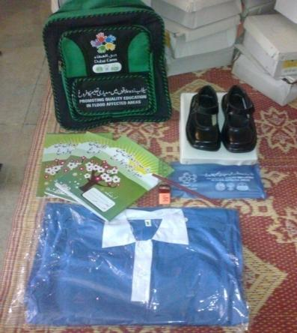
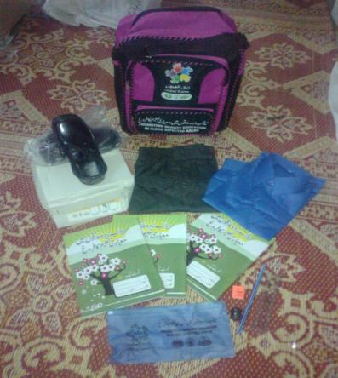
Kit for Girls | Kit for Boys
List of Items in School Kit: Uniform & Sweaters (70% Girls, 30 %Boys) School Shoes (Girls, Boys) School Bags with DC Signage | Note Books (English, Urdu, Math) Stationary Pouch (Scale, Sharpener, Lead pencil, Eraser)

Slide 23
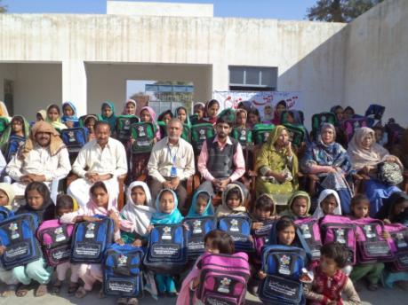
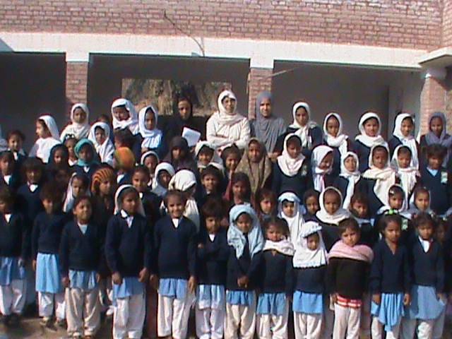
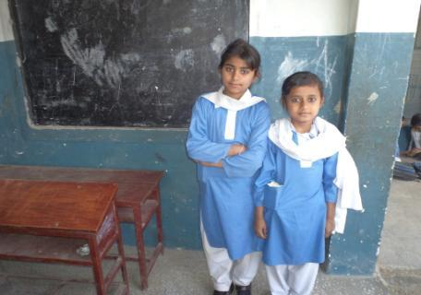
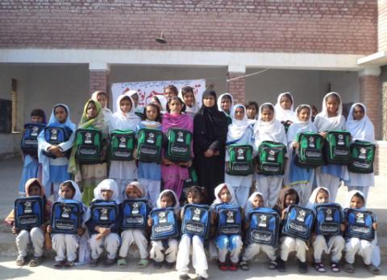

Slide 24
Component III
Early Childhood Development (ECD) centres
Sanjah /Panjoh Vehra
“Our Courtyard”

Slide 25
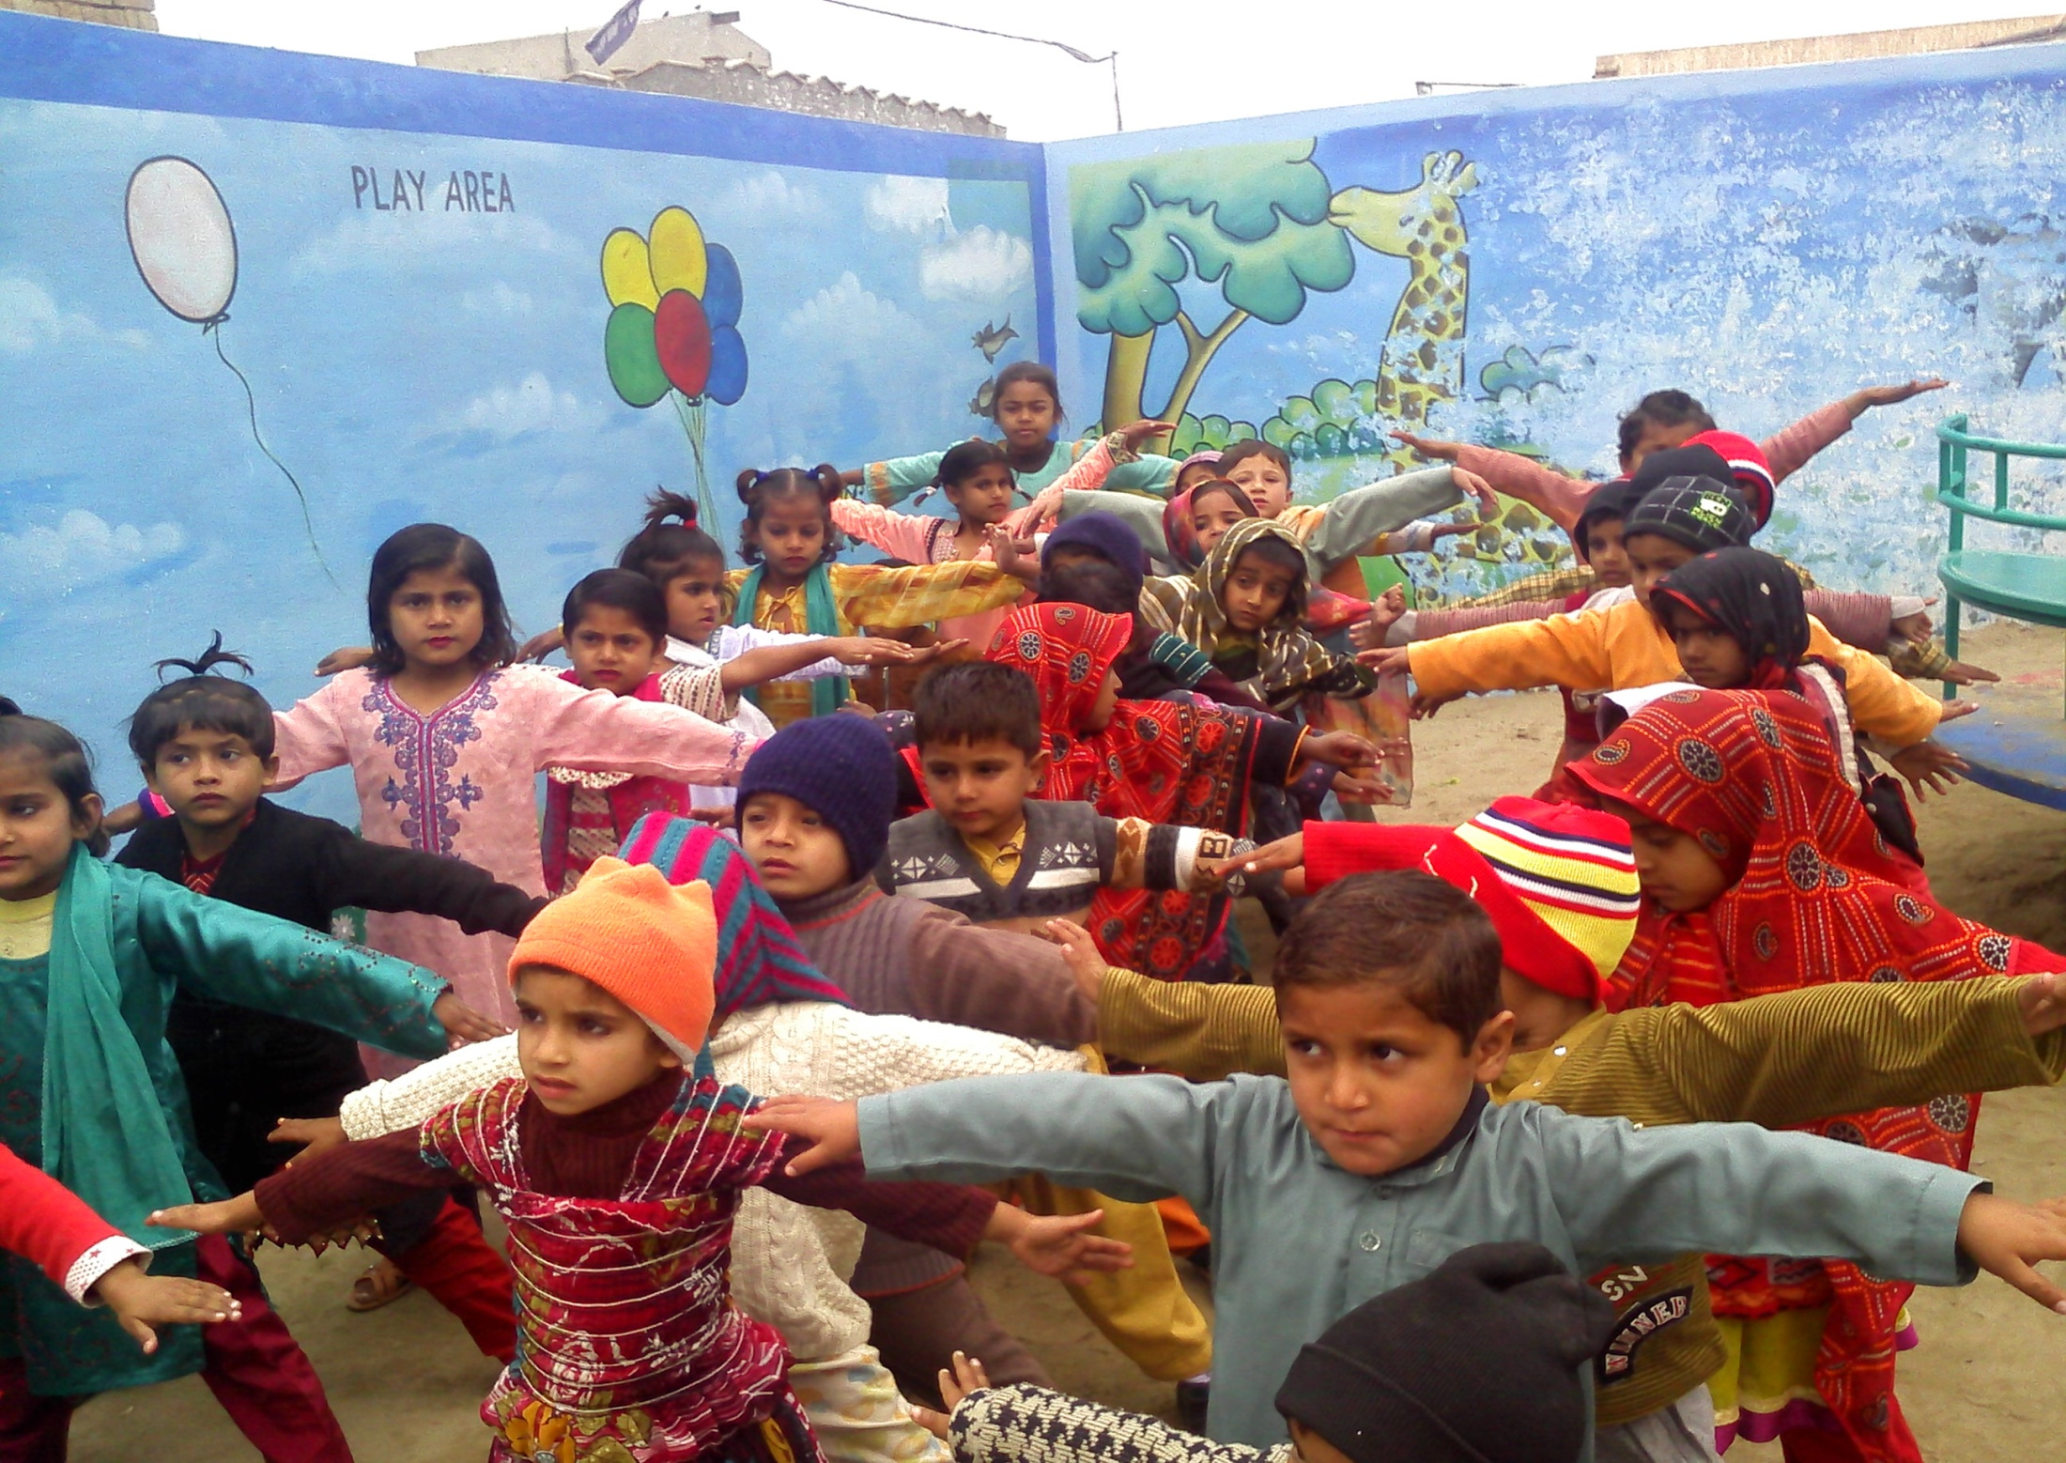
ECD Centres “Sanjha Vehra/Panjoh Vehro”

Slide 26
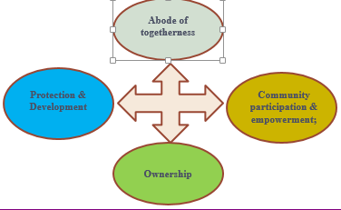
ECD Centres “Sanjah Vehra / Panjho Vehro”(SV/PV*)
A multi- sectoral program for mother and child development
“An abode of togetherness, protection and development, ownership, community participation and empowerment”
A holistic Approach for Strong Early Foundations and female empowerment
*SV/PV is literally translated as “shared courtyard” in Seraiki & Sindhi conveys several meanings.

Slide 27
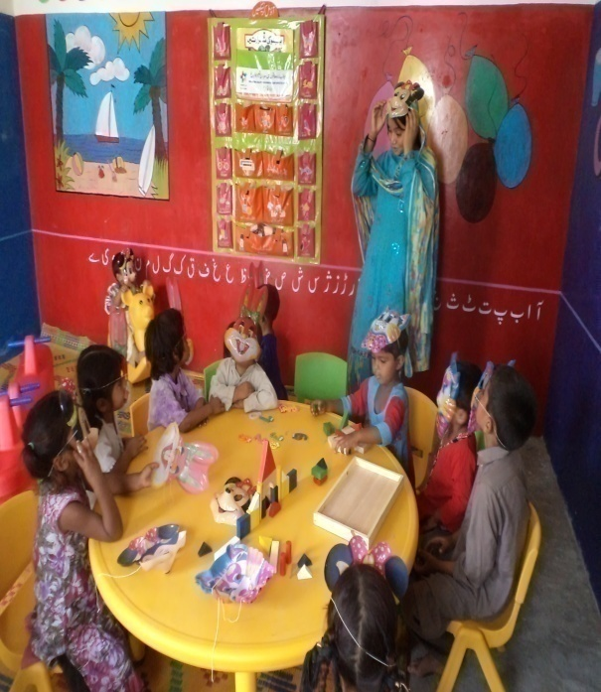
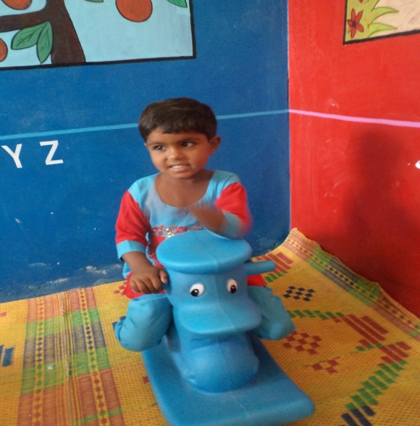
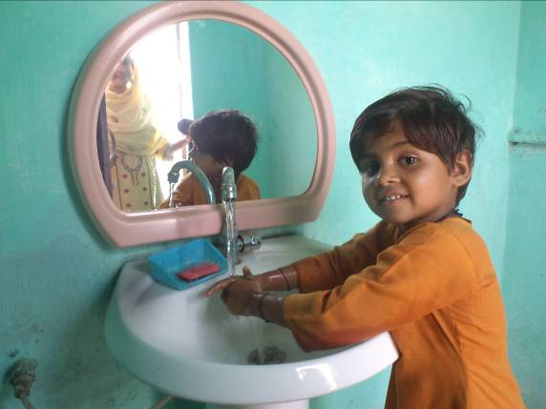
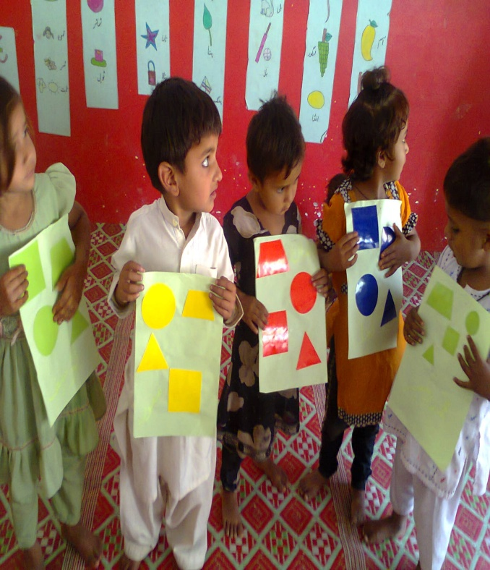
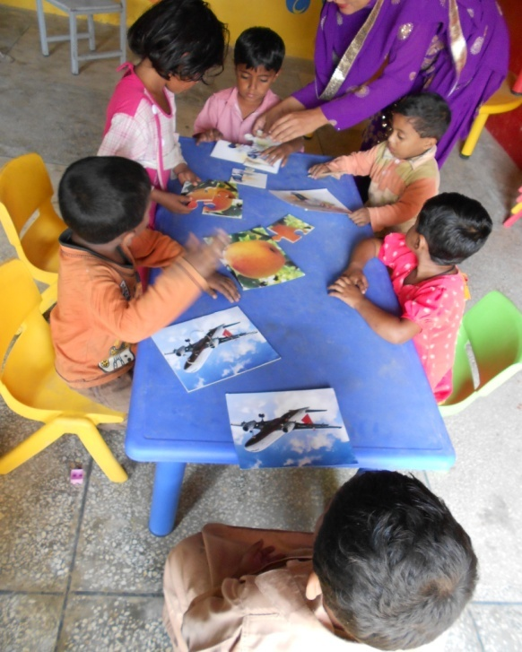
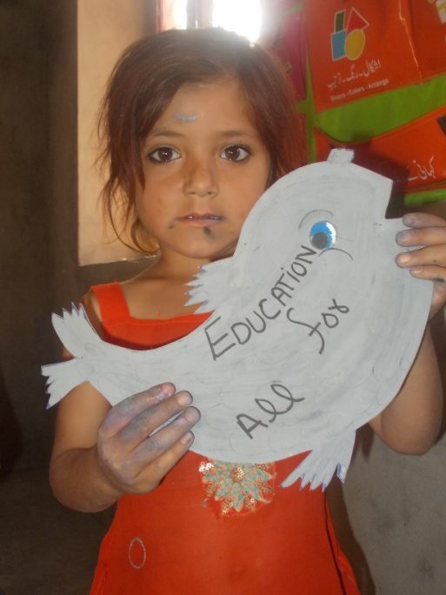
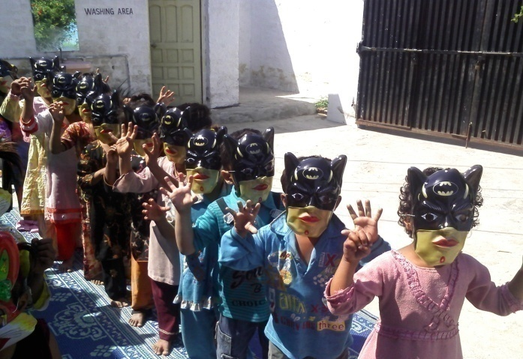
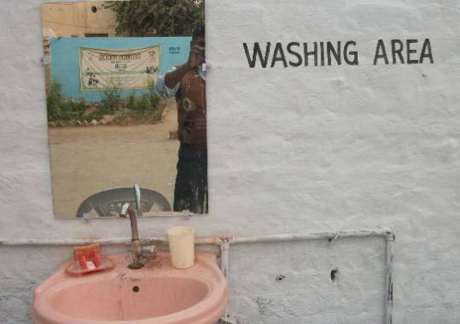
ECD Centres “Sanjha Vehra/Panjoh Vehro”
Learning through play
Health & hygiene

Slide 28
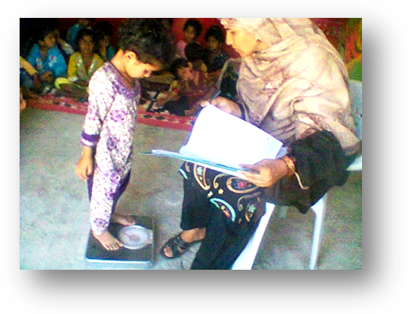
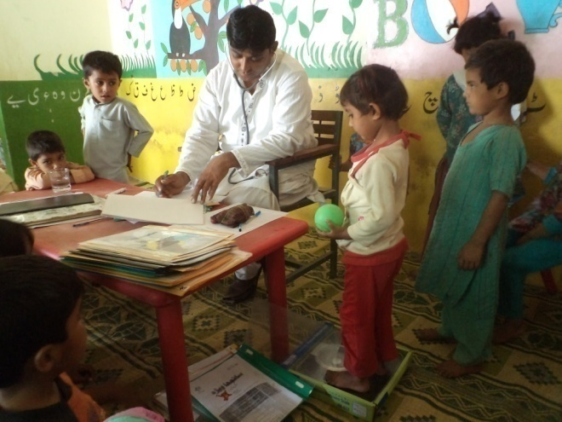
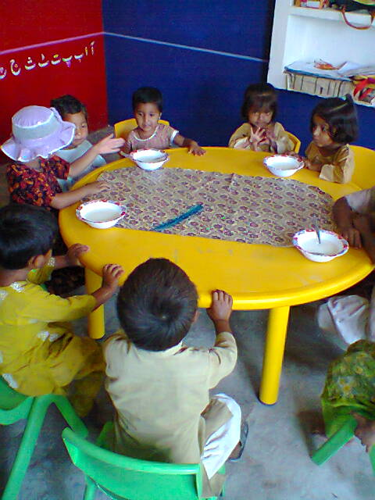
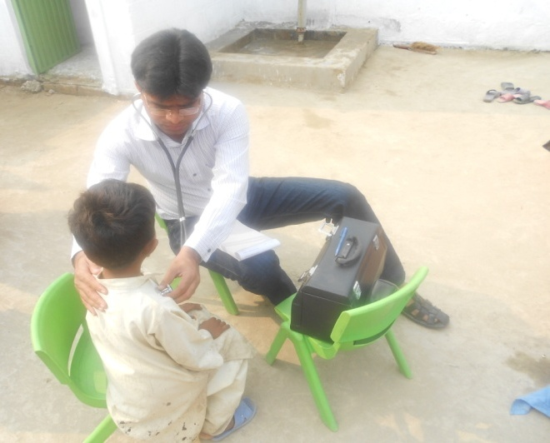
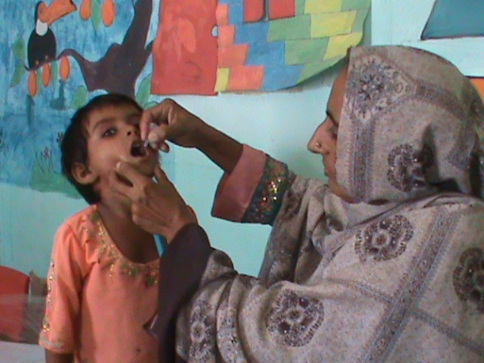
ECD Centres “Sanjha Vehra/Panjoh Vehro”
Sessions with mothers
Growth monitoring
Kitchen Gardening, nutritious meals & health
Medical Checkups, Early detection & referrals
Vaccination & age record

Slide 29
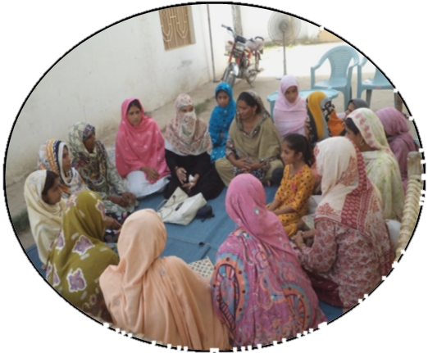
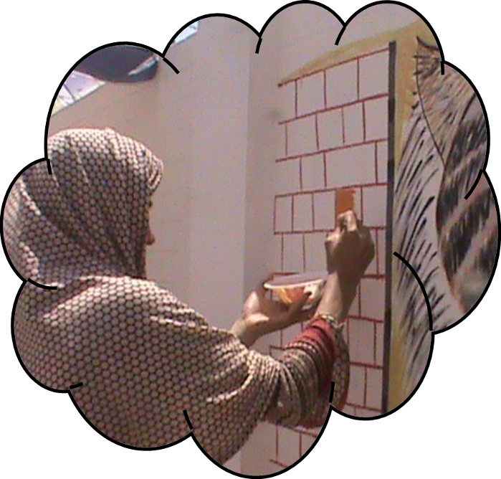



ECD Centres “Sanjha Vehra/Panjoh Vehro”
Community participation
Sanjh/Panjoh – Mothers’ Steering Committee
Sanjh Committee helping for cooking meal for children

Slide 30
Transitions :ECD –Primary & Post Primary School
-Catching Early: 3 Pillars of Education First Initiative
Every Child in School,
Improve Quality of Learning
Foster Global Citizenship
ECD -SV
ECD- Sanjah Vehra - 6months -56 months
ECE/Primary
ECE-Primary School -
Post Primary Middle
Post Primary /Middle School
5-10 years
11-13 years
Sanjha Vehra - connecting families, communities and learning

Slide 31



Livelihood program for Mothers
@ ECD Basti Malook (District Muzaffargarh)
The need based certified vocational courses are offered in ECD centers as an integral part of the program in collaboration with TEVTA (Technical Education Vocational Training Authority).

Slide 32
        Way Forward
Piloting of Learning 4 Access

Slide 33
Piloting of L4A
A combination of best practices that is cheaper, effective with measureable impacts and scalable
Sr. No. | Elements | Borrowed From
1 | Household Survey | ASER
2 | Children's Learning | ASER
3 | CAMAL Methodology | Pratham India
4 | Summer Camp | WSIP-DC
5 | Girls/Boys Club | WSIP-DC
6 | Teaching Learning Materials | WSIP
7 | Para Teacher | WSIP
8 | SDPs /SMC strengthening | WSIP
9 | Training Para teachers | ITA

Slide 34
Literacy Camps
Round-1
Round-II
15 days camp by Children Levels
Round-III
15 days camp by Children Levels
15 days Camp by Children Level
Baseline Assessment
Final Assessment
2nd Term Assessment
3rd Term Assessment
Community Engagement
05 days break
05 days break
Sharing Improved learning levels with parents / community
Total Duration: 2.5 Months

Slide 35
Project Closing Ceremonies
District | Scheduled Dates
Rahim Yar Khan | June 25, 2013
Muzaffargarh | June 26, 2013
Shikarpur | June 27, 2013
Multan | June 28, 2013
Thanks

