Slide 1

CHALO PARHO BARHO
LET US READ & GROW
Learning Camps in Mardan & D. I. Khan

Slide 2
THE SOLUTION
CPB – 45 day long camps to boost learning among children in school and help children who are out of school to quickly gain knowledge and skills they need to enroll in school’
Problem: Large number of OOSC
Low learning levels and lower score on education quality indicators
The data from in school children also reflects that learning is not achieved with enrolment
The teaching needs to begin at the level of the child ‘teaching at the right level’

Slide 3
HOW CPB WORKS
Identify OOSC through community engagement and Baithaks
Identify in school children with risk of dropping out
Identify and select para teachers from community
Train teachers on ‘teach at right level’ and predesigned CPB material
Establish camps in or near to schools
Enrol and assess children before launching them on an ‘accelerated learning’ course
Conduct regular assessments to ensure that teaching is at the right level
Monitor and support teaching and learning
When the camp concludes, help ensure that out of school children enroll in formal schools

Slide 4
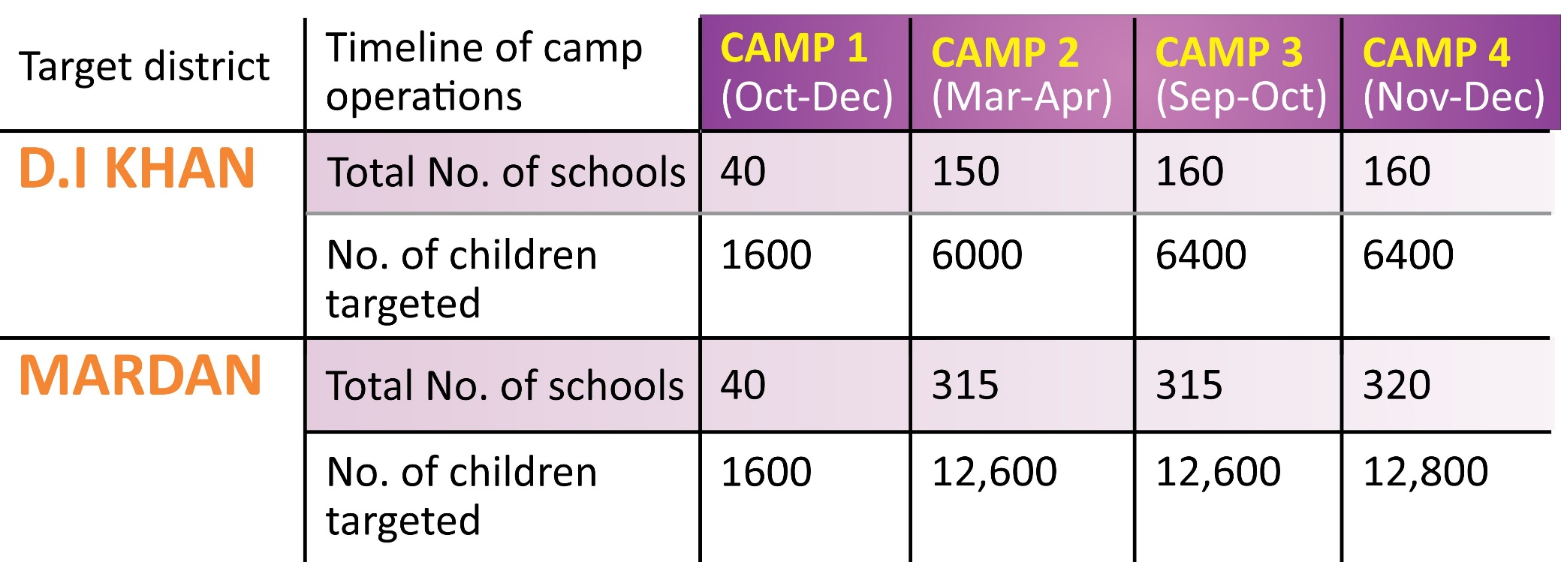
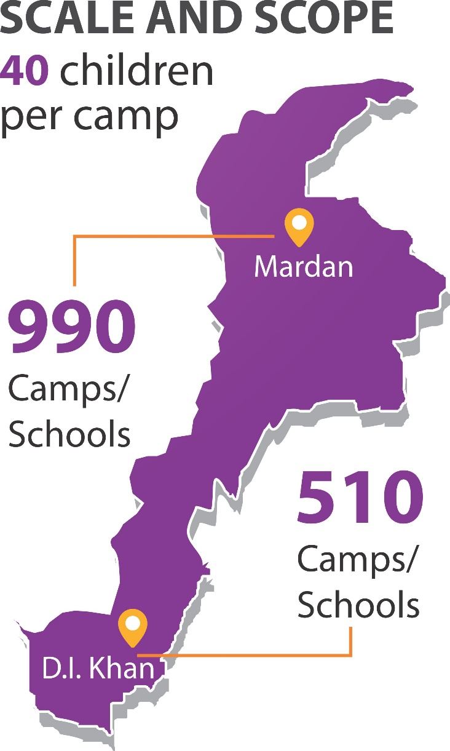
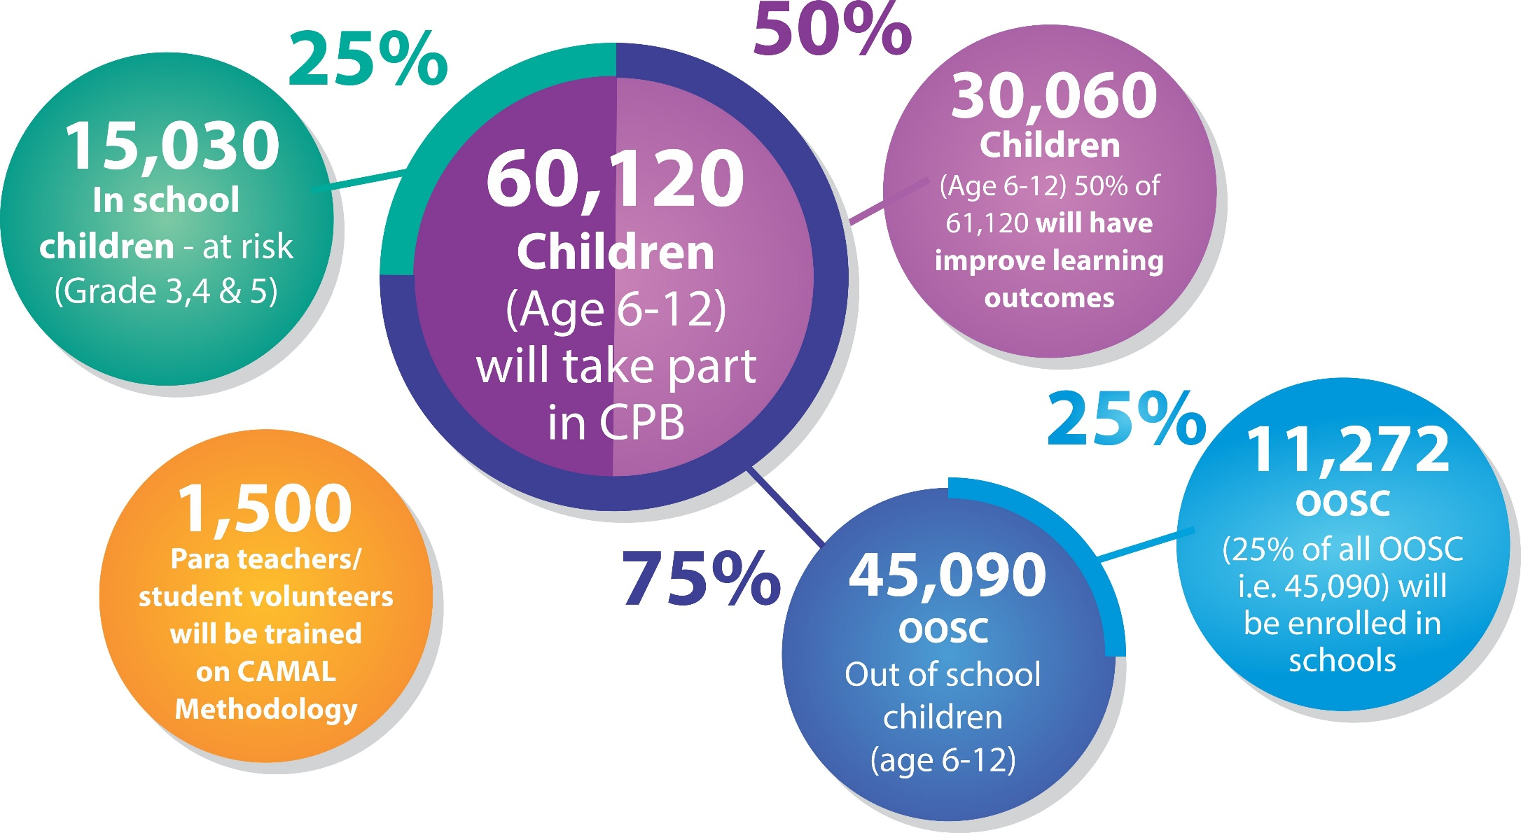

Slide 5

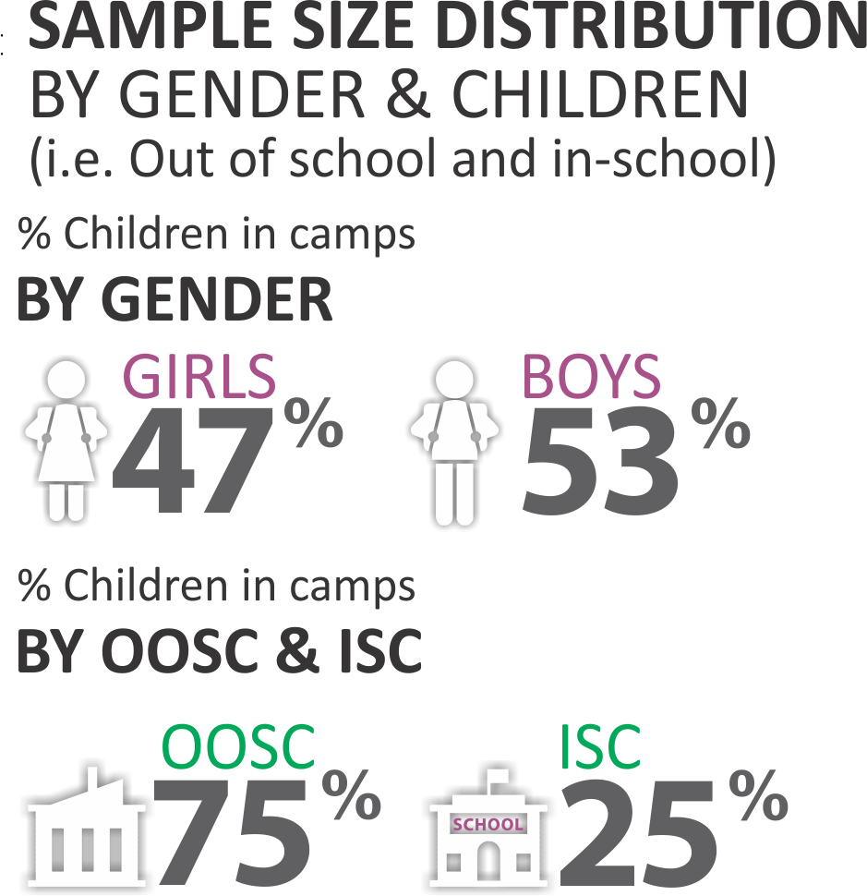
No. OF CHILDREN REACHED OUT
40039
Children
54% Boys
46% Girls
NO. OF CHILDREN IN CPB CAMPS
 | OOSC (76%) |  |  |  | ISC (24%) |  |  | Total
 | Boys | Girls | Total |  | Boys | Girls | Total
D.I.Khan | 9182 | 6638 | 15820 |  | 2771 | 2184 | 4955 | 20775
Mardan | 15762 | 14477 | 30239 |  | 5194 | 4606 | 9800 | 40039
Total | 24944 | 21115 | 46059 |  | 7965 | 6790 | 14755 | 60814
41% Boys
35% Girls
13% Boys
11% Girls
20775
Children
OOSC
ISC
54% Boys
46% Girls
OOSC: Out of School Children ISC: In School Children

Slide 6
CPB - MAINSTREAMED CHILDREN INFORMATION
Camp/District |  | OOSC in camps |  | Total | OOSC enrolled in school |  | Total | OOSC enrolled as a % of total OOSC
 |  | Boys | Girls |  | Boys | Girls
CAMP I | DI Khan | 642 | 577 | 1219 | 529 | 476 | 1005 | 82.4%
 | Mardan | 631 | 554 | 1185 | 589 | 409 | 998 | 84.2%
 | Total | 1273 | 1131 | 2404 | 1118 | 885 | 2003 | 83.3%
CAMP II | DI Khan | 2795 | 1891 | 4686 | 2127 | 996 | 3123 | 66.6%
 | Mardan | 4870 | 4375 | 9245 | 3516 | 3128 | 6644 | 71.8%
 | Total | 7665 | 6266 | 13931 | 5643 | 4124 | 9767 | 70.1%
CAMP III | DI Khan | 2759 | 2132 | 4891 | 2001 | 1596 | 3597 | 73.5%
 | Mardan | 4962 | 4342 | 9304 | 3589 | 3150 | 6739 | 72.4%
 |  | 7721 | 6474 | 14195 | 5590 | 4746 | 10336 | 72.8%
Grand Total |  | 16659 | 13871 | 30530 | 12351 | 9755 | 22106 | 72.4%
72% (25% mentioned in the project milestone) of out of school children till Phase III (44% girls and 56% boys) have been mainstreamed into primary schools.

Slide 7


PHASE IV

Slide 8
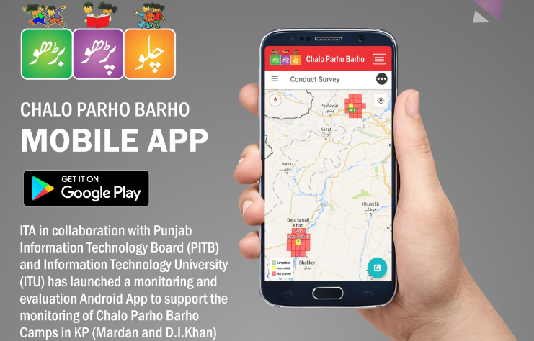
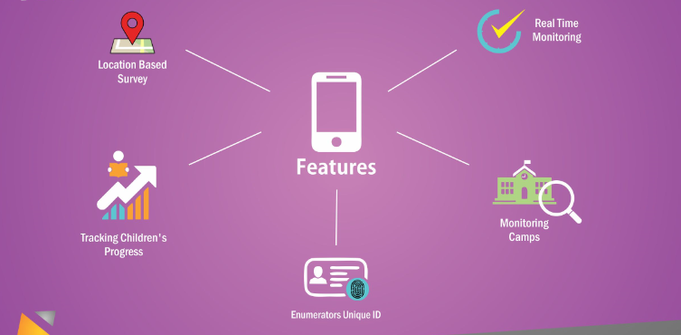
App based monitoring for real time data

Slide 9


THANK YOU

